Slide 1
Postpartum IUD Insertion Training
Lisa Goldthwaite, MD, MPH
Paul Blumenthal, MD, MPH
Stanford University Division of Family Planning Services and Research
Kristina Tocce, MD, MPH
The University of Colorado Division of Family Planning

Slide 2
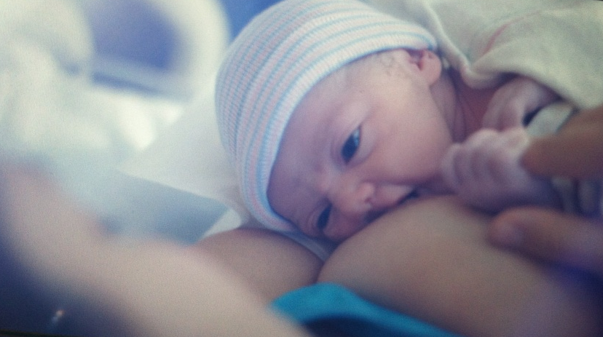
Benefits of the Postpartum IUD
Convenient
Safe
Helps with pregnancy spacing
Access to services
Cost effective
Prevents lost opportunities

Slide 3
PPIUD: Definitions
Postplacental insertion (“Delivery Room Insertion”)
  When the IUD is inserted within 10 minutes after the expulsion of the placenta following a vaginal delivery
Immediate postpartum insertion (“Morning After Delivery Insertion”)
  When the IUD is inserted after the postplacental period but within 48-72 hours of a vaginal delivery
Trans-cesarean insertion
  When the insertion takes place following a cesarean delivery, before the uterine incision is closed
Interval insertion
  Insertion of the IUD at ≥ 4 weeks postpartum

Slide 4
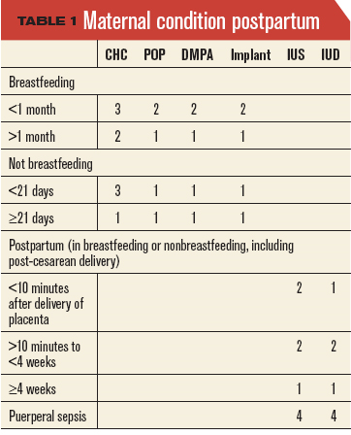
CDC Medical Eligibility Criteria
CDC MEC Categories
1 - No restriction (method can be used)
2 - Advantages generally outweigh theoretical or proven risks
3 - Theoretical or proven risks usually outweigh the advantages
4 - Unacceptable health risk (method not to be used)
Update to CDC's U.S. Medical Eligibility Criteria for Contraceptive Use, 2010: revised recommendations for the use of contraceptive methods during the postpartum period. MMWR Morbidity and mortality weekly report. 2011;60(26):878-83.

Slide 5
Contraindications to PPIUD
Postpartum-specific Contraindications
Chorioamnionitis or Puerperal Sepsis
Postpartum hemorrhage
Current or untreated sexually transmitted infection
Standard Contraindications
Distorted uterine cavity (uterine anomaly or significant fibroids)
Malignancy of genital tract
Allergy to any component of the IUD
Wilson’s disease (copper IUD only)
Breast cancer (LNG-IUS only)

Slide 6
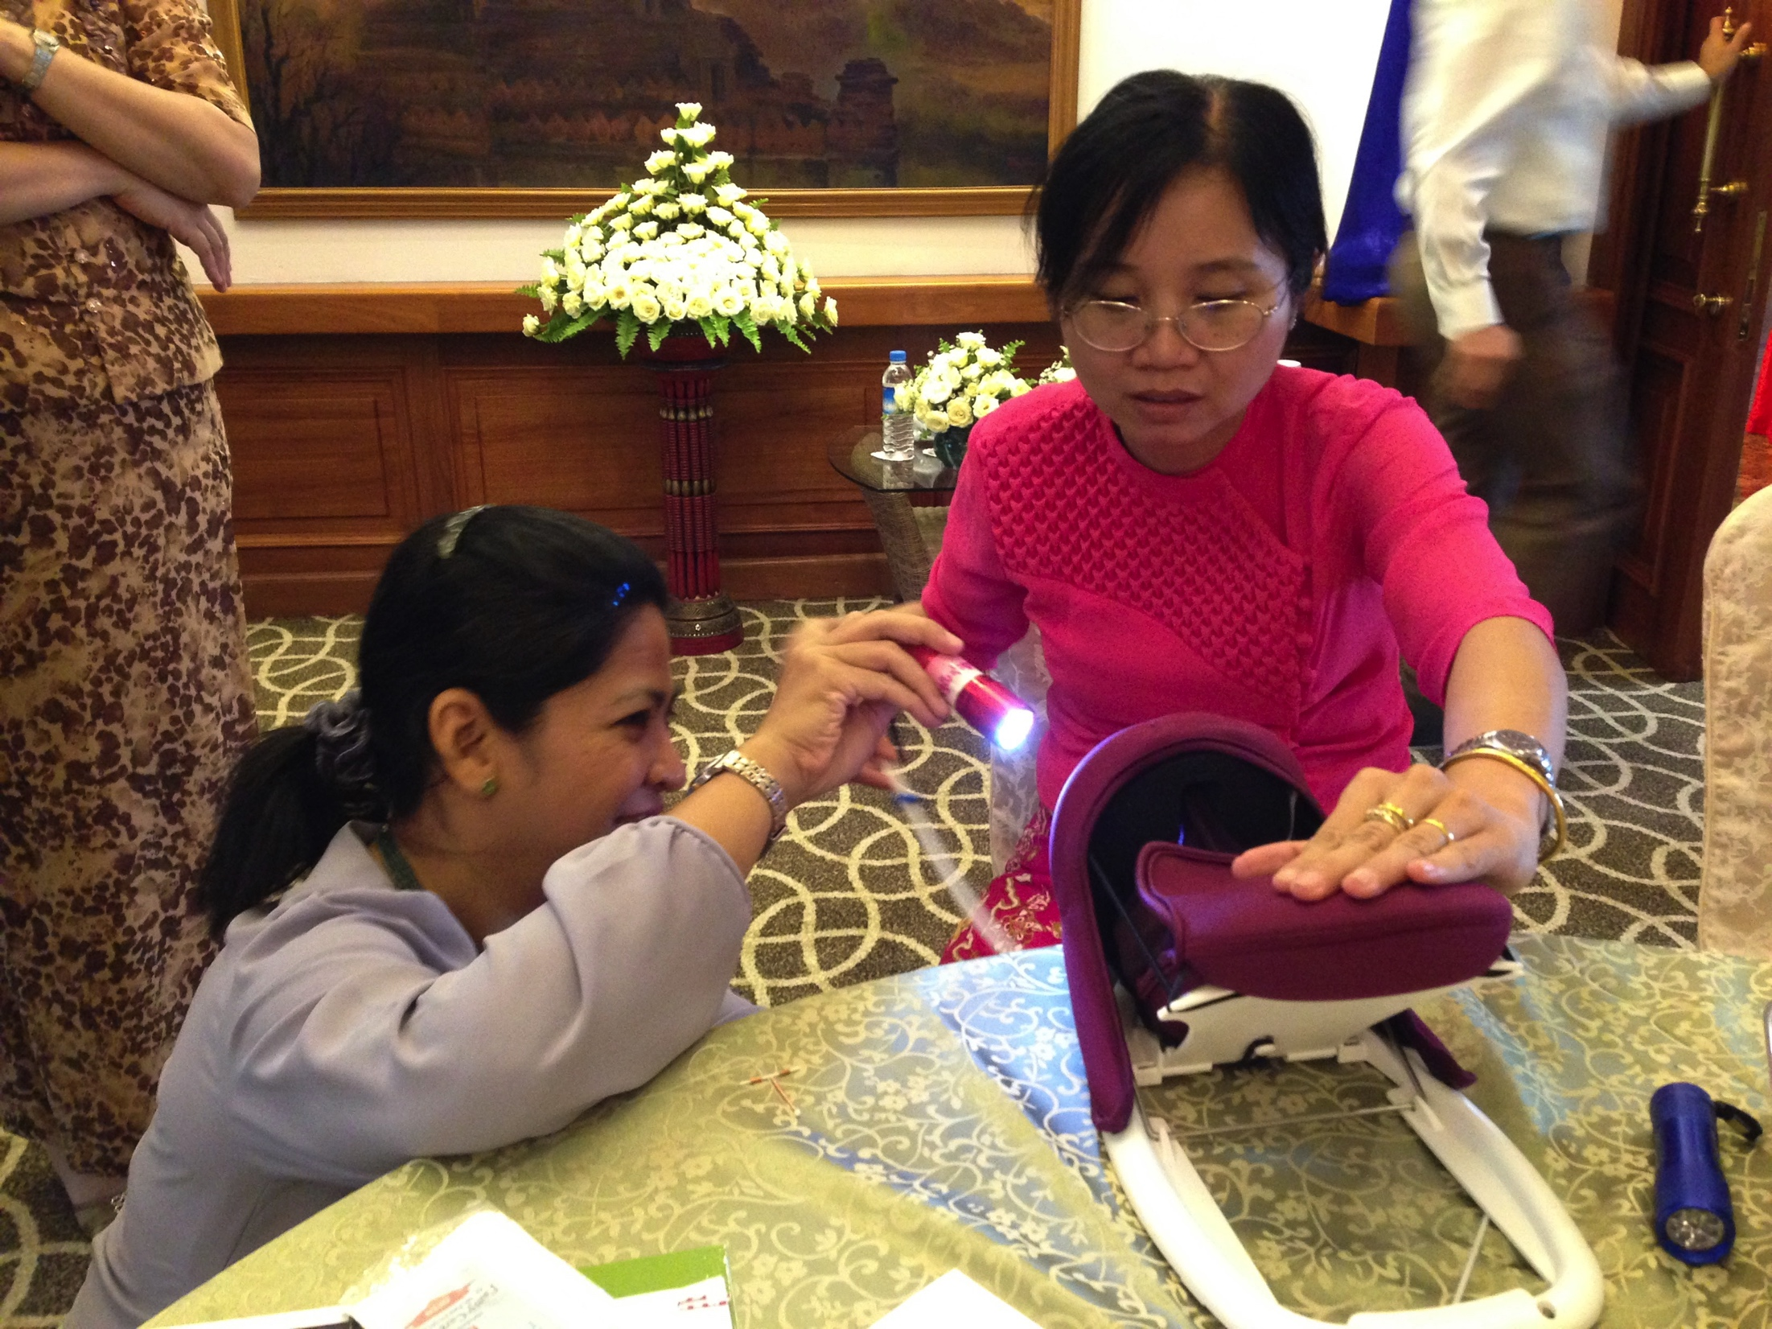
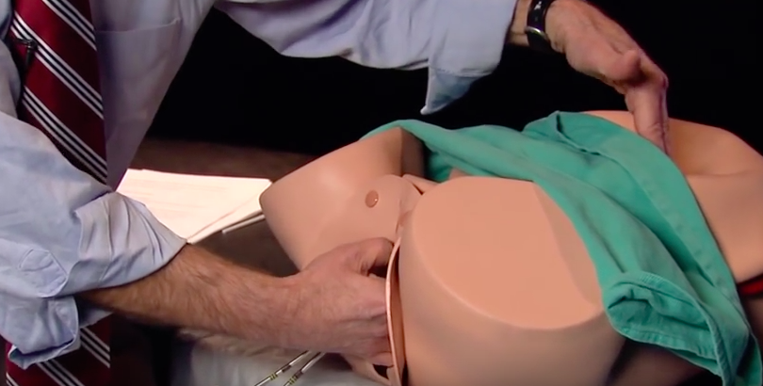
PPIUD models and demonstrations
SPIRES PPIUD Insertion Demonstration using Obstetrical Mannikin
  http://www.youtube.com/watch?v=uMcTsuf8XxQ
Mama U Postpartum uterus trainer
  https://www.youtube.com/watch?v=-xNlKUl5v_0

Slide 7
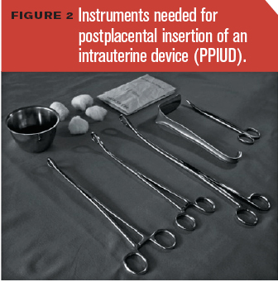
PPIUD Insertion: Pre Insertion
  Confirm consent and desire for PPIUD, and ensure no contraindications
  Palpate the uterus to evaluate the height of the fundus
  Cleanse the external genitalia and vagina with betadine
  Change into new sterile gloves
Voedisch AJ, Blumenthal PD. Contemporary OB/GYN. January 2012: 20-31.

Slide 8
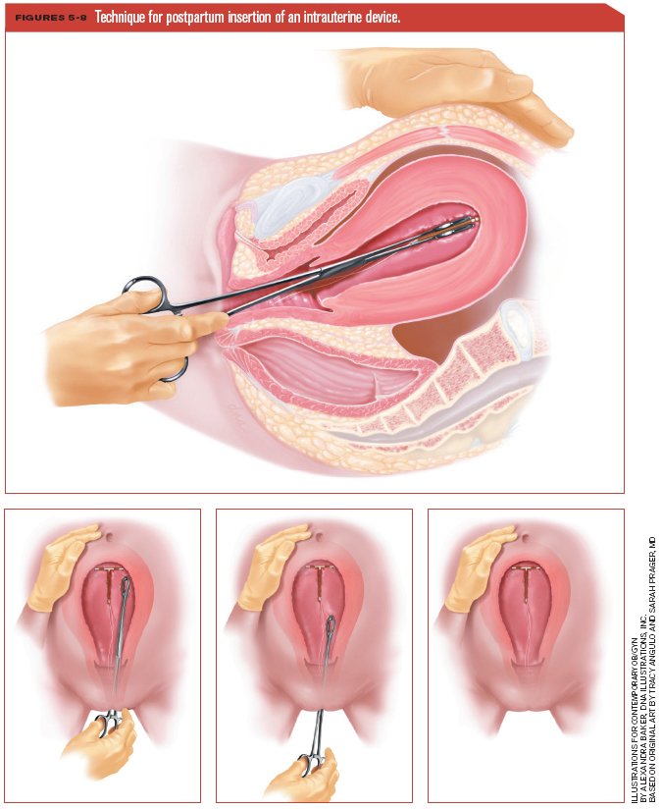
PPIUD Insertion:
Ring Forceps Method
  Grasp the anterior cervical lip with a ring forceps
  Grasp the IUD with the ring forceps – but DO NOT close the ratchets on the forceps
  Exert gentle traction toward yourself with the cervix-holding forceps
  Insert the forceps holding the IUD through the cervix and into the lower uterine cavity
  Release the hand holding the cervix and place the hand on the abdomen, palpating the fundus
  Move the IUD-holding forceps to the fundus
  Open the forceps and release the IUD
  Slowly remove the forceps from the uterine cavity, keeping it slightly open
Voedisch AJ, Blumenthal PD. Contemporary OB/GYN. January 2012: 20-31.

Slide 9
PPIUD Insertion:
Manual Insertion Method
Grasp the IUD between your 2nd and 3rd fingers and insert your hand into the uterus, to the fundus, using your other hand to confirm fundal location
Slowly open your fingers and remove your hand from the uterus
Voedisch AJ, Blumenthal PD. Contemporary OB/GYN. January 2012: 20-31.

Slide 10
PPIUD Insertion: Post-Insertion
  Examine the cervix for strings – if strings are visualized, cut the strings flush with the external cervical os
  Remove the ring forceps from the anterior cervical lip and remove the speculum (if used)
  Repair obstetrical laceration if indicated
The AQUIRE Project. 2008. The postpartum intrauterine device: A training course for service providers. Trainer’s Manual. New York: EngenderHealth.

Slide 11
Trans-cesarean IUD Insertion
After delivery of the infant and placenta, massage the uterus
Perform routine sweep
Place the IUD at the fundus
Place the IUD strings in the lower uterine segment near the internal cervical os. DO NOT pass the strings through the cervix as this may increase the risk of infection, but ok to trim the strings to the length of the cavity
Close the hysterotomy in the standard fashion, taking care not to incorporate the IUD strings into the uterine closure

Slide 12
Complications
Insertion Related
  Uterine perforation
  Cervical injury
  Severe pain
  Vasovagal reaction
Post-insertion
  Expulsion
  Infection
  Bothersome bleeding
  Cramping
  Malposition
  Missing strings
  Partner complaints about strings
  Failure (pregnancy)

Slide 13
QUESTIONS?

