Slide 1
Welcome!
As you get settled, please do the following:
  Go to www.pollEV.com/lc2015
  Access the CDC Medical Eligibility Criteria
    Download the app (free at iTunes)
    Syllabus
    Download the PDF at http://www.cdc.gov/reproductivehealth/unintendedpregnancy/usmec.htm
Check out the Contraception Stations

Slide 2
Contraception
Jody Steinauer, MD, MAS
Micki Baron, MD
Dept. Ob/Gyn & Reproductive Sciences
Bixby Center for Global Reproductive Health

Slide 3
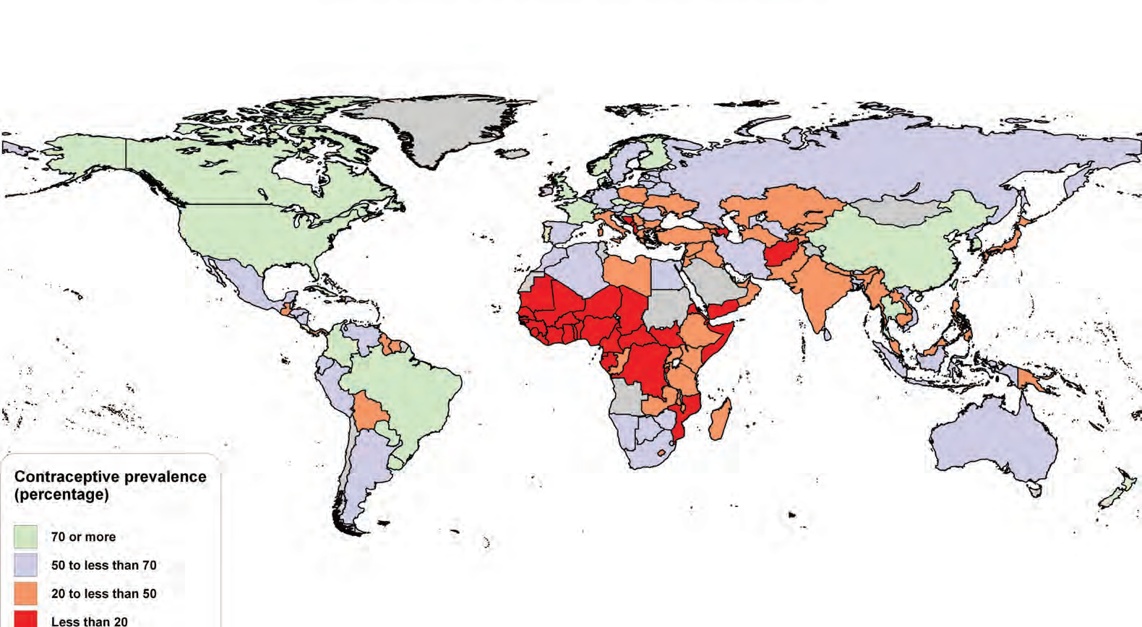
Proportion of Women Using Contraceptive Method
Proportion of women with unmet need for family planning is as high as 50% by country
www.unpopulation.org
Notes:
JODY
Women with unmet need are those who are fecund and sexually active but are not using any method of contraception, and report not wanting any more children or wanting to delay the next child. The concept of unmet need points to the gap between women's reproductive intentions and their contraceptive behaviour.
For MDG monitoring, unmet need is expressed as a percentage based on women who are married or in a consensual union.
Proportion of women who are married or in a union and using contraception.
Reproductive age

Slide 4
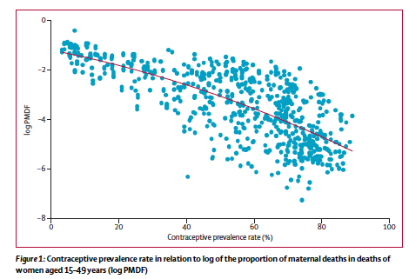
Contraceptive Prevalence & Maternal Deaths
Ahmed et al. Lancet. 2012
Notes:
JODY

Slide 5
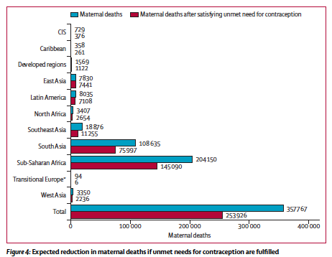
Effect of Unmet Need for Contraception
Ahmed et al. Lancet. 2012
Notes:
JODY
We estimate, using model I, that 342 203 women died of maternal causes in 2008, but that contraceptive use
averted 272 040 (uncertainty interval 127 937–407 134) maternal deaths (44% reduction), so without contraceptive use,
the number of maternal deaths would have been 1.8 times higher than the 2008 total. Satisfying unmet need for
contraception could prevent another 104 000 maternal deaths per year (29% reduction).
According to our analysis, of 1.2 billion women of
reproductive age who were married or sexually active,
about 722 million were using contraception. We estimate
that contraceptive use averted 272 040 maternal deaths
(uncertainty range 127 937–407 134) worldwide in 2008.
Without contraceptive use, the number of maternal
deaths would have been 1.8 times higher (equivalent to
614 000 deaths) than with contraceptive use, which
means that contra ceptive use averted 44.3% of maternal
deaths (272 040 of 614 000) or 38 maternal deaths for
every 100 000 repro ductive-age women using contraceptive
methods every year.
In regions where contraceptive prevalence rates were

Slide 6
6.4 Million U.S. Pregnancies Annually
Notes:
JODY
Med students as advocate in other specialties and on rotations

Slide 7
Contraceptive Method Use, U.S.*
10 million = 900,000 pregnancies each year
Most effective
⬇
Effective
28%
Least effective
*Among the 38 million women currently using birth control
6.6%
Mosher Vital Health Statistics, 2010
Alan Guttmacher Institute, Facts In Brief, 2010.
Notes:
7
JODY
IUD 5.5
Dmpa 3.5
Path/ring 3.6
Pill
Female sterilization- 27, male 10

Slide 8
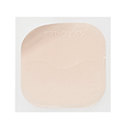

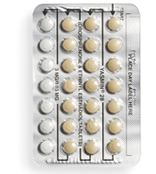
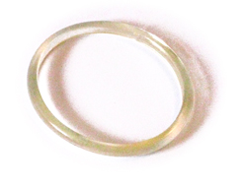
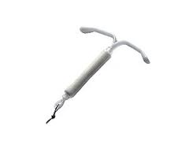
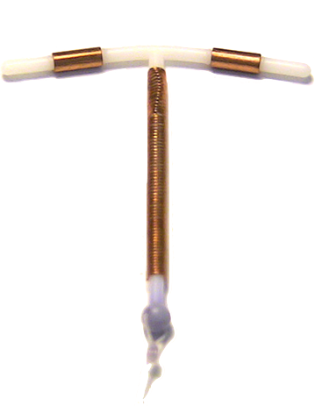
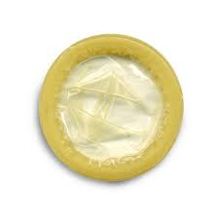
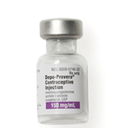
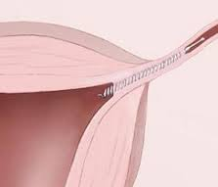
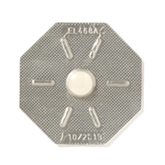
Contraception Methods
Least Effective
Most Effective
<88%
91%
94%
>99%
Episodic
Daily
Weekly
Monthly
3 mos
3 yrs
3-5 yrs
10 yrs
Permanent
Barrier
Progestin
Implant
BTL
Hysteroscopic
Vasectomy
NFP
Patch
Copper
IUD
OCPs
Ring
DMPA
(IM or SQ)
LNG-IUD
EC
Combined Hormonal
Progestin Only
IUD
Sterilization
Notes:
8
JODY

Slide 9
Natural Family Planning
Contraceptive Method | Failure Rate
 | Perfect Use | Typical Use
No Method | 85% | 85%
Withdrawal | 4% | 22%
Periodic Abstinence
Standard Days Method®* | 5% | 12%
Ovulation Method | 3% | 22%
Symptothermal | <1% | 13-20%
Two-Day Method® | 4% | 14%
* Including Cycle Beads
Trussell J. Contraceptive Efficacy. In Contraceptive Technology.
Notes:
JODY

Slide 10
Barrier Methods
Contraceptive Method | Failure Rate
 | Perfect Use | Typical Use
Condoms | 2 % | 18 %
Cervical Cap (parous/nullip) | 26%/9% | 32%/16%
Sponge (parous/nulliparous) | 20%/9% | 24%/12%
Female Condoms | 5 % | 21 %
Diaphragm | 6 % | 12 %
Trussell J. Contraceptive Efficacy. In Contraceptive Technology.
Notes:
JODY

Slide 11
Hormonal Methods
Contraceptive Method | Failure Rate
 | Perfect Use | Typical Use
Progestin Pills | 0.3 % | 9 %
Combined Pill/Patch/Ring | 0.3 % | 9 %
3-Month Injection | 0.2 % | 6 %
Implants | 0.05 % | 0.05 %
LNG IUD | 0.2 % | 0.2 %
Copper IUD/LNG IUS | 0.8 % | <1 %
Trussell J. Contraceptive Efficacy. In Contraceptive Technology.
Notes:
JODY

Slide 12

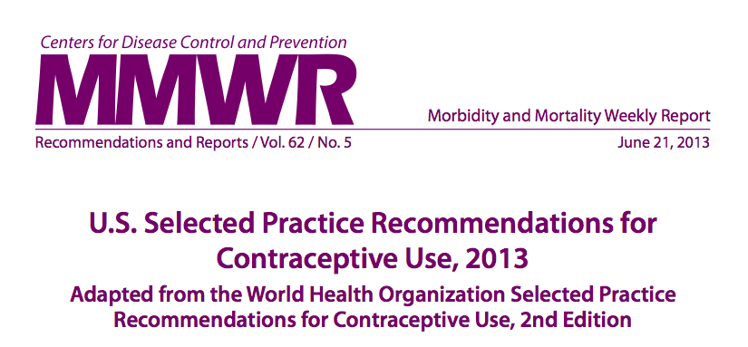
Can my patient use this method?
US Medical Eligibility Criteria (MEC)
1 | Can use the method | No restrictions
2 | Can use the method | Advantages generally outweigh theoretical or proven risks.
3 | Should not use method unless no other method is appropriate | Theoretical or proven risks generally outweigh advantages
4 | Should not use method | Unacceptable health risk
Notes:
JODY

Slide 13

Birth Control Methods
Medical Condition
MEC Category
Notes:
JODY

Slide 14
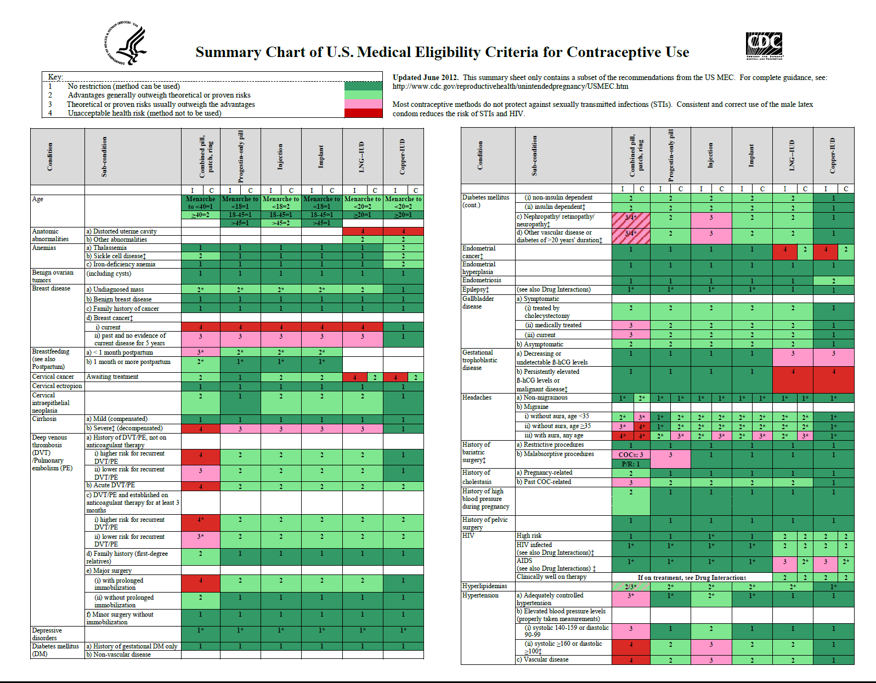
Notes:
JODY

Slide 15
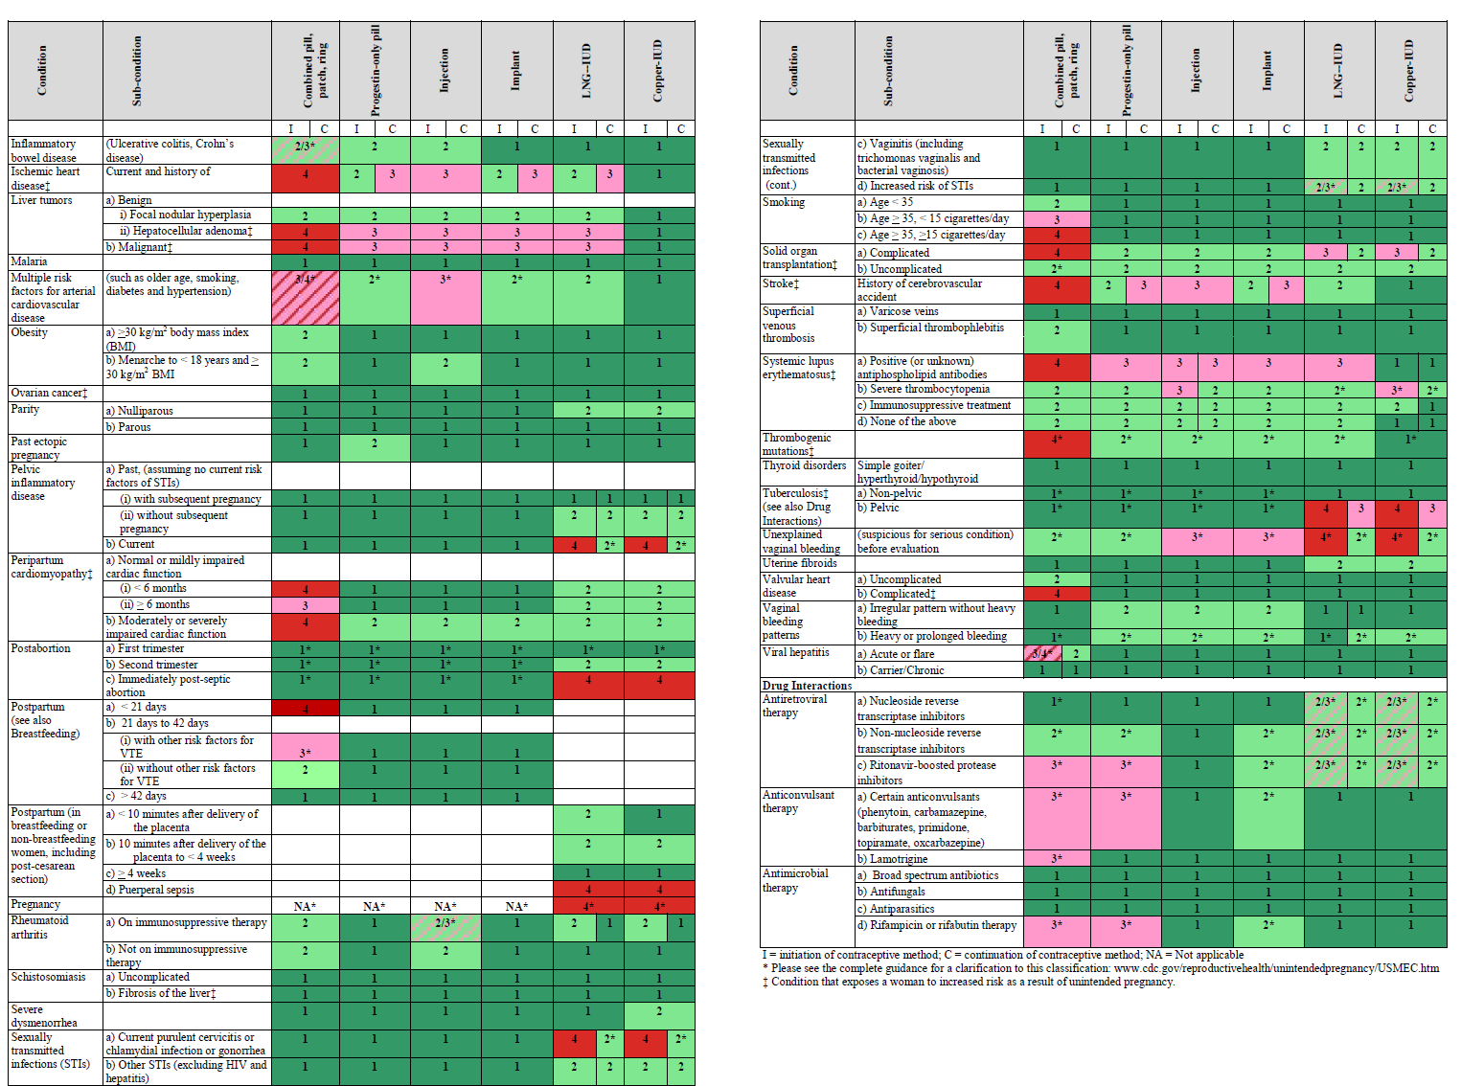
Notes:
JODY

Slide 16
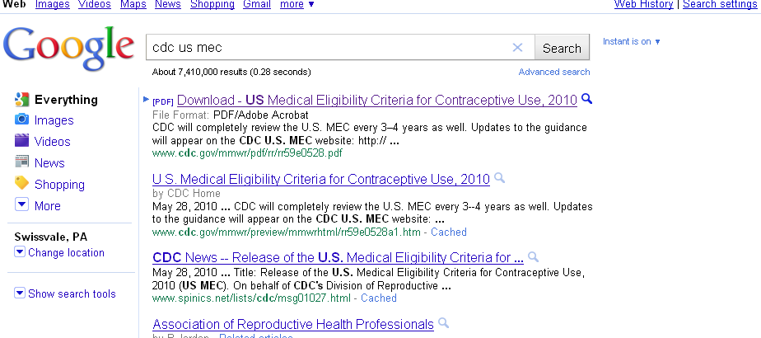
Where do you find the US MEC?
Notes:
JODY

Slide 17
Contraceptive Counseling
Preference-sensitive decision
Patient-centered care
Respect diverse priorities, concerns, experiences
  Control
  Safety concerns
  Concern about or desire for side effects
  Personal and friends’/family members’ experiences
  Convenience
  Efficacy
Notes:
17
JODY

Slide 18
Case 1
Rebecca is a 31 year old, G1P1 with no medical problems who delivered yesterday via an uncomplicated normal spontaneous vaginal delivery (NSVD). You were present during her labor and even helped with the delivery.
You present Rebecca to the team during postpartum rounds. Your chief resident asks, “what kind of birth control does she want?” In her chart from her prenatal visits it says that she is undecided about her birth control method and you make a plan to discuss this with her before discharge.
Notes:
MICKI
You are the third-year student on the Labor and Delivery team during your OB/GYN Clerkship.

Slide 19
Case 1 Continued
How would you initiate this discussion?
What general questions would you ask this patient?
Notes:
MICKI

Slide 20
Contraceptive Counseling
Develop awareness of your biases
Engage in shared decision-making
Questions to pose to patients
  Which method did you come today wanting to use?
  Are you interested in one of the most effective? Convenient? What does convenient mean to you?
  When – if ever – do you want a (another) child?
  What method(s) have you used in the past?
  What side effects are you willing to accept or desire?
Notes:
20
MICKI
What are you doing to protect yourself from STIs? Consider condoms.

Slide 21
Poll Everywhere
What specific issues must you consider regarding contraceptive use during the postpartum period?
Notes:
MICKI

Slide 22

Notes:
What specific issues must you consider regarding contraceptive use during the postpartum period?
https://www.polleverywhere.com/free_text_polls/mliUPcXB87z4DQZ

Slide 23
Postpartum Contraception:
General Considerations
Effective contraception –
Adequate birth spacing
Prevent unintended pregnancy
Avoid causing harm –
Avoid VTE
Support breastfeeding
Notes:
JODY

Slide 24
Postpartum Counseling: Risks
What is her risk of clot?
  Increased clot risk persists for six weeks
  Especially high risk for 3 weeks
Is she planning to breastfeed?
  Level I evidence of no impact of CHC on breastfeeding if initiated ≥ 30 days
  Safe to start CHC at one month
    Some older studies – level 2 – decreased exclusive BF
  Progestin methods SAFE
Notes:
24
JODY

Slide 25
Case 1 Continued
She states that she intends to exclusively breastfeed and is highly motivated to return for her 6-week postpartum visit.
What methods would you not recommend starting right away?
Notes:
MICKI

Slide 26
Case 1 Continued
She is very concerned about spacing her pregnancies and does not want to be pregnant again for 3 years. She thinks she would like to try the hormonal implant.
Notes:
MICKI

Slide 27
Poll Everywhere
When can she get the hormonal implant safely inserted?
Today
At her 6 week postpartum follow-up visit
This method is unsafe for her at this time
After she is done breastfeeding
Notes:
MICKI

Slide 28
Notes:
When can she get the hormonal implant safely inserted?
https://www.polleverywhere.com/multiple_choice_polls/TQGofciOaGVTVxW

Slide 29
Postpartum Contraception:
Individual Considerations
Timing
Immediate initiation
Delayed initiation
35% of women do not return for follow-up visit.
Ogburn et al. Contraception 2005
Notes:
JODY

Slide 30

Postpartum Ovulation
Exclusive breastfeeding:
  Mean ovulation 6 months
  Earliest is 3rd postpartum month
Partial/no breastfeeding:
  Mean ovulation 6 weeks
  Earliest is 3rd postpartum week
Rule of 3
Notes:
JODY

Slide 31
Postpartum Counseling
TIMING
  IUD: Immediate safe
    Increased risk of expulsion compared to delayed insertion
    As high as 25% in some studies
  Implant: Immediate safe
  DMPA: Immediate safe – although studies wait until just before discharge
  CHC: Wait according to CDC guidelines
Notes:
31
JODY

Slide 32
Poll Everywhere
What side effect should she be aware of?
Insertion site pain
Increased risk of DVT
Irregular bleeding
Weight gain
Notes:
MICKI

Slide 33
Notes:
What side effect should she be aware of?
https://www.polleverywhere.com/multiple_choice_polls/Y4jeYU9euUi4i4r

Slide 34
Bedsider.org
http://bedsider.org/features/56

Slide 35
Contraception Methods
Least Effective
Most Effective
<88%
91%
94%
>99%
Episodic
Daily
Weekly
Monthly
3 mos
3 yrs
3-5 yrs
10 yrs
Permanent
Barrier
Progestin
Implant
BTL
Hysteroscopic
Vasectomy
NFP
Patch
Copper
IUD
OCPs
Ring
DMPA
(IM or SQ)
LNG-IUD
EC
Combined Hormonal
Progestin Only
IUD
Sterilization
Notes:
35
Show during stations/break

Slide 36
Case 2
Ana is a 25-year-old G0 presenting to the GYN clinic for a birth control consultation.
On her intake form you see that she is 5’1” and 190 lbs. Her intake vitals are HR 65, BP 110/65.
Notes:
MICKI

Slide 37
Case 2: History
HPI: She recently became sexually active with a male partner and wants to start a birth control method. She tried OCPs in the past but had a hard time remembering to take them everyday.
PMH: Obesity
PSH: Appendectomy at age 10.
Gyn Hx: Menarche at age 14. Regular cycles. History of Chlamydia age 20, treated as an outpatient. Sexually active with men.
SH: Smokes ½ pack per day. No drug or alcohol use.
FH: Mother has insulin dependent diabetes
ROS: negative
Notes:
MICKI

Slide 38
Poll Everywhere
What are the pertinent positives in her history than may influence the way you counsel her?
Notes:
MICKI

Slide 39
Notes:
What are the pertinent positives in her history than may influence the way you counsel her?
https://www.polleverywhere.com/free_text_polls/ihSSCKE8HBAAjnC

Slide 40
Poll Everywhere
Based on her medical history, are there any methods that are contraindicated?
Yes
No
Notes:
MICKI

Slide 41
Notes:
Based on her medical history, are there any methods that are contraindicated?
https://www.polleverywhere.com/multiple_choice_polls/lBBwHIQk74dJnnC

Slide 42

Obesity and Contraception
Efficacy
  May be lower for patch
Adverse events – CVD?
  Increased for multiple risk factors
Patch: increased failure⁵ if >90kg
BUT no effect with high BMI^{1,2}
¹Institute of Medicine. Weight gain in pregnancy: Reexamining the guidelines
Notes:
JODY
Ask residents why they think CHC is a category 2 for obesity.
Category 2 for <18 yo because of concern that DMPA could affect peak bone mass
Go through bullet points before summary:
Now, let’s further investigate this idea of contraception in obese women. What’s the data on efficacy of various different methods in obesity?

Slide 43
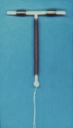
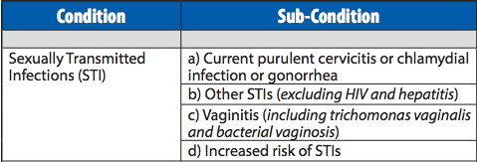
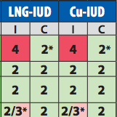




IUD: CDC Guidelines
High risk STI: caution
Past
PID
Current
PID or
cervicitis
C=continue
I= Initiate
Notes:
JODY

Slide 44
Case 2 Continued
If her PMH included a DVT in 2012 that occurred after a long road trip and required anticoagulation, would this change your approach to counseling her?
Notes:
MICKI

Slide 45
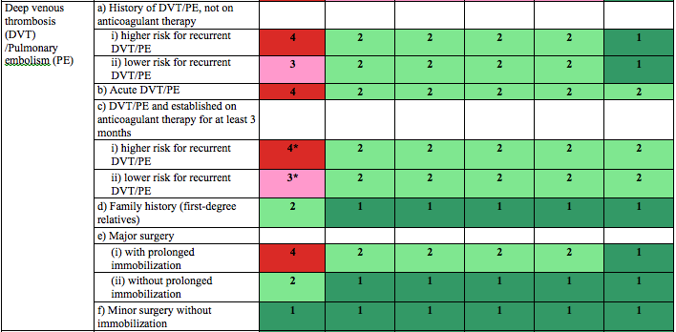
DVT and PE
All progestin-only methods are safe even if:
1)Current VTE
2)No anti-coagulation
3)Provoked or unprovoked VTE
Notes:
JODY

Slide 46
Case 2: Summary
Counseling – facilitate shared decision-making
Obesity
  All methods okay if no other risk factors for CVD
H/o DVT
  No CHC, other methods are safe
  In women on anticoagulation – may avoid copper IUD
Smoking
  Above 35 and smoking
H/o STI
  Screen based on CDC guidelines; okay to place IUD
Notes:
46
JODY

Slide 47
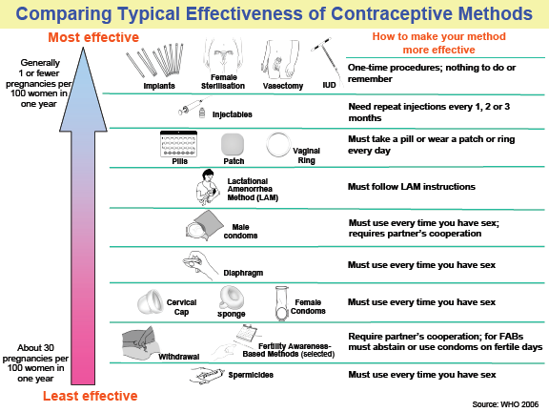
Case 2 Continued
She would like to learn more about her options. What resources do you have?
  Bedsider.org
  WHO and CDC materials
    Selected Practice Recommendations
Notes:
MICKI

Slide 48
Case 2 Conclusion
She decides to get the 5-year progestin IUD.
You did such a nice job counseling this patient and presenting her case that your supervising attending would like to teach you how to insert the IUD.
http://bedsider.org/features/348
Notes:
MICKI

Slide 49
Conclusions
Contraception saves lives
Prioritize contraceptive counseling and patient concerns
Use the CDC guidelines
Remember contraception on all rotations!
Notes:
JODY

Slide 50
Thank You!
Contraception demos and insertion instruction
  Until noon
Resources for you:
  Bedsider.org
  CDC and WHO selected practice recommendations
  Contraception “Cheat Sheet”

