Slide 1

Improving Contraceptive Counseling through Shared Decision-Making
Christine Dehlendorf, MD MAS
Biftu Mengesha, MD
Angeline Ti, MD MPH

Slide 2
Structure of Course
Part 1: Overview of shared decision making
Part 2: Role-playing
Part 3: Case-based exercises

Slide 3
Part 1

Slide 4
Outline
Why does health communication matter?
Contraceptive counseling
  Different counseling approaches
  Role of SDM
  How do you implement SDM into practice?

Slide 5
Importance of Health Communication

Slide 6
Health Communication:
Why does it matter?
Influences the formation of a positive therapeutic relationship between the provider and the patient
Is essential to providing information about diagnoses and treatment plans
Positive association between patient experience of interpersonal communication and both subjective and objective health outcomes

Slide 7
What evidence is there the value of contraceptive counseling?
Counseling influences method selection
Quality of family planning care associated with use of contraception and satisfaction with method
And….patient-centeredness is the right thing to do
Dehlendorf, unpublished data
Rosenberg, Fam Plann Perspect, 1998
Forrest, Fam Plann Perspect, 1996
Harper, Patient Ed Counsel, 2010

Slide 8
Contraceptive Counseling

Slide 9
What are the stages of counseling?
Identifying need for contraception
Counseling about method options and selecting a method (i.e. contraceptive decision making)
Providing information about chosen method

Slide 10
Approaches to Contraceptive Decision Making
Consumerist Counseling
Directive Counseling

Slide 11
Consumerist Counseling
Informed Choice
  Provides only objective information and does not participate in method/treatment selection itself
Foreclosed:
  Only information on methods asked about by the patient are discussed
Both prioritize autonomy

Slide 12
Consumerist Counseling Most Common
Observational study of contraceptive counseling
  80% of visits used “foreclosed” or “informed choice” approach
Patient preferences elicited in less than 50% of visits
Providers infrequently mention or elicit women’s reproductive goals
Dehlendorf, Contraception, 2015 and unpublished data

Slide 13
Problems with Consumerist Counseling
Foreclosed: Fails to ensure women are aware of and have accurate information about methods
Informed Choice: Provider does not assist patient in understanding how preferences relate to method characteristics or tailor information to patients needs

Slide 14
Approaches to Contraceptive Decision Making
Consumerist Counseling
Directive Counseling

Slide 15
Directive Counseling
Provides information and counseling designed to promote use of specific methods
Paternalistic method of communication
Rooted in the healthcare provider’s preferences, or assumptions about the patient’s priorities

Slide 16
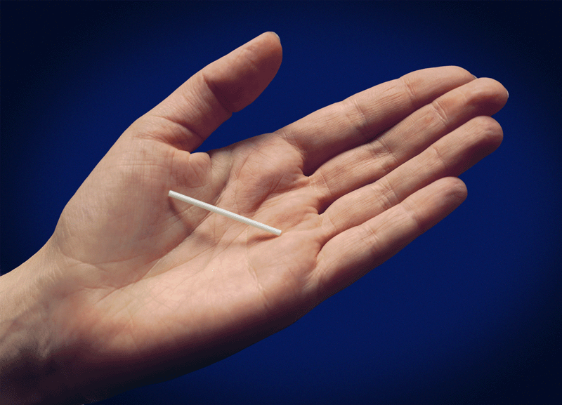
Directive Counseling Towards LARC Methods
Examples of directive counseling towards LARC:
  Tiered effectiveness
  Motivational interviewing
No data supporting this approach
What should goal of counseling be?
Pressure to use methods may be counterproductive (Kalmuss, 1996)

Slide 17
Contraceptive Decision Making
Consumerist Counseling
Directive Counseling
Directive Counseling
Consumerist Counseling
Promote patient autonomy
Increase use of highly effective methods
Shared Decision Making

Slide 18
Shared Decision Making
“A collaborative process that allows patients and their providers to make health care decisions together, taking into account the best scientific evidence available, as well as the patient’s values and preferences….This process provides patients with the support they need to make the best individualized care decisions.”
  Informed Medical Decisions Foundation

Slide 19
Shared Decision-Making in
Family Planning
Choice of a contraceptive method is a preference-sensitive decision
  Best method for an individual depends on her preferences
    Women will weight effectiveness differently relative to other characteristics
Consistent with women’s preferences for counseling
  Active facilitation, without expressing a preference, may be optimal

Slide 20
Shared Decision Making in Family Planning
“I just think providers should be very informative about it and non-biased…maybe not try to persuade them to go one way or the other, but maybe try to find out about their background a little bit and what their relationships are like and maybe suggest what might work best for them but ultimately leave the decision up to the patient.”
Dehlendorf, Contraception, 2013

Slide 21
Contraceptive Counseling and Disparities
Women have color have higher rates of unintended pregnancy
  Has the potential to encourage directive counseling
Especially concerning given historical context
  35% of Black women reported “medical and public health institutions use poor and minority people as guinea pigs to try out new birth control methods.”
Thorbun and Bogart, Women’s Health, 2005
Notes:
Suggesting need to “promote” highly effective methods

Slide 22
Are women of color counseled differently?
Phone survey of 1,800 women
  Minorities and women with lower education levels are more likely to be report being dissatisfied with their family planning provider
Survey of 500 Black women
  67% reported race based discrimination when receiving family planning care
Forrest and Frost, Fam Plann Perspect 1996
Thorbun and Bogart, Women’s Health, 2005

Slide 23
Are women of color counseled differently?
Minority and low-income women are more likely to report being pressured to use a birth control method and limit their family size
Providers are more likely to agree to sterilize minority and poor women
Providers more likely to recommend IUDs to low-SES black and Latina women than to low–SES white women
Downing et al, AJPH, 2007
Harrison, Obstet Gynecol 1988
Dehlendorf, AJOG, 2010

Slide 24
Counseling and Family Planning Disparities
Given historical context and documented disparities in counseling, essential to ensure that providers focus on individual preferences when caring for women of color
Shared decision making provides explicit framework for doing this, without swinging too far to other side

Slide 25
How can contraceptive decision making be optimized?

Slide 26
The Process of Shared Decision Making
Establish rapport
Focus on patient preferences:
  “What is important to you about your method?”
  Probes:
    Effectiveness
    Frequency of using method
    Different ways of taking methods
    Return to fertility
    (Specific) side effects

Slide 27
Talking About Effectiveness
Effectiveness often very important to women
Frequent misinformation or misconceptions about relative effectiveness of methods
Effectiveness rarely mentioned
  Only 21% of all visits in which IUDs mentioned
Use natural frequencies:
  Less than 1 in 100 women get pregnant on IUD
  9 in 100 women get pregnant on pill/patch/ring
Use visual aids

Slide 28
Don’t Assume Women Know Their Options
Provide context for different method characteristics
  e.g. “There are methods you take once a day, once a week, once a month, or even less frequently. Is that something that makes a big difference to you?”
Even if express strong interest in one method, ask for permission to provide information about other methods

Slide 29
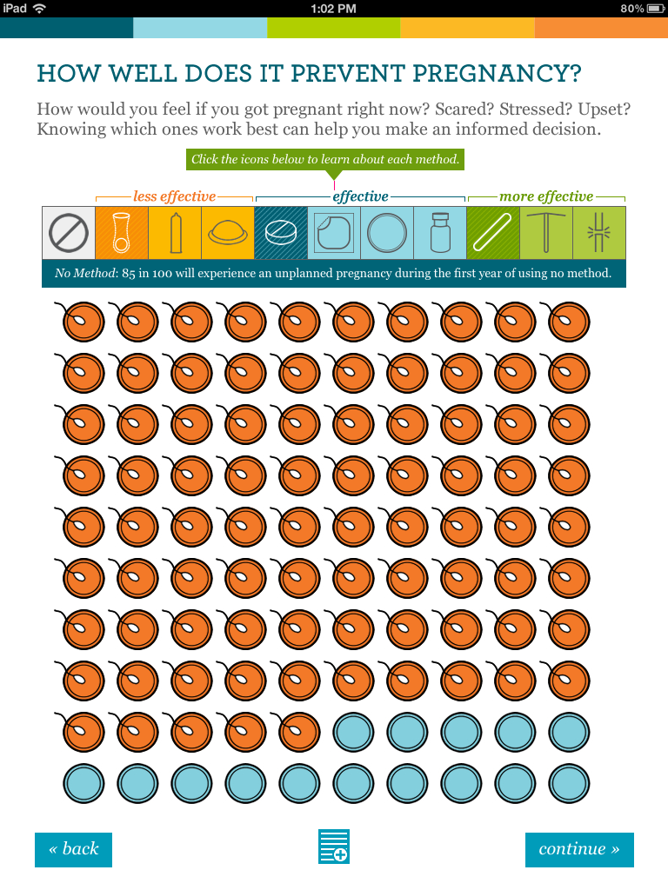
OCP Effectiveness

Slide 30
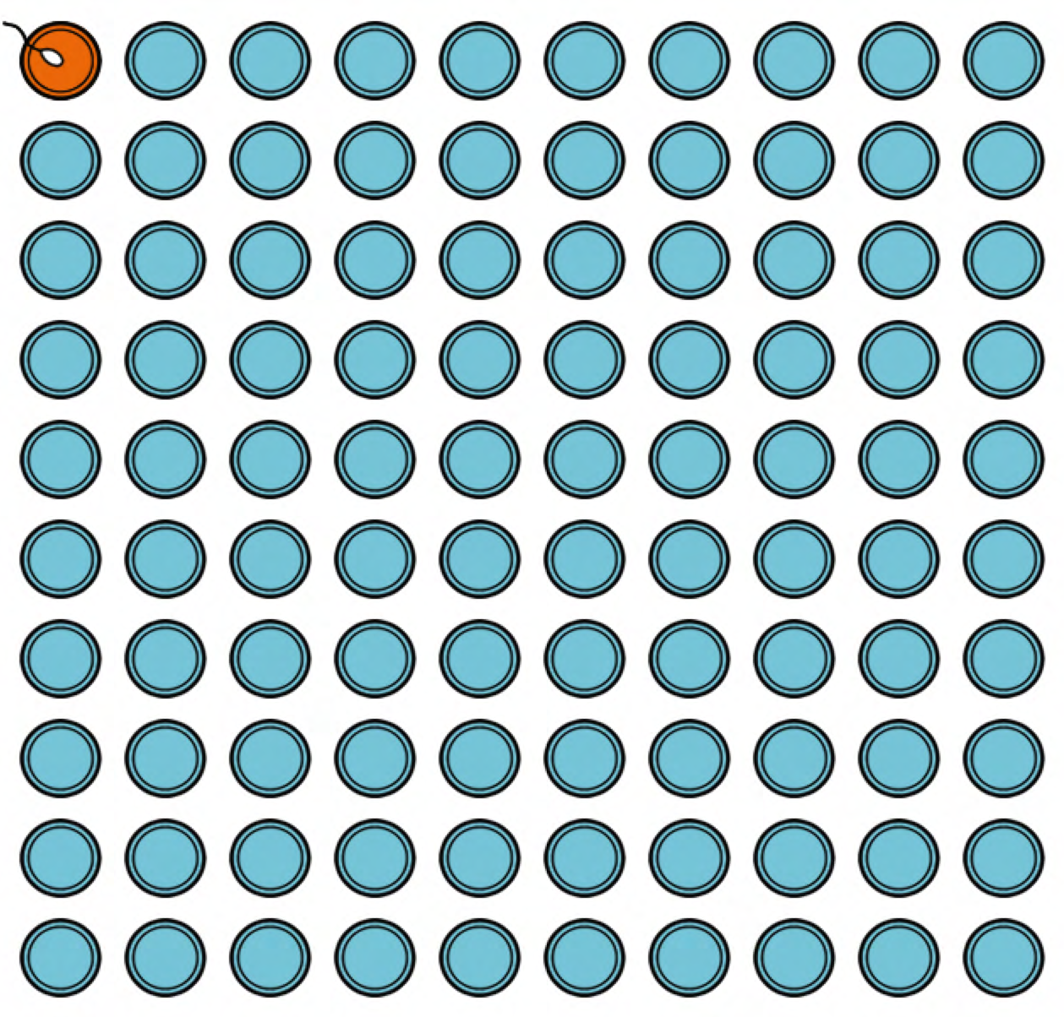
IUD Effectiveness

Slide 31
Sharing Decision Making
Provide scaffolding for decision making
  Given their preferences, what information do they need?
  Actively facilitate, while avoiding stating opinions not based on patient preferences
Notes:
After figuring out what women’s preferences are, you can then move into the active decision making, where you tailor the information you provide to the women’s preferences and her responses to the information. This is actually a time saving approach relative to the informed choice approach, as you don’t have to go into detail about every method. The key here is to actively facilitate, while…iterative process, responding to patient responses

Slide 32
Examples of Facilitation
“I am hearing you say that avoiding pregnancy is the most important thing to you right now. In that case, you may want to consider either an IUD or implant. Can I tell you more about those methods?”
“You mentioned that it is really important to you to not have irregular bleeding. The pill, patch, ring and copper IUD are good options, if you want to hear more about those.”
Notes:
Overly simplistic, is a much more iterative process
Make sure debunk amenorhea concerns
And then go on to address specific side effects about methods

Slide 33
Provide Adequate Information about Side Effects
Studies have found that many women report that they:
  Do not receive adequate information
  Feel providers dismiss concerns and overlook possible side effects
Counseling about side effects associated with positive outcomes
Canto De Centina, Contraception, 2001
Becker, Perspect Sex Repro Health, 2007
Dehlendorf, Contraception, 2013
Yee, JHCPU, 2011
Notes:
This is relevant to both before and after method choice
Including IUDs, more satisfied with method

Slide 34
Experiences of Contraceptive Counseling
“I think that they hide the fact of the complications or the defects, the things that might happen if you take that. They don’t give you that information and I don’t think any provider has given me that information.”
Dehlendorf, Contraception, 2013

Slide 35
Address Patient’s Concerns
  Know the evidence about which side effects have in fact are proven to be associated with methods
  Proactively address patient concerns about other side effects in a respectful manner
  “That’s too bad your friend had that experience. I haven’t heard of that before, and I can tell you it definitely doesn’t happen frequently. My guess is that if you were to use this method it would not happen to you.”

Slide 36
Once a Method is Chosen….
Provide opportunity to ask questions
  Done in less than 50% of all counseling visits
Discuss what to do if not satisfied with method (contingency counseling)
  Only done in 65% of visits
Facilitate actually receiving chosen method
Ensure that discontinuation is discussed when implant or IUC chosen
Dehlendorf, unpublished data
Namerow, Fam Plann Perspect, 1989

Slide 37
Shared Decision Making
Establish rapport
Elicit patient preferences with direct questioning
  Provide context about options
Provide scaffolding for decision making process
  Include adequate information about side effects, effectiveness and logistics of method use
Ensure access to chosen method and discuss discontinuation

Slide 38
Questions?

Slide 39
Part 2

Slide 40
Role-Playing
2 volunteers: 1 student will be the healthcare provider, and 1 student will be the patient.
The patient is a woman presenting to the clinic seeking to discuss and initiate contraception. She has not used contraception before.
Using the information presented about shared decision-making, act out a healthcare encounter in which the healthcare provider applies the shared decision-making model to this contraceptive counseling visit.

Slide 41
Review Role Playing Experience
  What aspects of this exercise were challenging or frustrating?
  Did it go as you expected?
  What did you like about it?
  How was it different or similar to patient encounters you’ve had previously?

Slide 42
My Birth Control
iPad tool designed to facilitate shared decision making
Provides women with information about their options, focusing on:
  Effectiveness
  How methods are taken
  How often methods are taken
  Side effects and benefits
  Return to fertility

Slide 43
My Birth Control
Preference elicitation exercise
Identification of methods that are consistent with preferences across different dimensions
Opportunity to ask questions and indicate which methods wish to discuss with provider
Printout of preferences, contraindications, questions, methods of interest

Slide 44
My Birth Control
Can use printout to make counseling more efficient
  Know patients have had opportunity to be informed about options
  Have information about preferences and places they may be discordant
  Can dive into iterative process of considering options

Slide 45
Part 3

Slide 46
Case-based Learning

Slide 47
Case 1
A 21 yo G0P0 presents to the family planning clinic requesting Depo-Provera for contraception. She has never used contraception before, but is considering becoming sexually active soon and wishes to initiate a new contraceptive method. Her friends use “the shot” and she thinks she would like this method. How would you counsel this patient?

Slide 48
Case 1: Learning Points
Should always start by acknowledging patient preferences
Elicit rationale for preference in order to:
  Evaluate whether it is an informed choice by assessing patient’s preferences
  Identify other possible appropriate methods
Ask the patient for permission to discuss other methods of contraception that align with stated preferences

Slide 49
Case 2
An adolescent presents to the office for an annual well-visit. She is sexually active and currently uses condoms and withdrawal for contraception. She is satisfied with this method of contraception. How would you counsel this patient?

Slide 50
Case 2: Learning Points
Establishing rapport is the most important first step!
More tendency to be directive with adolescents
  Need to prioritize autonomy
  Providers being directive can elicit reaction in this age group
Can choice of condoms and withdrawal represent an informed choice?

Slide 51
Case 2: Learning Points
Elicit the patients preferences surrounding method characteristics, including effectiveness
  Evaluate if her contraceptive choice aligns with her stated goals
  Provide education about relative effectiveness of methods as appropriate
Promote continued use of condoms to prevent STI transmission
Screen for reproductive coercion and/or abuse

Slide 52
Case 3
A 25 yo G0 woman presents to discuss switching her contraceptive method from OCPs to an IUD. She has used OCPs for the past 10 years without any problems. She asks if you have an IUD or if you would switch to an IUD if you were her. How would you respond?

Slide 53
Case 3: Learning Points
Self-disclosure is controversial in the general medical literature
  Balance between relationship building and inappropriate influence
In family planning, limited evidence it can be acceptable
  Consistent with desire for intimate relationship with provider
  May be most appropriate after method selection
Decision to disclose should be individualized
Disclosure should be followed by reestablishing focus on patient’s needs and preferences

Slide 54
Case 4
  A 19 yo G2P2 presents to the clinic 5 months after she had an IUD inserted, requesting you remove it. She had thought she was done having children but began a new relationship 1 month ago and now is unsure if she wants to have more kids, but “wants to still have that option.” How would you counsel this patient?

Slide 55
Case 4: Learning Points
Tendency for high efficacy of IUD to motivate providers to promote continuation of this method
Begin with assurance that will remove method at patient request
SDM refocuses attention on woman’s preferences
  Side effects with method?
  Fear about future fertility?
  Desire for or ambivalence about pregnancy?
Ensure patient preferences are well-informed and supported

Slide 56
Case 5
  A 23 yo presents to the family planning clinic after an abortion. This was her 6th abortion. During the counseling session, when you ask her if she would like to discuss birth control at this visit she replies, “No” and makes it clear she does not wish to discuss this further. How would you proceed with this counseling session?

Slide 57
Case 5: Learning Points
  May have a desire to encourage contraceptive use in this high risk patient
  However, this can conflict with a focus on providing the care that is consistent with her preferences
  Continuity relationship with patient may be best means of helping her meet her family planning needs
    Recognize that patients may prefer to risk pregnancy rather than use a method that is not acceptable to them
    SDM provides structure to ensure patient has verbalized her preferences and has the information and support to make decisions consistent with these preferences

Slide 58
Review: 5 Steps to Improving
Contraceptive Counseling through SDM
Establish rapport, build trust
2) Elicit and clarify patients’ priorities, values, preferences, and personal situation
3) Provide evidence-based information including risks, benefits, and side effects for contraceptive methods that best align with patients’ stated preferences
May use decision aids to facilitate patient education

Slide 59
Review: 5 Steps to Improving
Contraceptive Counseling through SDM
4) Encourage and enable the patient to ask questions
5) Facilitate the selection of a mutually agreeable contraceptive choice that reflects that patients preferences and satisfies the patient

Slide 60




Questions?

