Slide 1

Fertility Awareness, Abstinence & Withdrawal
Introduction
Cynthia Belew, CNM, WHNP-BC
Associate Clinical Professor
UCSF School of Nursing
Elizabeth Donnelly, CNM, WHNP-BC

Slide 2
Goals
Define abstinence, withdrawal and fertility awareness-based methods of contraception
Describe the different types of FAB methods, including how they work and how each is used.
Describe the physiologic basis of the methods
Discuss the effectiveness of the methods to avoid pregnancy
Indicate advantages and disadvantages of the these methods
Describe resources for providers and clients

Slide 3
Why FAB, Abstinence and Withdrawal
Widely accessible
Inexpensive or free
User Controlled
No side effects
Can support deepening of intimacy and partner communication
Important component of reproductive literacy
Fertility signs can also be used to achieve pregnancy and to monitor reproductive health

Slide 4
FAB, Abstinence & Withdrawal considerations
Require communication skills and trust between partners
  FAB methods require that the individual have the agency to be able to say no to unprotected intercourse during the fertile phase.
  Withdrawal requires partner communication during intercourse
If the person is subject to sexual violence or coercion these are not good methods
Requires ongoing engagement and effort from the individual & couple
Except for some forms of Abstinence, the methods don’t protect against STIs
The methods are unforgiving of incorrect use

Slide 5
Part of patient-centered respectful care
Race & SES considerations
Feminist / DIY Gynecology
Religious groups
LGBTQ

Slide 6
Reproductive Coercion
1920’s -1940’s
  Eugenics movement resulted in compulsory sterilization laws , >70,000 involuntarily sterilized¹ 1/3 of these were in California².
1970’s
  Frequent sterilization of Black, Latina and Native American women without their consent.
  Puerto Rico: by 1968 one-third of women of childbearing age were sterilized
  Native Americans: > 25% sterilized
1978 sterilization reform:
  Federally funded programs: informed consent; 30-day waiting period
Roberts 2014; Stern 2016
Notes:
1920’s Eugenics movement resulted in 30 states with compulsory sterilization laws.
Initially focused on incarcerated/institutionalized men and later applied more aggressively to women especially women who were “promiscuous” or who had become pregnant out of wedlock. Focus on institutionalized “criminals, imbeciles, feeble minded” etc. Concerns over black and southern European childbearing and interracial coupling.
1927 Buck v Bell: supreme court upheld the state’s right to “preemptively sterilize people with hereditary defects”
1970’s “Mississippi Appendectomies”; Boston City Hospital; New York Municipal Hospitals; Los Angeles County Hospital
Teaching hospitals performed sterilizations w/o consent for resident education. People pressured into the procedure during labor or when seeking abortion, 1973 Court Case found 100,000-150,000 sterilizations annually in the south with ½ being black women. Meanwhile white women encountered barriers in access sterilization.
1978 sterilization reform: Federally funded programs required informed consent; 30-day waiting period; no hysterectomies for sterilization; sterilization of minors, mentally incompetent and institutionalized persons
1990’s Noroplant: many states required or gave extra benefits to women who relied on government aid if they used this highly effective, provider-controlled method of contraception.
2006-2010 CA Prisons: 150 inmates sterilized without required state approval. Many of these were coerced. (Johnson, 2013)
Roberts, D. (2014). Killing the black body: Race, reproduction, and the meaning of liberty. New York: Vintage.
Stern, A (January 7, 2016) That Time The United States Sterilized 60,000 Of Its Citizens. Politics. The Huffington Post. Retrieved from http://www.huffingtonpost.com/entry/sterilization-united-states_us_568f35f2e4b0c8beacf68713

Slide 7
Reproductive Coercion
1990’s Norplant:
  States required or gave extra benefits to women on government aid if they used this provider-controlled method
2006-2010 CA Prisons:
  150 inmates sterilized without required state approval. Many coerced.¹
Currently:
  Family cap policies: deny additional benefits or reduce the cash grant to families who have additional children while on assistance.²
  LARC removal denied: “South Dakota Medicaid will not reimburse for the removal of the implant if the intent is for the recipient to become pregnant.”³
Johnson 2013; Mckee, 2016
Notes:
Johnson, C. G., (2013, July 7) Female inmates sterilized in California prisons without approval. The Center for Investigative Reporting. Retrieved from: http://cironline.org/reports/female-inmates-sterilized-california-prisons-without-approval-4917
National Conference of State Legislatures (200) Family Cap Policies. Retrieved from http://www.ncsl.org/research/human-services/welfare-reform-family-cap-policies.aspx
McKee, C. (2016, April 13) CMS Highlights State Policies to Improve Access to Long-Acting Reversible Contraceptive Methods. National Health Law Program Legal and Policy Matter. Retrieved from: http://www.healthlaw.org/issues/reproductive-health/LARC-issue-brief#.V4G1L6673KJ

Slide 8
Reproductive Coercion
Currently: LARC first perspective. :
  Gubrium et al 2016: Very clearly laid out set of concerns regarding advocacy for LARC as “first line” contraception to “remedy health inequities” for low-income young women of color.¹
  “Promoting use among “high-risk” populations through programs and contraceptive counseling aimed at increasing uptake of LARC methods may restrict options for the most vulnerable women.”²
Currently: Provider Discrimination³:
  Pt preferences elicited in < 50% of visits
  Providers more likely to recommend IUDs to low-SES black and Latina women than to low–SES white women
  Minority and low-income women are more likely to report being pressured to use a birth control method and limit their family size
Gomez, et al, 2014; Gubrium, et al, 2016; Delendorf et al, 2016
Notes:
Gubrium, A. C., Mann, E. S., Borrero, S., Dehlendorf, C., Fields, J., Geronimus, A. T., ... & Luker, K. (2016). Realizing reproductive health equity needs more than long-acting reversible contraception (LARC). American journal of public health, 106(1)
Gomez, A. M., Fuentes, L., & Allina, A. (2014). Women or LARC first? Reproductive autonomy and the promotion of long-acting reversible contraceptive methods. Perspectives on sexual and reproductive health, 46(3), 171.
Delendorf, C., Biftu., & Angeline T. (2016) Improving Contraceptive Counseling through Shared Decision-Making Curriculum. Retrieved from: http://innovating-education.org/2016/03/2743/

Slide 9
Reproductive Coercion Resources
No Mas Bebes (film)
  The story of immigrant mothers who sued county doctors, the state, and the U.S. government after they were pushed into sterilizations while giving birth at the Los Angeles County-USC Medical Center during the 1960s and 70s.
Killing the Black Body by Dorothy E. Roberts (Book)
  In Killing the Black Body, Northwestern University professor Dorothy Roberts exposes Americas systemic abuse of Black Women’s bodies, from slave master’s economic stake in bonded women’s fertility to government programs that coerced thousands of poor Black women into being sterilized as late as the 1970s
That Time The United States Sterilized 60,000 Of Its Citizens by Alexandra Minna Stern (Article)
Female inmates sterilized in California prisons without approval by Corey Johnson (Article)
Reproductive Justice by Zakiya Luna and Kristin Luker
  Academic article examining the development of reproductive rights, a law- focused movement, and reproductive justice,
Reproductive Justice Briefing Book: A Primer on Reproductive Justice and Social Change
  A number of short articles on a wide range of RJ topics
Loretta Ross Video & Publication List
  Loretta Ross was one of the women who coined the term Reproductive Justice and much of her work focus on the intersection of race, class and reproductive freedom.
Notes:
This list is by no means comprehensive but is a few good places to start to increase your awareness and understanding.
No Mas Bebes
http://www.nomasbebesmovie.com/
Killing the Black Body
https://www.amazon.com/Killing-Black-Body-Reproduction-Meaning/dp/0679758690
That Time The United States Sterilized 60,000 Of Its Citizens
http://www.huffingtonpost.com/entry/sterilization-united-states_us_568f35f2e4b0c8beacf68713
Female inmates sterilized in California prisons without approval.
http://cironline.org/reports/female-inmates-sterilized-california-prisons-without-approval-4917
Ropoductive Justice Briefing Book: A Primer on Reproductive Justice and Social Change
https://www.google.com/url?sa=t&rct=j&q=&esrc=s&source=web&cd=2&cad=rja&uact=8&ved=0ahUKEwj_lcrRj5rOAhVYz2MKHWtbBVgQFggkMAE&url=https%3A%2F%2Fwww.law.berkeley.edu%2Fphp-programs%2Fcourses%2FfileDL.php%3FfID%3D4051&usg=AFQjCNHF8topEfdIVgi7LeGSB6EVv8J64A&sig2=2Jf9SQk_oe8089N4CfOpXA&bvm=bv.128617741,d.cGc
Loretta Ross Video & Publication List
http://www.lorettaross.com/Videos-Publications.html
Reproductive Justice by Zakiya Luna and Kristin Luker
http://www.annualreviews.org/eprint/m9mbcNnQsNsP8vifExDe/full/10.1146/annurev-lawsocsci-102612-134037?utm_source=CRRJ+Account+-++Fall+2013&utm_campaign=CRRJ+Account+-+Fall+2013&utm_medium=archive

Slide 10
Pt Centered Care: Race & SES Considerations
Latina and Black women report
  Higher rates of FAB method use than White women¹
    1%–4% of women use some form of FAB in a given year
    13-17% Hispanic women and 15% of black women report ever using FAB
  Higher level of interest in FAB methods^{1,2}
  Desire for more self-control over the method and methods that don’t change the menstrual cycles³
Black and Latina women lack access to accurate information:
  In-depth interviews of Latina and Black users of FAB methods (n=58):¹
    Almost all (92%) abstained intercourse during fertile window.
    Only about half (58%) were able to correctly identify their fertile window.
    “Our study finds that while women's behavior was there, the knowledge was often lacking for many to make their FAM use effective”
Guzman et al, 2013: Jackson et al, 2016; Leonard et al, 2006
Notes:
Guzman, L., Caal, S., Peterson, K., Ramos, M., & Hickman, S. (2013). The use of fertility awareness methods (FAM) among young adult Latina and black women: what do they know and how well do they use it? Use of FAM among Latina and black women in the United States. Contraception, 88(2), 232-238.
Leonard, C. J., Chavira, W., Coonrod, D. V., Hart, K. W., & Bay, R. C. (2006): 357 reproductive-aged women, mostly Hispanic (81.8%), presenting for ambulatory and hospital reproductive care in Phoenix, AZ,
Jackson, A. V., Karasek, D., Dehlendorf, C., & Foster, D. G. (2016). Racial and ethnic differences in women's preferences for features of contraceptive methods. Contraception, 93(5), 406-411

Slide 11

Pt. Centered Care: Feminist/DIY Gynecology
Values: Self-resourcing, user-controlled, personal empowerment
  See examples:
    Hot Pantz¹
    Unreproductive: Zines on Herbal Abortion and Menstrual Extraction²
    Mimi Zine Distro: Menstrual Health, Abortion Options, STI’s and General D.I.Y. Health/Self Care A-M³
Slide adapted from presentation by Lucy Yanow
Notes:
Woman controlled, self-resourcing, personal empowerment. No drugs or devices are needed
Hot Pantz Download: https://www.indybay.org/newsitems/2010/04/06/18643940.php
Unreproductive: Zines on Herbal Abortion and Menstrual Extraction: http://zinelibraries.info/2013/07/20/unreproductive/
Mimi Zine Distro: Menstrual Health, Abortion Options, STI’s and General D.I.Y. Health/Self Care A-M: https://mimizinedistro.wordpress.com/menstrual-health-abortion-options-sti%E2%80%99s-and-general-d-i-y-healthself-care-a-g/
“Patriarchy sucks. It’s robbed us of our autonomy and much of our history. We believe that it’s integral for women to be aware and in control of our own bodies. The recipes we present here have been known for centuries, passed down from mother to daughter and have survived the censorship of the witch hunts. Our intent is simple and practical: to help break away from the medical establishment's tentacular grip on our bodies and our approaches to health and healing.”
Gauthier I., & Vinebaum, L. (1994) HotPantz. Retrieved from: https://www.indybay.org/newsitems/2010/04/06/18643940.php
jenna (July 20, 2013) Unreproductive: Zines on Herbal Abortion and Menstrual Extraction. ZineLibraries.info retrieved from: http://zinelibraries.info/2013/07/20/unreproductive/
sonia (April 29,2010) Menstrual Health, Abortion Options, STI’s and General D.I.Y. Health/Self-Care A-M. The Mimi Zine Distro. A Feminist Zine Distro Promoting D.I.Y. Health Care. Retrieved from: https://mimizinedistro.wordpress.com/menstrual-health-abortion-options-sti%E2%80%99s-and-general-d-i-y-healthself-care-a-g/

Slide 12
Pt. Centered Care: Religion
Roman Catholics
Orthodox Jews
Conservative Protestants
Barrett et al, 2014; Haimov et al, 2007; Kellogg Spadt et al, 2014, Shahawy et al, 2015; United States Conference of Catholic Bishops
Notes:
Catholic doctrine: specifically forbids the use of external birth control methods but accepts the use of NFP²
Judaism: prohibits sexual contact during menses and for seven days after^{1,3}, this will typically push coital activity into the most fertile part of the cycle³.
For Orthodox Jews who strictly follow the Jewish codes of conduct external forms of contraception is permitted only if childbearing would endanger the woman’s life or health³…NFP may be an acceptable method?
Conservative Protestants: “Third, although there appeared to be a broad Protestant consensus in favor of contraception during the 1960s and 1970s, there are clear signs that this support has eroded (Ellison and Goodson 1997; Goodson 1997). Among some segments of conservative Protestantism, concern for the status of the nuclear family has given rise to pronatalist ideology and new enthusiasm for large families. The combination of sexual conservatism and the influence of the anti-abortion movement has fueled reservations about many contraceptive technologies (Ellison and Goodson 1997).”⁴
Church of Latter-Day Saints (aka Mormon): From their website: “decisions about birth control and the consequences of those decisions rest solely with each married couple…abortion is contrary to the commandments of God⁵
Muslim: “various forms of contraception are widely used and accepted among Muslims worldwide. Reversible forms of contraception such as IUDs, OCP, diaphragm spermicides and condoms are considered permissible. Irreversible forms such as tubal and vasectomy are generally more controversial”.⁶
Kellogg Spadt, S., Rosenbaum, T. Y., Dweck, A., Millheiser, L., Pillai‐Friedman, S., & Krychman, M. (2014). Sexual health and religion: a primer for the sexual health clinician (CME). The journal of sexual medicine, 11(7), 1606-1619.
United States Conference of Catholic Bishops. Natural Family Planning. Marriage and Family Retrieved from: http://www.usccb.org/issues-and-action/marriage-and-family/natural-family-planning/
Haimov-Kochman, R., & Hochner-Celinkier, D. (2007). Contraceptive counseling for orthodox Jewish women. The European Journal of Contraception & Reproductive Health Care, 12(1), 13-18.
Barrett, J. B., DaVanzo, J., Ellison, C. G., & Grammich, C. (2014). Religion and Attitudes Toward Family Planning Issues Among US Adults. Review of Religious Research, 56(2), 161-188.
The Church of Jesus Christ of Latter-Day Saints (2010) Birth Control. Retrieved from: https://www.lds.org/topics/birth-control?lang=eng
Shahawy, S., Deshpande, N. A., Nour, N. M. (2015). Cross-Cultural Obstetric and Gynecologic Care of Muslim Patients. Obstetrics and gynecology, 126(5), 969-973. Cites: Sachedina A, Islamic biomedical ethics, Oxford University Press 2009

Slide 13
Techniques & Theories to Support Pt. Centered Care.
Practice Shared Decision Making¹
  Effectiveness is only one of many considerations when choosing BCM.²
Be aware of and avoid “statistical discrimination” ³
  “applying statistics … regarding specific subpopulations to an individual patient from that subgroup”
Improve your Structural competency⁴
  The trained ability to understand how symptoms, attitudes, or diseases represent downstream implications of a wide variety of upstream structural systems.
Delendorf et al, 2016; Gomez et al, 2014; Jackson et al, 2016; Metzl et al, 2014
Notes:
Delendorf, C., Biftu., & Angeline T. (2016) Improving Contraceptive Counseling through Shared Decision-Making Curriculum. Retrieved from: http://innovating-education.org/2016/03/2743/
Gomez, A. M., Fuentes, L., & Allina, A. (2014). Women or LARC first? Reproductive autonomy and the promotion of long-acting reversible contraceptive methods. Perspectives on sexual and reproductive health, 46(3), 171.
Jackson, A. V., Karasek, D., Dehlendorf, C., & Foster, D. G. (2016). Racial and ethnic differences in women's preferences for features of contraceptive methods. Contraception, 93(5), 406-411
Metzl, J. M., & Hansen, H. (2014). Structural competency: Theorizing a new medical engagement with stigma and inequality. Social Science & Medicine, 103, 126-133.
Balsa, A. I., McGuire, T. G., & Meredith, L. S. (2005). Testing for statistical discrimination in health care. Health services research, 40(1), 227-252.
Using race or other characteristic to inform the likelihood that a patient as a disease (or in the case of contraception that a patient will benefit from a specific form of contraception)
“read[ing] the diagnostic signals with more noise from members of minority groups.” (In the case of contraception: language, culture or communication barriers may make it more difficult to understand and fulfill the client’s contraceptive goals.

Slide 14
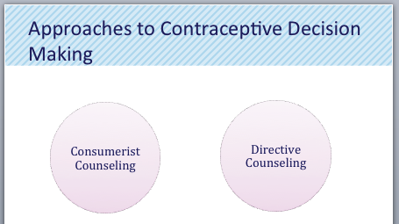
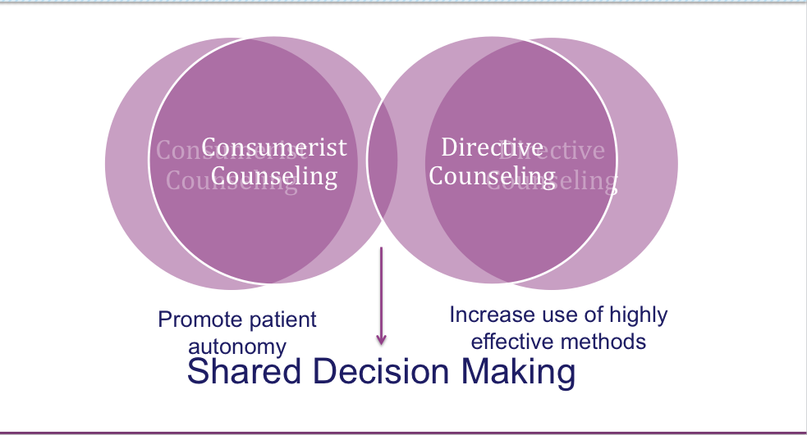
Shared Decision Making
“A collaborative process that allows patients and their providers to make health care decisions together, taking into account the best scientific evidence available, as well as the patient’s values and preferences….This process provides patients with the support they need to make the best individualized care decisions.” – Informed Medical Decisions Foundation¹
“All reproductive decision-making takes place within the power dynamics and social structures of patient’s lives, including the history of reproductive coercion, forced sterilization and bias between pts and providers. Using a SDM model…is a step toward addressing that social context.”²
Notes:
Online lectures explore shared decision making process and include some case studies
http://innovating-education.org/2016/04/improving-contraceptive-counseling-shared-decision-making-approach-new-medical-curriculum/
http://innovating-education.org/2016/03/contraceptive-counseling-responding-to-patient-preferences/
Delendorf, C., Biftu., & Angeline T. (2016) Improving Contraceptive Counseling through Shared Decision-Making Curriculum. Retrieved from: http://innovating-education.org/2016/03/2743/
Bixby center for Global Reproductive Health (2015) Changing the Conversation: Shared Decision Making in Reproductive Health. Innovating education in reproductive health. Retrieved from: http://innovating-education.org/2016/04/changing-the-conversion-shared-decision-making-in-reproductive-health/

Slide 15
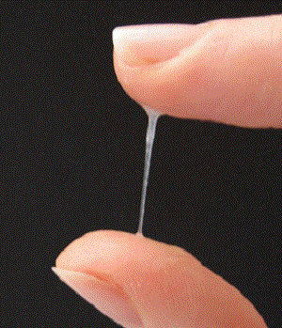

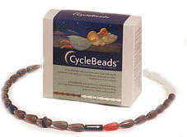
Fertility Awareness, Abstinence & Withdrawal
FAB Methods
Cynthia Belew, CNM, WHNP-BC
Associate Clinical Professor
UCSF School of Nursing
Elizabeth Donnelly, CNM, WHNP-BC

Slide 16
FAB Methods Introduction
  Terminology
  Efficacy

Slide 17
FAB Methods Terminology
NFP (Natural Family Planning)
  Avoiding intercourse during the fertile time
FAB (Fertility Awareness Based)
  Avoiding intercourse OR Using barrier methods during the fertile time
Notes:
Natural Family Planning is the term typically used by Roman Catholic organizations and most resources that use the term NFP will recommend/require that people that use it abstain during their fertile window.
You will notice that your text CT doesn‘t use the term NFP and instead uses the term FAB, FAB typically is used by folks that want to teach the same set of skills, but are comfortable with the use of a barrier method during the fertile window.

Slide 18
Why teach FAB Methods?
Basic reproductive literacy and life skill: Supports individuals to prevent or plan a pregnancy
People are interested:
  1 in 5 women expressed interest in using FAB¹ and interest is as high as 60% in some populations².
People commonly attempt to avoid the fertile phase to avoid pregnancy but have incomplete knowledge:
  7800 women with unintended pregnancy were asked why they didn’t use birth control³
    12-33% felt they could not get pregnant at the time of the cycle that they had sex and conceived
    20% thought that they couldn’t get pregnant b/c unprotected intercourse had not resulted in pregnancy in the past.
Stanford et al1998; Leonard et al, 2006; Nettleman, 2007, Biggs et al 2012
Notes:
Biggs et al Surveyed 1,392 women with no history of abortion. Nearly half (46%) of respondents engaged in UI within the past 3 months, mostly owing to barriers accessing birth control (49%), not planning to have sex (45%), and the belief that they could not get pregnant (42%). The most prevalent attitudes about UI were that it "feels better" (42%) or "more natural" (41%). Factors associated with an increased odds of having engaged in UI, included holding the views that UI is okay at certain times, feels better, and is more natural, underestimating the risk of conception from 1 year of UI, experiencing difficulty getting birth control prescriptions, having less than a college education, being ages 20 to 24, and being African American/Black.
Stanford, J., Lemaire, J., & Thurman, P. (1998). Women's interest in natural family planning. The Journal of family practice, 46(1), 65-71
Leonard, C. J., Chavira, W., Coonrod, D. V., Hart, K. W., & Bay, R. C. (2006). Survey of attitudes regarding natural family planning in an urban Hispanic population. Contraception, 74(4), 313-317.
Nettleman, M D, Chung, H, Brewer, J, et al. (2007). Reasons for unprotected intercourse: analysis of the PRAMS survey. Contraception, 75(5), 361-6.
Biggs, M. A., Karasek, D., & Foster, D. G. (2012). Unprotected intercourse among women wanting to avoid pregnancy: attitudes, behaviors, and beliefs. Women's Health Issues, 22(3), e311-e318.

Slide 19
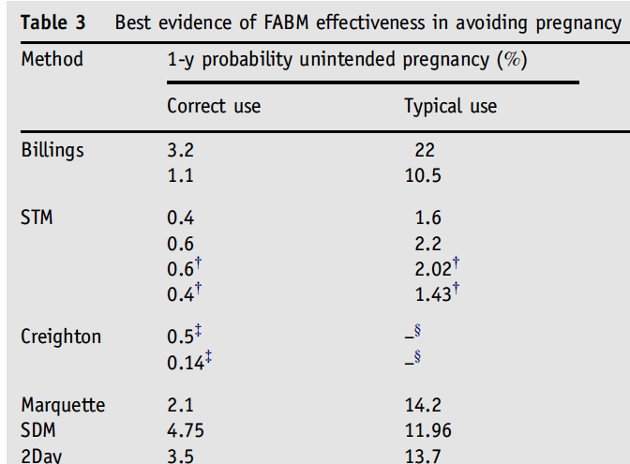
FAB Methods are Effective
Compare to:²
Condoms
  2% perfect use
  18% typical use
Pill
  3% perfect use
  9% typical use
Paraguard IUD
  .6% perfect
  .8% typical
No method
  80% typical
Sympto-
Thermal
Method
Manhart et al, 2013; Hatcher et al 2011; Malarcher, Fabic, Spieler and Starbird 2016
Notes:
Methods are quite effective. Great review paper published in 2013 in Osteopathic Family Physician titled Fertility awareness-based methods of family planning: A review of effectiveness for avoiding pregnancy using SORT.
This table lists all studies deemed of good quality - prospective cohort studies - on FAB methods showing pregnancy rates with correct use and typical use. These pregnancy rates compare well with rates for barrier methods and even with some hormonal methods.
Note that the failure rate with typical use for the symptothermal method is quite low, at around 2%, and that the SDM and twoday methods are nearly as effective as the OCP and more effective than condom use
Keep in mind that the pregnancy rate with NO contraceptive use for a year would be around 80%
Manhart, M. D., Duane, M., Lind, A., Sinai, I., & Golden-Tevald, J. (2013). Fertility awareness-based methods of family planning: a review of effectiveness for avoiding pregnancy using SORT. Osteopathic Family Physician, 5(1), 2-8.
Hatcher, R., Trussell, J., Nelson, A., Cates, W., Kowal, D., & Policar, M., (2011). Contraceptive Technology. Ardent Media.

Slide 20
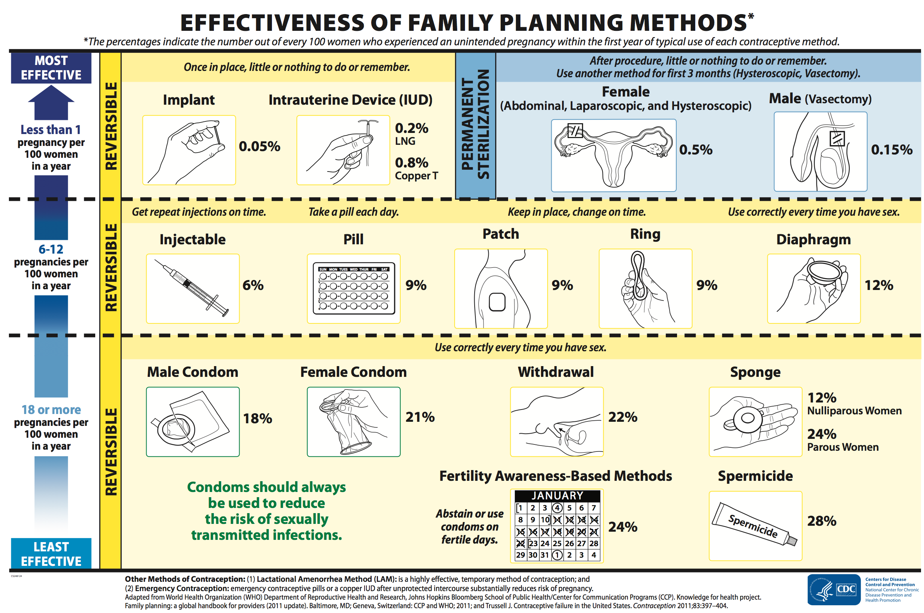
Misinformation in counseling resources
Notes:
Not representative of the current research or the diversity of methods.
Center for Disease Control and Prevention (CDC) (2016) Effectiveness of Contraceptive Methods. Contraception. Retrieved from: http://www.cdc.gov/reproductivehealth/UnintendedPregnancy/Contraception.htm

Slide 21
Popular Media
“The Trump administration wants to replace reliable birth control methods with "fertility awareness," a dubious family-planning technique that fails nearly a quarter of women every year.”
Notes:
http://www.newsweek.com/trump-replace-birth-control-fertility-awareness-leaked-document-689840

Slide 22
Problems w research on efficacy
Where does 24% risk of pregnancy comes from^{1,2}?
  1995 and 2002 National Surveys of Family Growth: Women with unintended pregnancies were asked to recall which family planning method they were using at the time of conception. ³
  From this number, all FAB methods were pooled and efficacy was estimated from this data. The majority of women using FAB reported using Calendar Rhythm method. ³
  Lumping together of data for all FAB methods masks important differences in their effectiveness, a fact acknowledged by the author of this estimate. ^{1,2}
Research challenges³:
  Methods developed concurrently in many locations. Difficult to have standardized definition.
  Characteristics of study population
  How pregnancy rates are calculated and how pregnancies are determined to be intentional or unintentional
Not profitable = less research.
Frank-Herrmann et al 2007; Duane, Motley & Manhart 2013, Trussell 1990; Fu et al 1999
Notes:
This number is proposed by the Trussel in contraceptive tech. (p780). The number is based on data from 1995 and 2002 National Surveys of Family Growth these retrospective surveys asked women to recall which method they were using at the time of unintended pregnancy
These estimates of pregnant rate are from 1995 and 2002 national survey of family growth, these retrospective surveys asked women to recall which method they were using at the time of unintended pregnancy
From this number, all NFP methods are pooled, then adjusted to account for underreporting of abortion, and an estimated unintended pregnancy rate is generated.
Duane, M., Motley, R., & Manhart, M. (2013). Physicians need more education about natural family planning. American family physician, 88(3), 158-9
Dumitru, A. M., & Duane, M. (2016). Behavioral Methods of Family Planning: A Comparative Study of Efficacy and Safety of Fertility Awareness Based Methods and Birth Control Pills. Issues L. & Med., 31, 205.
Contraceptive Tech: p 780 & p47
Frank-Herrmann, P., Heil, J., Gnoth, C., Toledo, E., Baur, S., Pyper, C., Jenetzky, E., Strowitzki, T., & Freund, G., (2007) The effectiveness of a fertility awareness based method to avoid pregnancy in relation to a couple’s sexual behaviour during the fertile time: a prospective longitudinal study Human Reproduction 22(5) 1310–1319

Slide 23
Provider based Barriers in Access to FAB methods
Providers are poorly educated
  2013 Family Medicine Residency Programs (N=120)
    >1/2 women's health faculty members not familiar with FAB,
    25% do not include FAB in the women's health curriculum”.¹
  2017 DO Family Medicine Residents (N=172) 83% recived <1hr of education on NFP in medical school ²
Provider Misconceptions:
  Physicians underestimate the effectiveness of FAB methods³.
  It is too complicated and time consuming to teach about FAB⁴.
Information not provided to patients
  30-50% of providers do not routinely include info on these methods³.
  47% DO Family Medicine Residents never mention NFP to their patients ²
Duane, et al, 2013; Stanford et al., 1999; Kelly et al, 2012
Notes:
Duane, M., Motley, R., & Manhart, M. (2013). Physicians need more education about natural family planning. American family physician, 88(3), 158-9
Vandenberg, R., & Schneider, R. (2016). Osteopathic family medicine resident’s knowledge, views, & management of natural family planning. Osteopath Family Physician, 8(2), 18-21.
Stanford, J., Lemaire, J., & Thurman, P. (1998). Women's interest in natural family planning. The Journal of family practice, 46(1), 65-71
Kelly, P. J., Witt, J., McEvers, K., Enriquez, M., Abshier, P., Vasquez, M., & McGee, E. (2012). Clinician perceptions of providing natural family planning methods in Title X funded clinics. Journal of Midwifery & Women’s Health, 57(1), 35-42.

Slide 24
Physiology
  Menstrual Cycle Review
  Fertile Window
  Basal Body Temperature
  Cervical Secretions

Slide 25
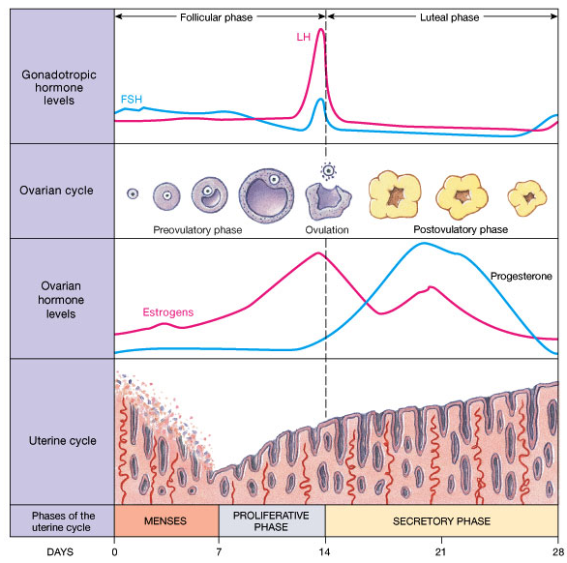
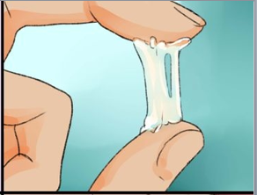

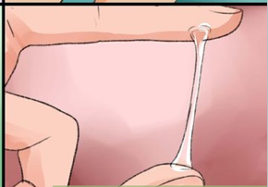
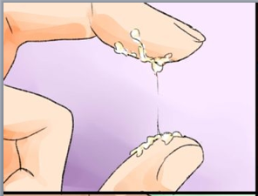
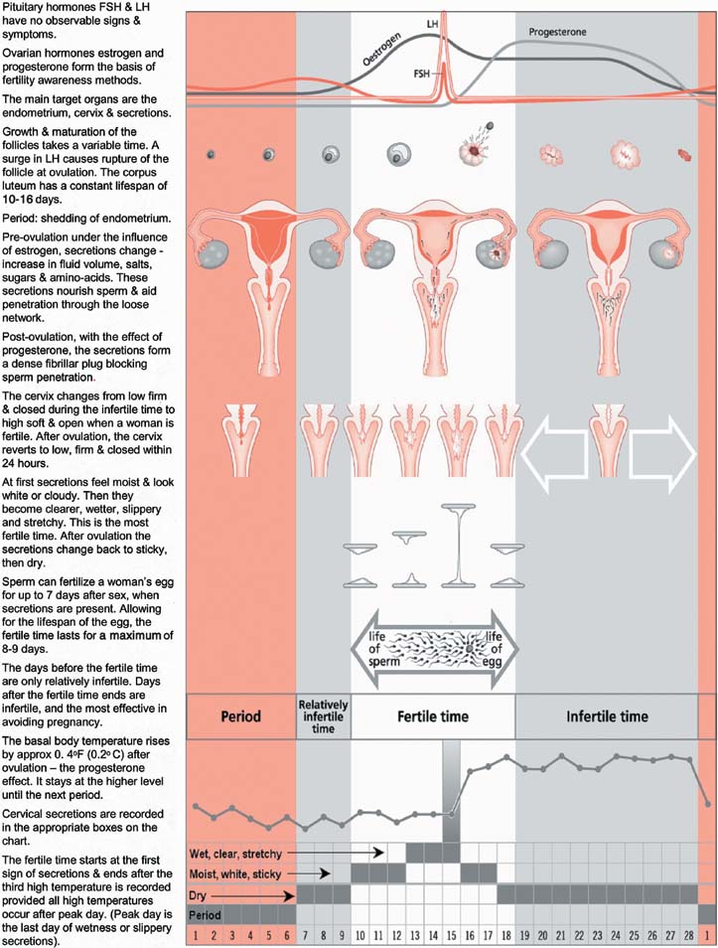
Follicular
Luteal
Ovarian
Hormone
Levels
Basal Body
Temperature
1
Notes:
FSH and LH are released from the pituitary – there are no gross observable signs of FSH and LH
Progesterone and Estrogen are produced in the ovaries. Changes in the level of these hormones cause observable changes in the body and are the basis of the fertility awareness methods.
Estrogen predominates in pre-ovulatory follicular phase which includes the fertile window AND progesterone predominates in the luteal phase including much the infertile periods.
The first day of menses is called Day 1 and is the start of the Follicular phase Follicle stimulating hormone or FSH, , stimulates growth of follicles in the ovary.
One follicle becomes dominant. The developing follicle secretes estrogen.
Estrogen
has a proliferative effect on the endometrium;
stimulates the glands within the cervix to produce secretions, transparent, and stretchy secretions (allows for enhanced sperm motility, nourishment, and survival)
When estrogen reaches a peak, it triggers a surge in Luteinizing Hormone or LH, which in turn causes Ovulation, release of the egg from the follicle.
Ovulation always occurs within 24 hours of the peak of the LH surge. Ovulation usually occurs only once per cycle. The egg has a lifespan of 12- 24 hours.
If a second ovulation occurs, it will happen within 24 hours of the first ovulation.
Some individuals can feel ovulation as a unilateral pain called mittelschmerz.
The ruptured follicle transforms into the corpus luteum and begins to produce primarily progesterone. It is also producing estrogen and inhibin, but progesterone is the dominant hormone in Luteal phase.
Progesterone:
matures the thickened endometrium into secretory tissue rich in blood an nutrients ready to support and nourish a fertilized egg, if fertilization occurs.
changes the thin, watery cervical secretions into a thicker secretions plug, which inhibits sperm penetration, and
has a thermogenic effect causing a rise in basal body temperature. You can see the biphasic pattern of BBT here, it is lower during the follicular phase then it rises after ovulation has occurred, and stays up for the rest of the Luteal phase.
If no pregnancy: corpus luteum has a fixed life span of approximately 14days.
As it atrophies progesterone levels drop
Progesterone holds the uterine lining in place, as progesterone levels fall, the endometrial lining sloughs off and menstruation occurs.
FSH & LH can increase & we begin a new follicular phase
FHS stimulates the growth of follicles in the ovaries starting the cycle over again.
The pill: keeps progesterone level the same so an LH surge is not triggered.
(If pregnancy occurs Human Gonadotropin Hormone HCG is similar enough to LH to keep CL alive to produce Estrogen & Progesterone to keep the endometrial lining )
The length of cycle varies from person to person and over time for the same person. When variation in cycle length occurs, the variation occurs in the follicular phase. The luteal phase, because of the fixed lifespan of the corpus luteum, is of a FIXED DURATION of approximately 14 days, while the duration of the follicular phase can vary. So if there is a 25 day menstrual cycle or a 35 day cycle, the luteal phase is always around 14 days, it is the follicular phase that is longer or shorter.
One other sign that some folks use: around ovulation, the cervix can be noted to be soft, high, open and wet while at other times it is by comparison Firm, Low, Closed and “non-wet”. (Weschler, 2006)
Hatcher, R., Trussell, J., Nelson, A., Cates, W., Kowal, D., & Policar, M., (2011). Contraceptive Technology. Ardent Media.
Weschler, T. (2006). Taking charge of your fertility: the definitive guide to natural birth control, pregnancy achievement, and reproductive health. New York: HarperCollins.

Slide 26
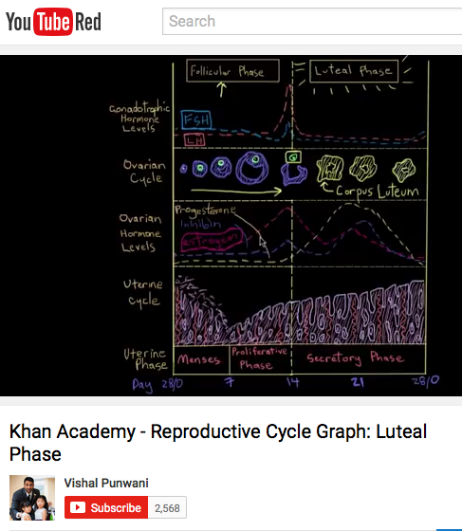
Menstrual Cycle Resources
Follicular Phase
Luteal Phase
Notes:
Check out Khan Academy’s GREAT videos on the menstrual cycle
Folicular Phase: https://www.youtube.com/watch?v=K0mWhPj7eYQ
Luteal Phase: https://www.youtube.com/watch?v=1t9uZdpF_1o
Image on the retrieved from: http://imgarcade.com/1/vaginal-discharge-when-fertile/ is great at pulling it all together. Includes cervical secretions, fertile window, basal body temp as well as hormone cycles.
Source of menstrual cycle graph: Pyper CM and J Knight (201) Fertility awareness methods of family planning: they physiologic background, methodology and effectiveness of fertility awareness methods. Jo Fam Plann Reprod health Care 27(2): 103-9
--------------------------------------------
Not using the text below
FSH and LH are released from the pituitary – there are no observable signs of FSH and LH
Progesterone and Estrogen are produced in the ovaries. Changes in the level of these hormones cause observable changes in the body and are the basis of the many fertility awareness methods.
Estrogen predominates in the fertile window; progesterone predominates in much of the the infertile periods.
Hypothalamus: pulses of gonadotropin-releasing hormone(GnRH) regulate pituitary output of follicle-stimulating hormone (FSH) and luteinizing hormone (LH)
Follicular phase: FSH from the pituitary stimulates development of the follicle, which contains the ovum. The growing follicle(s) secretes estrogen.
Estrogen
has a proliferative effect on the endometrium;
stimulates the glands within the cervix to produce secretions, transparent, and stretchy secretions (allows for enhanced sperm motility, nourishment, and survival)
Ovulation: Estrogen rising to a threshold level provides feedback to the pituitary gland to produce the LH surge
Luteal Phase: corpus luteum (the ruptured follicle) secretes progesterone & estrogen
Progesterone:
matures the thickened endometrium into secretory tissue to nourish an embryo,
it changes the thin, watery cervical secretions into a thicker secretions plug, which inhibits sperm penetration, and
it has a thermogenic effect causing a rise in basal body temperature.
If no pregnancy: corpus luteum atrophies; progesterone & estrogen produced by CL drops and folicular phase starts again
One other sign that some folks use: around ovulation, the cervix can be noted to be soft, high, open and wet while at other times it is by comparison Firm, Low, Closed and “non-wet”. (Weschler, 2006)
CAN AN INDIVIDUAL GET PREGANT WHILE MENSTRATING?
Yes! Can be fertile during menstruation if cycle is short.
Luteal Phase is fixed ~14d after ovulation.
Follicular phase is more variable and can be impacted by stress, diet, sleep, age etc.
When fertile during menstruation, it means that the person has had a relatively short follicular phase and ovulated while menstruating
One other sign that some folks use: around ovulation, the cervix can be noted to be soft, high, open and wet while at other times it is by comparison Firm, Low, Closed and “non-wet”. (Weschler, 2006)
(Manhart, Duane, Lind, Sinai, & Golden-Tevald, 2013)

Slide 27
Physiology: Signs of Fertility
Estrogen and Progesterone cause predictable, observable changes in that can be used to detect the onset and end of the fertile phase
Basal Body Temperature (BBT)
Cervical Secretions
Secondary signs:
  Position of cervix
  Mittlesmertz

Slide 28

Physiology: Basal Body Temperature (BBT)
BBT increases after ovulation under influence of progesterone
  Post-ovulatory progesterone production causes BBT to rise by at least 0.4° Fahrenheit (0.2° Celsius)
  Elevation occurs 1-2 days after LH surge, persists > 10 days
      Normal range: 97.0°-97.7°.
      Postovulatory range: >97.8°
Retrospective sign, occurs after ovulation, informs about the end but not about the onset of the fertile phase
Notes:
(some thermometers give readouts in two-tenths of a degree, you don’t want that)
Chart the temp so that you can see changes over time.

Slide 29
Factors that may alter BBT
Fever
Anti-pyretic medications
Changes in sleep patterns
  Less sleep than normal, earlier or later bedtime, shift work, travel
Taking temperature at a different time
  BBT increases as day goes on
Weschler, T. (2006)

Slide 30
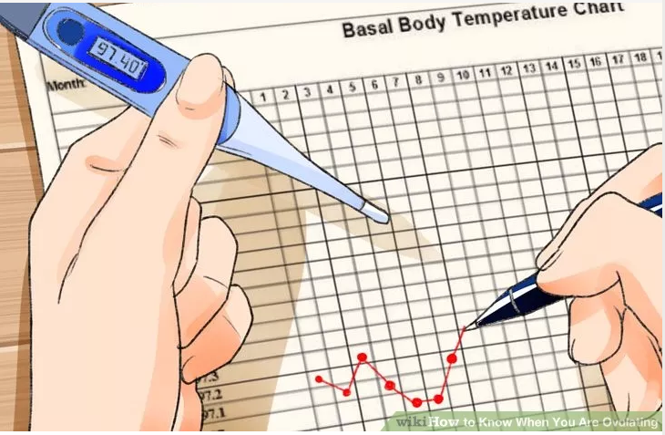
Basal Body Temperature – How its done
  Taken each morning before getting out of bed (after > 6 hours of sleep)
  At around the same time (within 1 hour of awakening)
  Use a thermometer that is accurate within one tenth of a degree (ex 98.1)
  Record graphically or electronically so you can see patterns over time
Notes:
http://www.wikihow.com/Know-When-You-Are-Ovulating

Slide 31
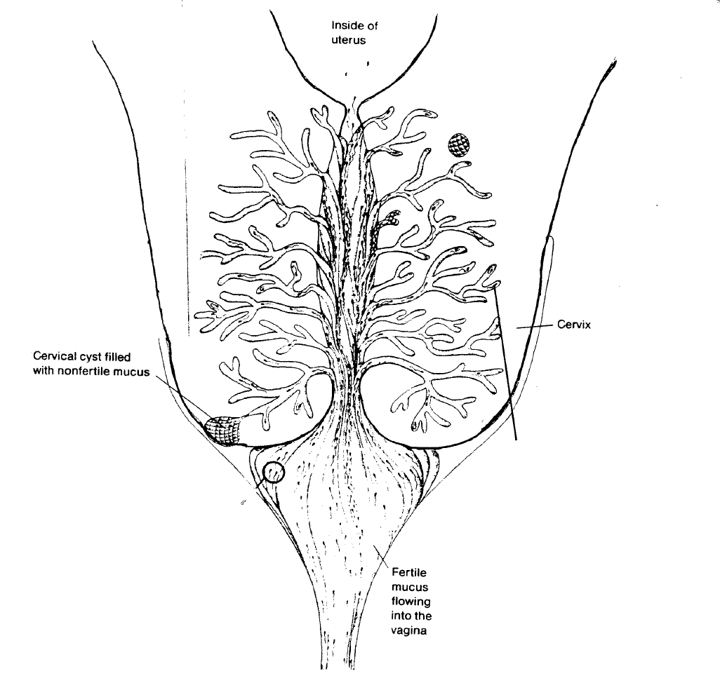
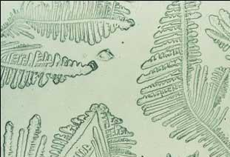
Physiology Cervical Secretions
Sperm can live in the cervix for up to 5 days in the presence of fertile secretions
Cervical Mucus
Ferning
Endocervical Glands

Slide 32
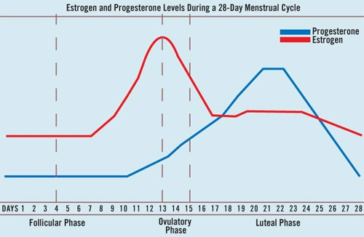
Physiology: Cervical Secretions
Estrogen and Progesterone
cause characteristic changes in Cervical Secretions
Estrogen
Progesterone
Notes:
The features of cervical secretions, such as consistency and color, are determined by estrogen and progesterone
In the early part of the follicular phase, estrogen levels are low, cervical secretions is usually thick, and may not even leave the cervix. The sensation at the vulvar area dry. As estrogen levels increase, the cervical secretions become increasingly more abundant, slippery and stretchy. The sensation at the vulvar area is wet.
Once ovulation occurs and the corpus luteum begins secreting progesterone, cervical secretions becomes thick, plug-like, pasty, and tacky.

Slide 33
Cervical Secretions - Characteristics
Estrogen (Fertile) secretions
Progesterone (Infertile) secretions
Abundant
Wet
White, or cloudy at first then clear as estrogen levels increase
Slippery
Stretchy
Like egg whites
Increases in fluid volume, salts, sugars and amino acids
Thick
Scant
Pasty
Sticky
Notes:
Descriptors of the different types of secretions

Slide 34
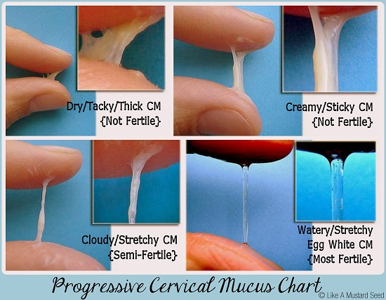
Provides information about both the onset and end of the fertile window
Not fertile:
Dry, tacky, thick
Not fertile:
Creamy Sticky
Near
Ovulation-
Spinnbarkeit
Likely fertile:
Cloudy, stretchy
Most Fertile:
Egg White
Notes:
When estrogen levels are low near the beginning of the cycle secretions start out scant, thick, white and sticky. The rising levels of estrogen cause secretions to gradually become more transparent, wetter and more stretchy. Near ovulation the secretions are very similar to raw egg whites. This changing pattern gives information about the ONSET of the fertile phase as well as about the END of the fertile phase

Slide 35
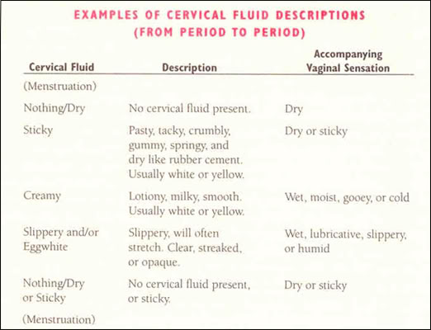
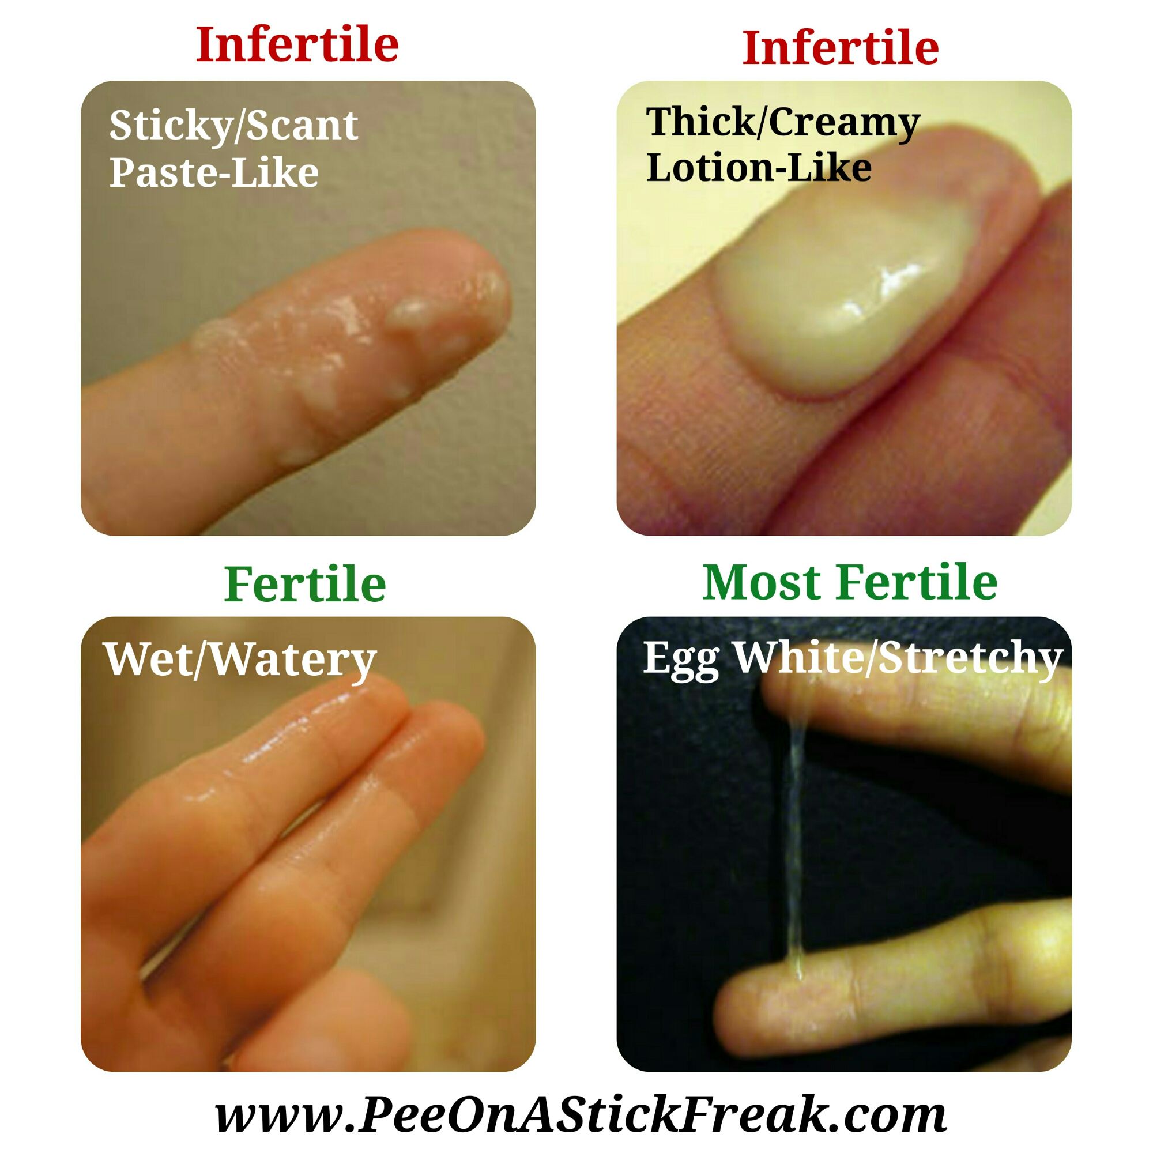
Progesterone Type
Estrogen Type
Notes:
Estrogen secretions: sugars nourish sperm, alkaline, protects sperm of acidity of vagina, high water content
Estrogen-type secretions: Similar to hand lotion - Creamy, white
Estrogen-type secretions / Spinnbarkeit - clear, wet, stretchy, slippery
Progesterone-type secretions - tacky, pasty, sticky, flaky - Hostile to sperm: acidic, contains leukocytes, antimicrobial agents, blocks sperm motility

Slide 36
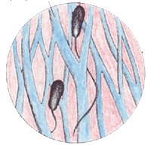
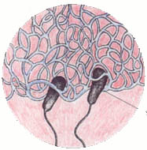
Cervical Secretions – Impact on Sperm
Estrogen (Fertile) secretions
Progesterone (Infertile) secretions
Create a hospitable environment for sperm
Changes the usually acidic vaginal environment to alkaline
Provides sugars to nourish sperm
Thin viscosity forms channels for sperm to move easily - facilitates sperm transport
Hostile environment - Sperm cannot survive
Acidic
Contains leukocytes
Thick viscosity, creates an impermeable barrier, blocks sperm transport
Notes:
The different types of secretions have very different physiologic functions.
Can connect this with how Mirena works,

Slide 37
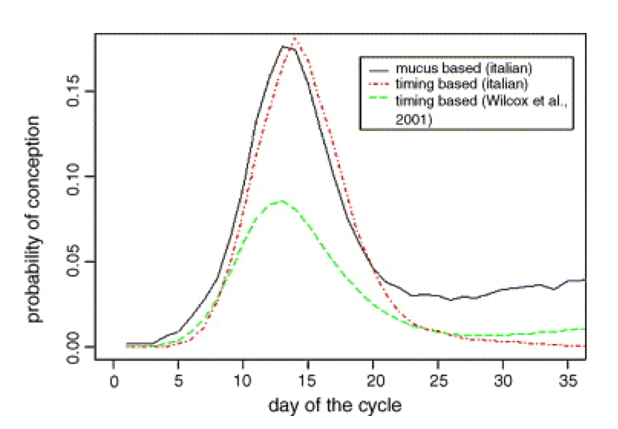
Physiology: Cervical Secretions
Cervical Secretions
are an accurate marker
of fertile days
Fertile Mucus
Pattern
Probability
of Conception
Scarpa, Dunson & Colombo 2006 Bigelow et al 2003 Fehring 2002;
Notes:
The green line shows you the same data you saw earlier from Wilcox on probablility of conception on days of the cycle relative to ovulation. The black line shows the fertile mucus pattern. You can see that the pattern of fertile secretions very closely mirrors the fertile phase, These researchers and others have reported that cervical secretions are a highly accurate marker of fertile days. This is because the onset of the fertile window corresponds with a significant rise in estrogen levels, and the rising estrogen results in the fertile cervical secretions.
(In fact, when intercourse occurs during the fertile wiindow, the type of secretions present is more predictive of conception than the timing relative to ovulation)
Scarpa, B., Dunson, D. B., & Colombo, B. (2006). Cervical mucus secretions on the day of intercourse: an accurate marker of highly fertile days. European journal of obstetrics & gynecology and reproductive biology, 125(1), 72-78.
Bigelow, J. L., Dunson, D. B., Stanford, J. B., Ecochard, R., Gnoth, C., & Colombo, B. (2004). Mucus observations in the fertile window: a better predictor of conception than timing of intercourse. Human reproduction, 19(4), 889-892
Fehring, R. J. (2002). Accuracy of the peak day of cervical mucus as a biological marker of fertility. Contraception, 66(4), 231-235.

Slide 38
Cervical Secretions: Factors that can interfere with recognition of cervical secretions patterns
Vaginal infections
Arousal fluid (short term effect)
Semen (short term)
Decongestant or antihistamine use
Spermicide
Douching

Slide 39
Physiology: Fertile Window
How many ovulations occur in a menstrual cycle?
How long does the egg live?
How long do sperm live in the female genital tract?
How many days are fertile in a menstrual cycle?
One ovulation per cycle
Egg lives 12-24 hours
Sperm live up to 5 days, in the presence of fertile cervical secretions
Fertile window is up to six days per cycle

Slide 40
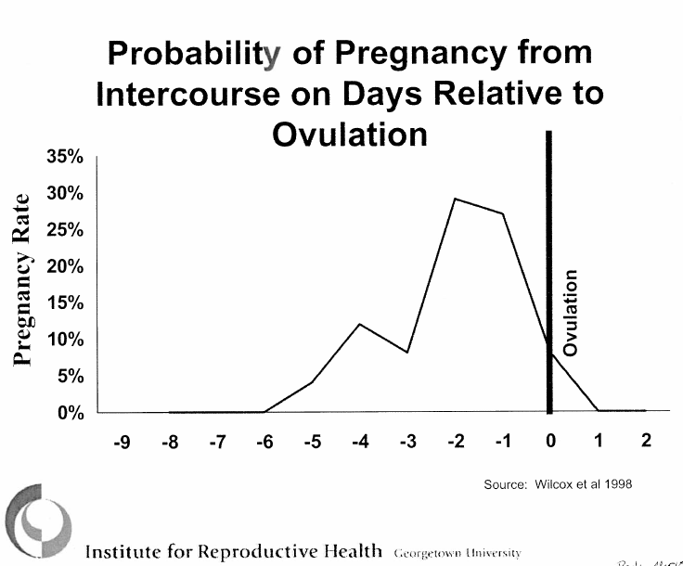
Physiology: Fertile Window
Narrow Fertile Window of 1-6 days
Wilcox et al 1998
Notes:
------------------------------------------------------------------------------------------
Ultrasound and hormonal studies show that the fertile phase lasts from one to five days, with the average being three days. Sperm can live in the cervical glands for up to five days. Fertilization can occur for up to 24 hours after ovulation. Thus there is a maximum fertile window of six days per menstrual cycle. The five days prior and the day of ovulation. The highest probability of pregnancy is in the two days just prior to ovulation, when the likelihood of pregnancy is 25 to 28%. It decreases to zero probability of pregnancy six days before, and one day after ovulation.
Length of the fertile window varies from one day up to six days. Six-day Fertile Window: The probability of pregnancy from unprotected intercourse is: 4% if UPI occurs 5d before ovulation, 28% 2 days before ovulation, 8-10% in the 24h after ovulation
Graph Data from: Wilcox, A. J., Weinberg, C. R., & Baird, D. D. (1998). Post-ovulatory ageing of the human oocyte and embryo failure. Human Reproduction, 13(2), 394-397.
Peri-ovulatory Libido Surge: Well documented that women tend to have peri-ovultoary peak in sexual desire. (Roney & Simmons, 2013)
Looked at the pattern of intercourse in women with non-hormonal IUDs or tubals.
Women have the most intercourse on the most fertile days. Why – pheromones, increased attractiveness.
Wilcox, A. J., Weinberg, C. R., & Baird, D. D. (1995). Timing of sexual intercourse in relation to ovulation—effects on the probability of conception, survival of the pregnancy, and sex of the baby. New England Journal of Medicine, 333(23), 1517-1521.
Wilcox, A. J., Weinberg, C. R., & Baird, D. D. (1998). Post-ovulatory ageing of the human oocyte and embryo failure. Human Reproduction, 13(2), 394-397.
Roney, J. R., & Simmons, Z. L. (2013). Hormonal predictors of sexual motivation in natural menstrual cycles. Hormones and Behavior, 63(4), 636-645.

Slide 41
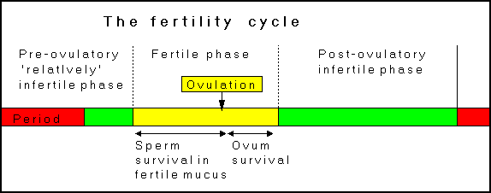
Physiology: Fertile Window
The cycles of fertility and infertility
Notes:
So in typical cycle there would be menstruation and an infertile phase of varying length, depending on the length of the follicular phase, followed by a fertile phase lasting up to six days that occurs around ovulation, then after ovulation and the 24 hour lifespan of the egg, the rest of the cycle is infertile.
http://www.fertilityuk.org/nfps20.html

Slide 42
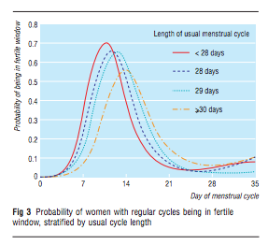
Physiology: Fertile Window in cycles of of different length
Notes:
Wilcox, A. J., Dunson, D., & Baird, D. D. (2000). The timing of the “fertile window” in the menstrual cycle: day specific estimates from a prospective study. Bmj, 321(7271), 1259-1262.

Slide 43
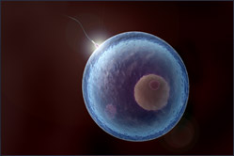

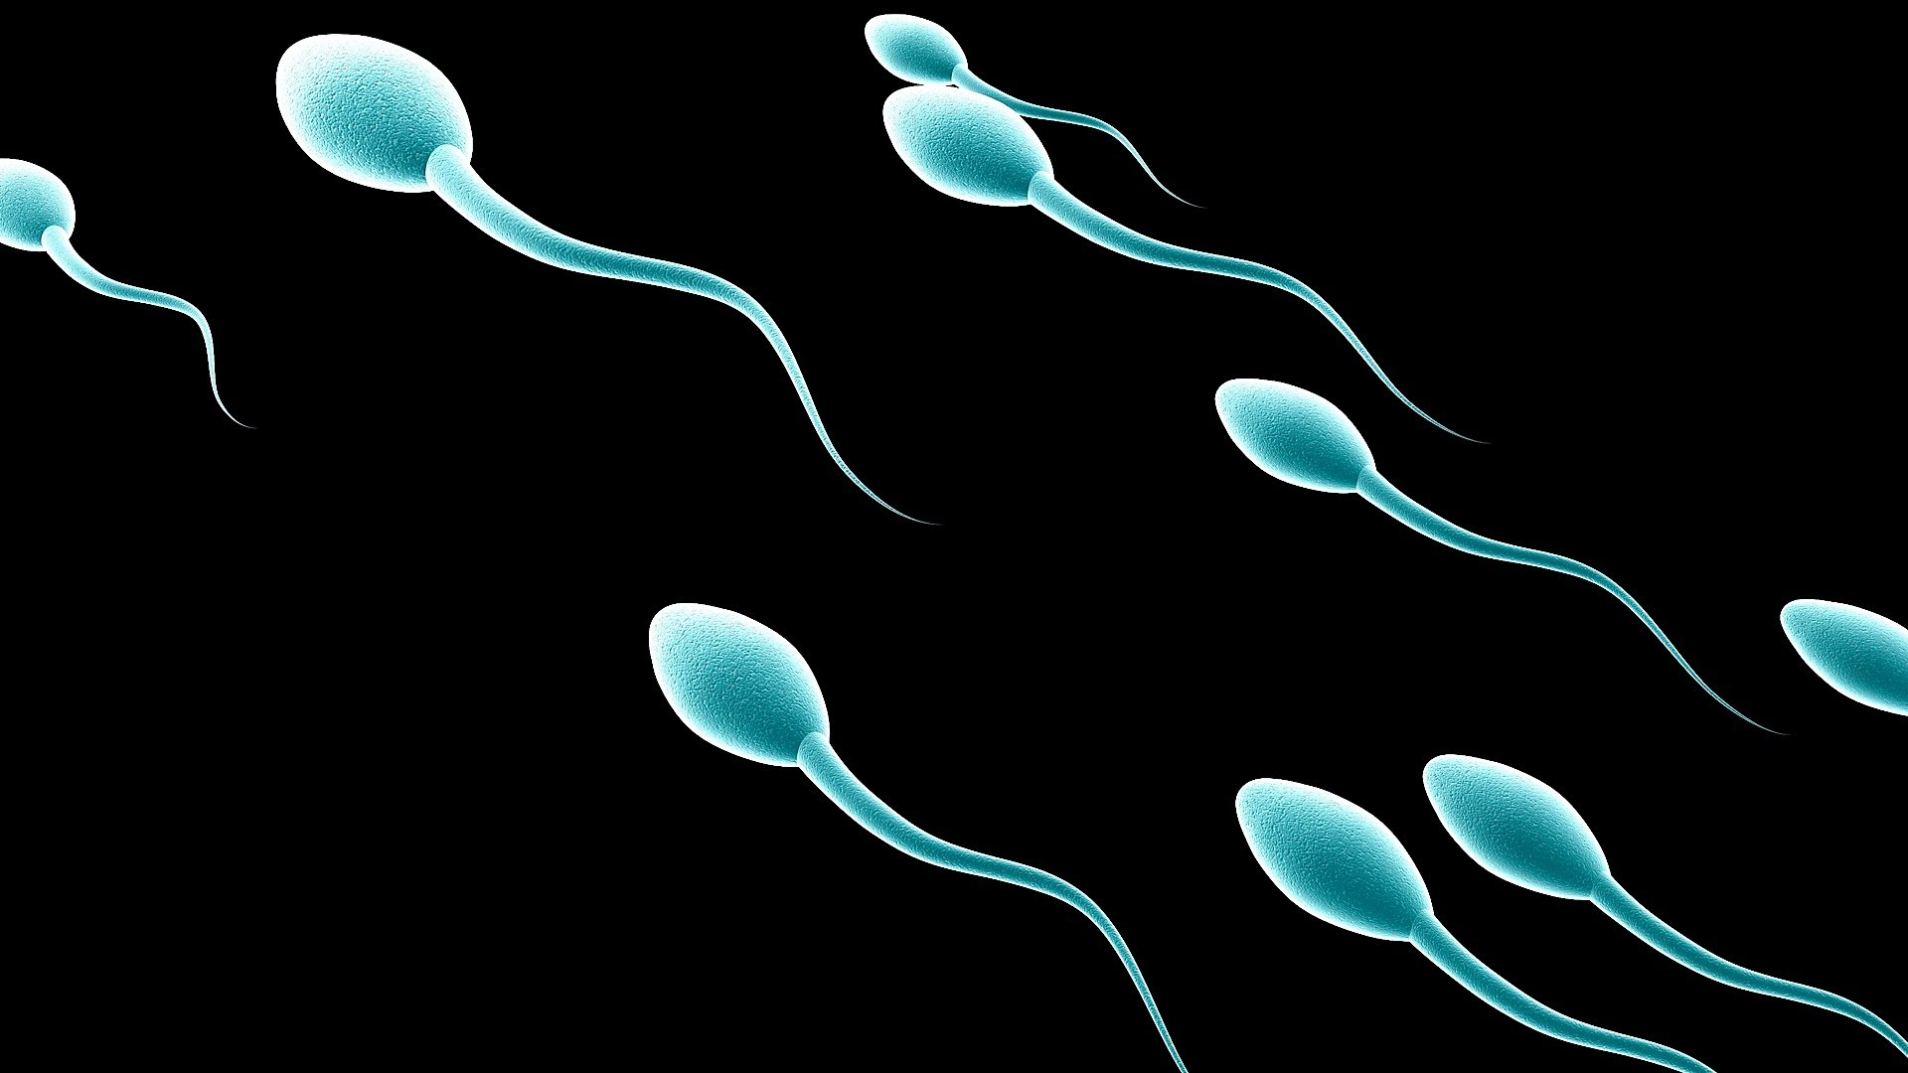
Physiology: Three Essential Components of Fertility
EGG
SPERM
FERTILE TYPE CERVICAL SECRETIONS
Notes:
We usually think that a sperm and an egg are all that is needed for pregnancy to occur, BUT, unless assisted reproductive technology is involved , in reality cervical mucus is an essential component of fertility.

Slide 44
FAB Methods

Slide 45
FAB Methods
Cervical Secretions Methods:
  TwoDay Method
  (Billings) Ovulation Method
  The Creighton Model FertilityCare System (Creighton)
Combination Methods:
  Symptothermal method: Cervical secretions & basal body temperature to determine fertility
  Symptohormonal methods: cervical secretions & technology to detect hormone levels in the urine.
Calendar Methods:
  Standard Days Method
  Rhythm Method

Slide 46
FAB Methods: Two basic categories
Calendar methods
  Predict fertile phase based on length of past menstrual cycles
  Expectation that the current cycle length will not vary greatly from previous cycles
  Requires that the user have regular menstrual cycles
Fertility Signs Methods
  Using specific observable physical signs of ovulation to identify fertile days
    Cervical Secretions
    Basal Body Temperature
    Hormone detection
  Can be used effectively by those with irregular cycles
Notes:
There are two basic categories of FAB methods
The calendar methods use the length of past cycles to predict what will happen in the current cycle. Therefore, Require that the user have regular menstrual cycles
Whereas The methods that use fertility signs, such as basal body temperature, cervical secretions are using specific signs of ovulation occurring in the current cycle to identify the fertile days.

Slide 47

Cervical Secretions Methods
  TwoDay Method
  Billings Ovulation Method
  The Creighton Model FertilityCare System

Slide 48
TwoDay Method
Efficacy:
  3.5% perfect use + abstinence; 6% perfect use + condoms; 14% typical use
Method Of Action: Cervical Secretions Tracking
  Focus is simply on presence or absence of any vaginal secretions rather than on characteristics of secretions
Fertile period: average 12days/cycle
Teaching: Easy to teach and learn
  Designed to be taught in 20 minutes to low-literacy clients.
Cycles: can be any length and can be irregular
Resources:
  Institute for Reproductive Health at Georgetown University
Notes:
The TwoDay method is a very simplified cervical secretion method that was developed at Institute for Reproductive Health at Georgetown University for use in low-resource countries.
Designed to be taught in 20 minutes to low-literacy clients. STOP THERE AND GO ON
People are encouraged to ck secretions in whatever way works for them, some might notice secretions in their underwear or the sensation at the vulva, others might touch the vulva to note the presence or absence of secretations. Therefor a benefit of this method it it has been shown to be effective with a wide range of detection methods.
Institute for Reproductive Health at Georgetown University (2016) TwoDay Method Family Planning Presentation. retrieved from: http://irh.org/?s=TwoDay&search_type=resource&country=&paged=3

Slide 49
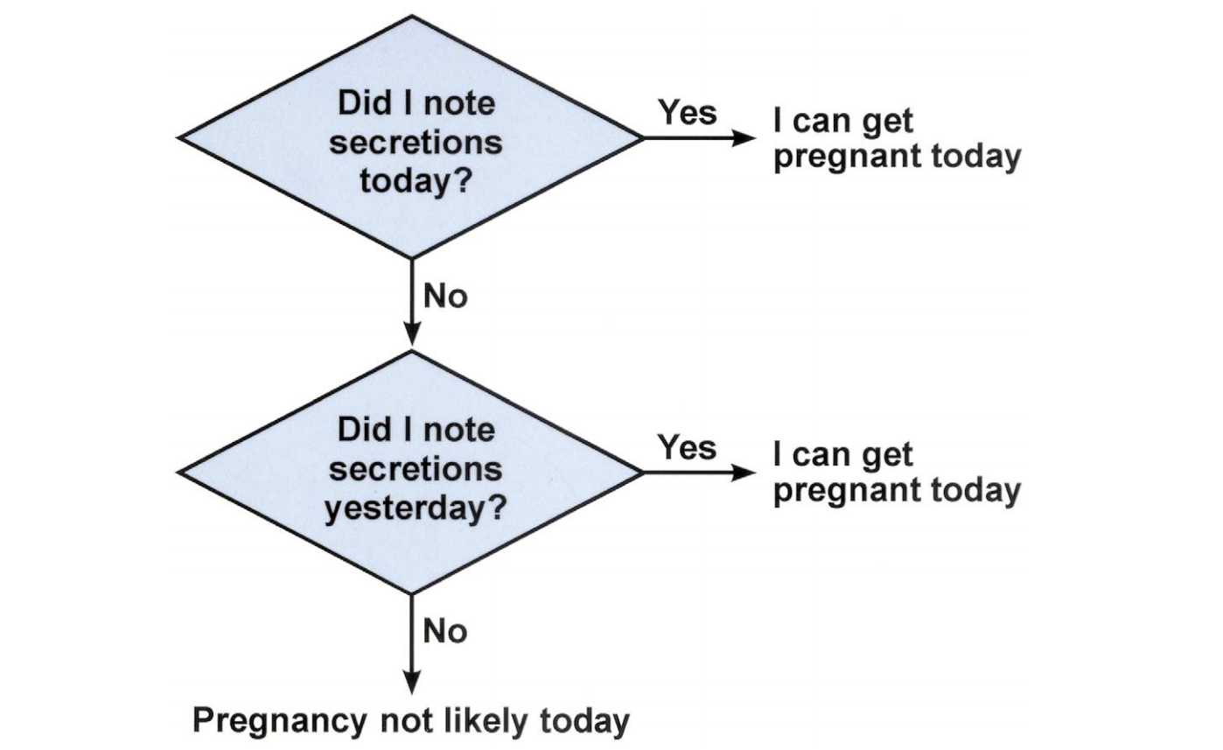
TwoDay Method: Algorithm
Notes:
This is the algorithm used to identify fertile days. it is very simple and easy to use. Each day the user ask themselves these two questions:
The person simply notes if the sensation of wetness is present today or yesterday. There is no teaching about the characteristics of the secretions.
These two questions are asked every day, if secretions are noted either yesterday or today then the person is assumed to be fertile. If there were no secretions either yesterday or today, pregnancy is unlikely
.
• Once they begin, secretions continue to appear for several days in a row and that they look different as the days go by. It is important to explain to the woman that she WILL NOT see or feel the same thing every day. What she sees or feels one day is not necessarily the same as she will see or feel on other days. What she sees or feels will depend on where she is in her cycle.
• Although the quantity may change or they may look or feel different, any secretion indicates that a woman can become pregnant. She should not have unprotected sex when she has secretions, if she wants to avoid pregnancy.
She is postpartum or breastfeeding: She must have had at least 4 periods after the childbirth.
She recently used the 3-month injectable: 4 months must have passed since she received the last injection She must have had at least one period after those 4 months.
She recently used the 1-month injectable: At least one month must have passed since she received the last injection. She must have had her period after that month.
She recently used the pill: She must have stopped using the method. She must have had her period after stopping the method.
She recently used the emergency contraceptive pill: She must have had her period after taking the pill. She must wait until the bleeding associated with use of the pill ends.
She recently used an IUD: Make sure that the IUD has been removed.
She recently had an abortion: Wait until the bleeding associated with the loss of pregnancy ends. She must have had at least one period after childbirth.
Image from: Natural Family Planning (2012)Two Day Method. Retrieved from: http://www.naturalfp.com/twoday-method.html

Slide 50
TwoDay Method: Initial Evaluation
Are the vaginal secretions healthy?
Are there any special considerations?
  Lactating, recent DMPA or EC use…
Will the partner cooperate?
Can unprotected intercourse be avoided during fertile days?
Will the individual remember to check twice daily?
Instruct, give card, make follow-up appointment
Notes:
There are several factors to consider to determine if the person is a candidate for this method; this method would not be effective in someone with current or recurrent vaginitis, who is lactating or has recent use of hormonal contraceptives, or does not have control over when intercourse occurs,

Slide 51
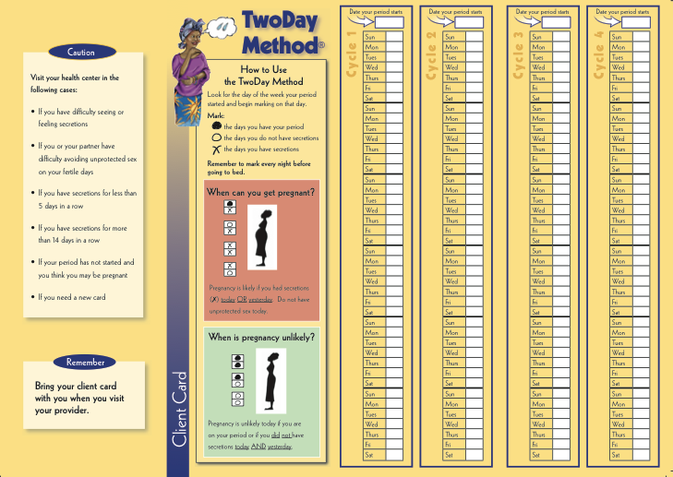
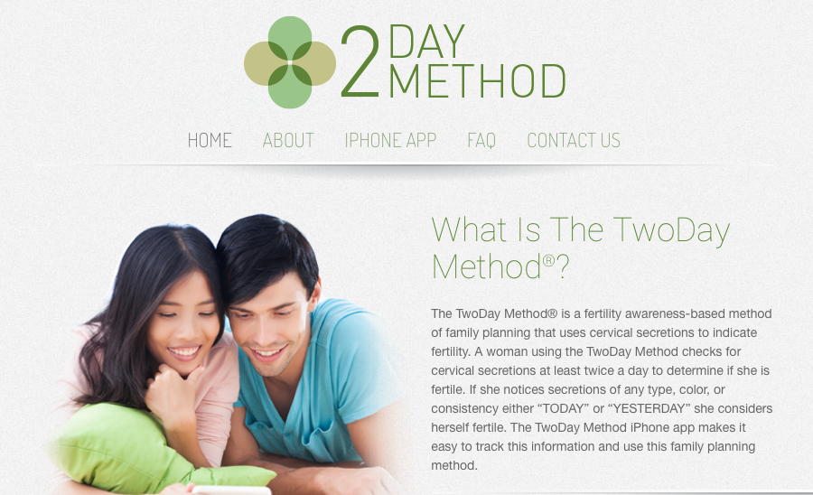
TwoDay Method: Teaching Tools
www.k4health.org/toolkits/twoday
Notes:
There are excellent teaching tools for the TwoDay method available online.

Slide 52
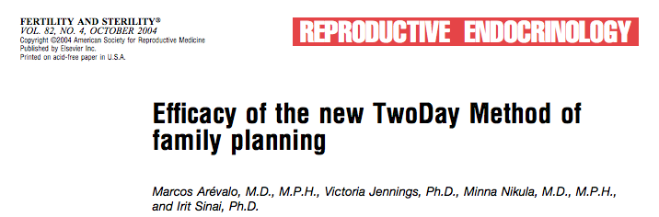
TwoDay Method: Evidence Base
First-year pregnancy rates:
  All cycles/all pregnancies: 13.7
  Correct-use
    - abstinence during fertile phase: 3.5
    - barrier/withdrawal during fertile phase: 6.3
Most pregnancies occurred in first few cycles of use, efficacy improved with continued use
Mean number of days w secretions: 12
  More than the 6.5 - 10 days reported with use of the Billings Method
Notes:
DON’T SAY PERCENT
The TwoDay method algorithm was derived from large data sets from the World Health Organization, followedup by clinical trials that included nearly 450 couples in low-resource countries, followed for 13 cycles
The first-year pregnancy rate In all pregnancies-all cycles the preg rate was 13.7.
With correct use and abstinence during the fertile phase it was 3.5, and if withdrawal or a barrier method is used during the fertile phase it was 6.3.
Arévalo, M., Jennings, V., Nikula, M., & Sinai, I. (2004). Efficacy of the new TwoDay Method of family planning. Fertility and Sterility, 82(4), 885-892.

Slide 53
Billings Ovulation Method
Efficacy: 3% perfect use 22% typical use
Method of action: cervical secretion awareness ONLY
  More in-depth version of tracking cervical secretions.
  Detailed observation of quantity and quality: color, texture, stretchiness
  Last day of fertile secretions (peak day) closely correlates with ovulation
Fertile Period:
  Abstinence/barrier use from first day of estrogen secretions until 4 days after the last day of estrogen mucus
  Mean # days of fertile secretions: 6.5-10 days
  Range: 2.5-10 days of fertile secretions.
Cycles: Can be any length and irregular
Teaching: Complicated, recommended that client be taught by trained educator.
  Find educators in USA here: boma-usa.org/
Resources: www.billings.life
Scarpa et al 2006; Fehring RJ 2002
Notes:
The BOM uses only cervical secretions and requires the user to go into more detail about the color, texture and stretchiness of the secretions.
It was one of the earliest cervical secretions methods first developed in 1960s, it has some very specific rules that are a bit complicated to teach and learn,
The advantage of this method of using more detailed observation of secretions is that users identify fewer days as fertile than they do with the more simplified Twoday method. The mean number of days identified as fertile is 6.5-10, compared to 12 days with the TwoDay method

Slide 54
Billings Ovulation Method: The Four Rules
Early Day Rule 1: Avoid intercourse on days of heavy menstrual bleeding.
Early Day Rule 2: Alternate evenings are available for intercourse when these days have been recognized as infertile, ie, basic infertile pattern (BIP).
Early Day Rule 3: Avoid intercourse on any days of discharge or bleeding that interrupt the BIP. If ovulation is not confirmed, allow three days from return of the BIP before resuming intercourse.
Peak rule: From the beginning of the fourth day after the peak until the end of the cycle, intercourse is available every day at any time.
Notes:
Was the first method to use and research cervical secretion: these are the rules, they are complex, important to be aware of them, if you have a pt interested in this method they need to be referred to a billings ov teacher or self-educate…not user friendly version
The fertile period starts at the onset of secretions and ends 3 days after the last day of clear, stretchy, or lubricative secretions.”¹
BIP: “unchanging pattern of dryness or a sensation or discharge that is the same day after day.” ²
Manhart, M. D., Duane, M., Lind, A., Sinai, I., & Golden-Tevald, J. (2013). Fertility awareness-based methods of family planning: a review of effectiveness for avoiding pregnancy using SORT. Osteopathic Family Physician, 5(1), 2-8
Corkill, M., & Marshell, M. (2008) How to treat.: Natural fertility regulation — The Billings Ovulation Method Australian Doctor. Retrieved from: http://naturalfamilyplanning.sg/site/wp-content/uploads/2010/10/BOM-publication-19Dec08.pdf

Slide 55
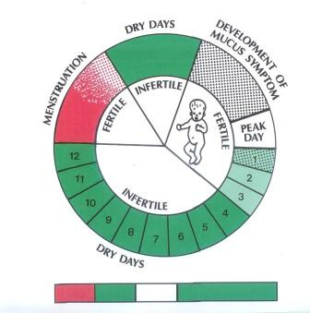
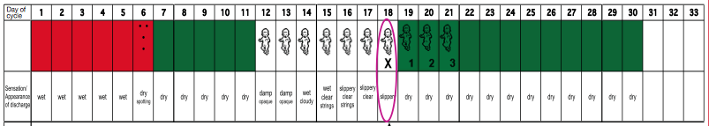
Charting with Billings Ovulation Method
Notes:
Circular image: from old powerpoint link no longer active http://www.justisse.ca/554.htm
“Because the production of the cervical secretions around the time of ovulation is an estrogen-dependent effect, and is produced at the time of the development of the follicle and approaching ovulation, when estrogen is increasing and ovulation approaching, the cervical secretions is produced and will be discharged before and during the time of ovulation. In long cycles there may be occasional “patches” of secretions prior to the onset of the secretions associated with ovulation. What is prolonged in these cycles is the pre-Peak (or preovulatory) phase of the cycle and what remains relatively consistent, is the post-Peak (postovulatory) phase of the cycle.” (http://creightonmodel.com/background.htm)

Slide 56
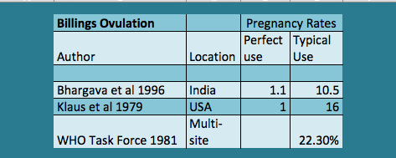
Billings Ovulation Method: Effectiveness
Notes:
Typical use pregnancy rates have been reported as ranging 10-22%. There is no recent research.

Slide 57
Creighton Model (NaProTechnology)
Efficacy:
  Hard to calculate “in the larger prospective Creighton studies, intentionality was defined by the couple’s behavior during the fertile window”¹
  Intercourse on fertile days interpreted as desire to achieve pregnancy
Method of action: cervical secretion awareness
  “Standardized modification” of the Billings Ovulation Method ²
Cycles: Can be any length and irregular.
Teaching:
  Taught by trained educator.
  Year-long, accredited training to be a certified instructor
Resources: www.creightonmodel.com
Explicitly Pro-Life/Anti-Choice
Manhardt et al 2013; www.creightonmodel.com, www.popepaulvi.com/about.php
Notes:
It is Similar to Billingsmethod in that it is based on detailed observation of secretions. The type of secretions are put into four standardized categories.
It was developed by the Pope Paul 6th institute for the study of human reproduction, this institute was stated in response to Pope Paul VI’s 1968 letter Humanae Vitae. This is the document that underpins the catholic churches stance against abortion and the use of hormonal contraception
The Creighton method uses a complicated and unusual method of reporting pregnancies so good information about efficacy does not exist.
-------
developed by an OBGYN in the 1070s, Dr Hilgar and colleagues
“users are instructed that conscious departure from the method rules resulting in intercourse…on fertile days implies that they are no longer using the method for avoiding pregnancy bur for achieving pregnancy. All pregnancies resulting from intercourse on fertile days are therefore classified as achieving-related pregnancies, without distinguishing between intended or unintended pregnancies.³
Manhart, M. D., Duane, M., Lind, A., Sinai, I., & Golden-Tevald, J. (2013). Fertility awareness-based methods of family planning: a review of effectiveness for avoiding pregnancy using SORT. Osteopathic Family Physician, 5(1), 2-8
CreightonModel.com Creighton Model Fertility Care System retrieved from: http://www.creightonmodel.com/index.html
Pallone, S. R., Bergus, G. R. (2009). Fertility awareness-based methods: another option for family planning. Journal of the American Board of Family Medicine, 22(2), 147-157.

Slide 58
Combination Methods:
  Sympto-thermal method
  Sympto-hormonal methods

Slide 59
Physiology: BBT, Cervical Secretions & Hormone detection
Cervical Secretions Awareness:
  used to indicate both onset and end of fertile phase
Basal Body Temperature:
  used to indicate the END of fertile phase
  Hormone detectors:
    Home urine tests that detect the onset and end of the fertile phase, by identifying estrogen metabolites and/or LH in the urine.
Notes:
Weschler, T. (2006). Taking charge of your fertility: the definitive guide to natural birth control, pregnancy achievement, and reproductive health. New York: HarperCollins.

Slide 60
Sympto-thermal Methods
Efficacy: 0.4 - 0.6% perfect use; 1.43 - 2.2% typical use
  Method of Action: Combines cervical secretions awareness and tracking basal body temperature to identify the fertile window. Abstinence/Barrier use from 1st day of estrogen secretions until the 3rd day of elevated body temperature, which covers the 6-day fertile window
  Cervical Secretions: used to identify beginning of the fertile period
  Basal Body Temperature: used to identify end of the fertile period.
  Variations include adding in: calendar calculations, cervical palpation, internal secretions checks, Middlesmertz awareness.
Cycles: Can be any length and irregular
Teaching: Complicated, lots of great client appropriate resources available. Can self-teach or find trained educator.
Resources: Many see resources slide.
Notes:
---------
Middlesmertz: mid-cycle cues that may indicate proximity to ovulation
Cross-checking two signs

Slide 61
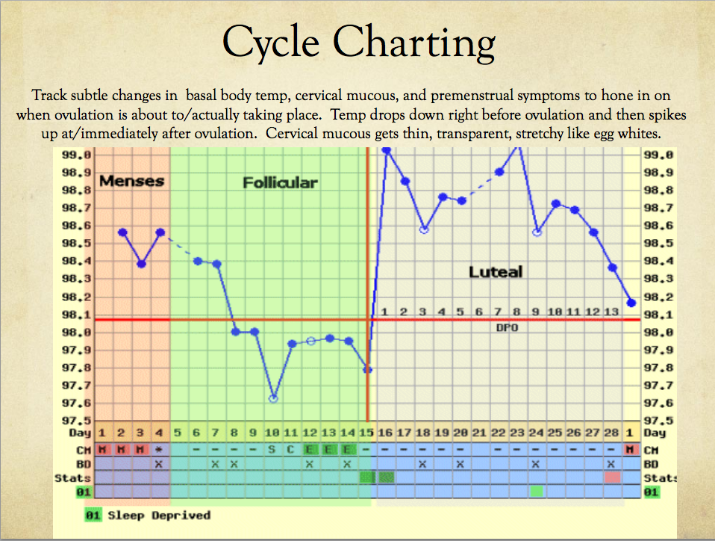

Notes:
The top shows the biphasic temperature pattern, with the BBT being higher after ovulation. The bottom shows the charting of the cervical secretions characteristic. s this method can also be used with online apps.

Slide 62
Sympto-Thermal plus Calendar
Frank-Herrmann et al (2007)
Notes:
Frank-Herrmann, P., Heil, J., Gnoth, C., Toledo, E., Baur, S., Pyper, C., Jenetzky, E., Strowitzki, T., & Freund, G., (2007) The effectiveness of a fertility awareness based method to avoid pregnancy in relation to a couple’s sexual behaviour during the fertile time: a prospective longitudinal study Human Reproduction 22(5) 1310–1319

Slide 63
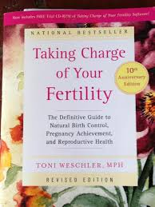
Sympto-thermal Methods: Resources
Symptothermal Methods & Barrier:
  Taking Charge of Your Fertility by Toni Weschler: www.tcoyf.com
  Justisse Healthworks for Women: www.justisse.ca
Symptothermal Method & Abstinence:
  Couple to Couple League: www.ccli.org
  Serena (Canada): www.en.serena.ca
  Northwest Family Services: www.nwfs.org
Notes:
The book entitled Taking Charge of your fertility by Toni Weschler is kind of the bible of fertility awareness methods, and it has been used by many people to teach to themselves
(Manhart, Duane, Lind, Sinai, & Golden-Tevald, 2013)
Weschler, T. (2006). Taking charge of your fertility: the definitive guide to natural birth control, pregnancy achievement, and reproductive health. New York: HarperCollins.

Slide 64
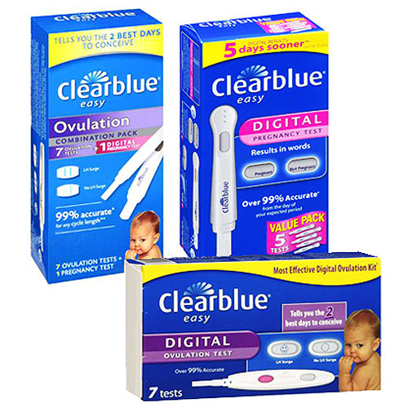
Sympto-hormonal Methods
Efficacy: 2.1% perfect use; 14.2% typical use (Marquette Model)¹
Method of Action:
  Cervical secretions awareness and technology to directly measure reproductive hormones, including estrogen metabolites and LH in the urine
    Example: clear blue easy ovulation predictors: Identifies the start of the fertile period with estrogen metabolites and ovulation with the LH surge. ovulation follows within 24-48hrs.
Cycles: Can be any length and irregular
Teaching: Resources are online for self-teaching.
Resources: Marquette Model
  nfp.marquette.edu
Notes:
Estrogen metabolites are used to identify the onset of the fertile phase and the LH surge identifies ovulation.
Can be Expensive.
Manhart, M. D., Duane, M., Lind, A., Sinai, I., & Golden-Tevald, J. (2013). Fertility awareness-based methods of family planning: a review of effectiveness for avoiding pregnancy using SORT. Osteopathic Family Physician, 5(1), 2-8.
Fehring, R. J., Schneider, M., Raviele, K., & Barron, M. L. (2007). Efficacy of cervical mucus observations plus electronic hormonal fertility monitoring as a method of natural family planning. Journal of Obstetric, Gynecologic, & Neonatal Nursing, 36(2), 152-160.

Slide 65
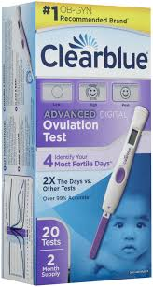
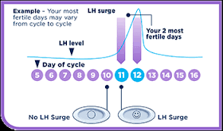
Hormone Detection
Notes:
Detecting estrogen metabolites and LH in the urine; ovulation typically follows within 24-48hrs.

Slide 66

Marquette Model: Charting
Notes:
Marquette University (2016) NFP Quick Instructions for the Marquette Model (Monitor and Mucus). Retrieved from: http://nfp.marquette.edu/inst_monitormucus.php

Slide 67
Calendar-based methods:
  Standard Days Method
  Rhythm Method

Slide 68
Methods based on fertility signs versus calendar-based methods
Cervical Secretion & Combination Methods:
  The determination of the fertile phase is based on observations of physical signs of fertility in real time
  Therefore, cycles can be of any length or regularity
Calendar-based methods:
  The fertile phase is predicted, based on the length of previous cycles, not based on what is happening in real time
  Effective use requires regular cycles
Notes:
As a reminder calendar based methods require that the user have regular cycles.

Slide 69
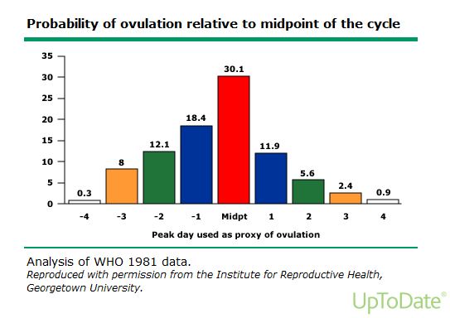
Physiology: Ovulation Timing
96% of ovulations occur within the six days before, during and after the midpoint of the menstrual cycle
Notes:
Germano “in the great majority of cycles, ovulation occurs very close to the middle of the cycle, particularly in cycles between 26 and 32 days long.

Slide 70
Standard Days Method (SDM)
Efficacy: 5% perfect use; 12% typical use
Mechanism of Action: Estimate the “fertile window”
  Uses a standard algorithm to identify fertile days
Cycles: must be 26-32 days
  75% of women have 26-32 day cycles
  Assessment: if yes to both questions, client is likely a good candidate for SDM
    "Do your periods usually come about one month apart?”
    "Do your periods usually come when you expect them?”
  Fertile days are days 8-19 of the person’s cycle. (12 total days)
Teaching: Easy to teach, no calculations, no observation of physical signs
Resources: www.cyclebeads.com & Institute for Reproductive Health at G.U.
Notes:
The Standard Days method estimates the timing of the fertile window.
Cycles: must be 26-32 days. 75% of women have 26-32 day cycles. If the person reports that the periods usually come about a month apart and usually come when expected, that assessment is deemed sufficient for the person to initiate use of the this method.
Thse SDM Very easy to teach and use, no calculations, no observation of physical signs.
The time identified as potentially fertile is 12 days, twice as long as the six days of actual fertility, this is because the calculations take into account fluctuations in cycle length between 26 and 32 days
The Standard Days Method (SDM) determines fertile days using two sets of probabilities: the probability of pregnancy with respect to ovulation and the probability of correctly timing ovulation with respect to the mid-point of the cycle. (UpToDate)
.

Slide 71
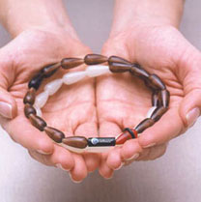
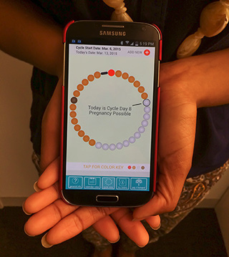
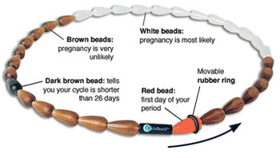
Standard Days Method/Cycle Beads: Tools
iCycleBeads: android and ios apps
www.cyclebeads.com
Notes:
This string of 32 plastic beads has different colors representing the fertile and infertile days of the cycle. It is designed to make it very easy for users to know exactly which where they are in their cycles, without having to write or record any information. The first day of the menses is represented by the red bead. Each day the person moves a small rubber ring from one bead to the next. The fertile days, days 8 through 19, are represented by 12 white beads that glow in the dark. It also serves as a device for communication with the partner.
There is an online app that can be used instead of the physical beads.

Slide 72
Standard Days/Cycle Beads: Evidence Base
Study: Efficacy of a new method of family planning: The Standard Days Method¹
  N=478, Bolivia, Peru, Philippines
  Unintended Pregnancy rate:
    Correct Use: 4.8 per 100 person-years
    Typical-use: 12 per 100 person-years
Other research ¹
  1000 women, Turkey, 12% pregnancy rate in first year of use²
  Method continues to be effective in 2nd-3rd yrs of use³
  14% pregnancy rate⁴
Arevalo Jennings & Sinai 2002; Kurson et al 2014; Sinai et al 2012; Gribble et al 2008
Notes:
The SDM algorithm is based the same data set that we mentioned earlier, data from 7500 cycles collected as part of a clinical trial supported by the World Health Org.
A second clinical trial with nearly 500 women followed, showed here, documented a 95% effectiveness rate with perfect use and an 88% effectiveness rate with TYPICAL use.
----
---------Keeping in mind that with regular intercourse and NO contraceptive use 85% of people will get pregnancy in one year
-----------------------
Arévalo, M., Jennings, V., & Sinai, I. (2002). Efficacy of a new method of family planning: the Standard Days Method. Contraception, 65(5), 333-338.
Kursun, Z., Cali, S., & Sakarya, S. (2014). The Standard Days Method®: Efficacy, satisfaction and demand at regular family planning service delivery settings in Turkey. The European Journal of Contraception & Reproductive Health Care, 19(3), 203-210.
Sinai, I., Lundgren, R. I., & Gribble, J. N. (2012). Continued use of the Standard Days Method®. Journal of Family Planning and Reproductive Health Care, 38(3), 150-156.
Gribble, J. N., Lundgren, R. I., Velasquez, C., & Anastasi, E. E. (2008). Being strategic about contraceptive introduction: the experience of the Standard Days Method®. Contraception, 77(3), 147-154.

Slide 73

Standard Days/Cycle Beads: Evidence Base
Effectiveness claims are based on limited research
Cycles during which there was protected coitus on fertile days were excluded, so results don’t apply to those who have intercourse w barrier methods on fertile days
Study participants used calendar to track menses as well as beads, but it is not promoted that way
More research is needed
Notes:
Marston, C. A., & Church, K. (2016). Does the evidence support global promotion of the calendar-based Standard Days Method® of contraception?. Contraception, 93(6), 492-497.

Slide 74
Calendar Rhythm Method
Efficacy: Likely High failure rate; no well designed clinical trials.
Mechanism of Action: Estimate the “fertile window”
  Chart length of cycles for 6-12 months
  Calculate fertile period:
    Shortest cycle length minus 18
    Longest cycle length minus 11
Teaching: Not frequently taught.
Notes:
The calendar or rhythm method requires that the person determine the length of the last 6 cycles and then use a mathmetical calculation to determine the fertile phase. No well designed trials have been done and this method is generally not taught although you WILL find it all over the internet.
From UpToDate:
Calendar rhythm — In the early decades of the 20th century, it was known that women were more likely to become pregnant at midcycle and that the luteal phase was of a more fixed length than the follicular phase [45]. The calendar rhythm method was developed based on this information.
This method requires that, prior to using the method, the woman determine the length of her last six cycles and then subtract 18 from the number of days in her shortest cycle and 11 from the number of days in her longest cycle. This determines her fertile period, when unprotected intercourse should be avoided. As an example, if her shortest cycle is 26 days and her longest cycle is 34 days, then her fertile period is from day 8 to 23.
While undoubtedly serving to prevent many unplanned pregnancies, calendar rhythm resulted in high failure rates because it required the user to maintain records of cycle length prior to and during method use, involved arithmetical calculations each cycle, had no eligibility criteria, and had poorly-defined parameters. No well-designed efficacy trials of the calendar rhythm method have been conducted, and generally it is not offered in clinical services today

Slide 75
FAB Resources

Slide 76
Apps for FAB
Nearly 100 Apps exist for cycle tracking, many do not use evidence-based FAB methods
Six shown to have either a perfect score on accuracy (app-defined fertile days = evidence-based fertile days) or no false negatives (no days of fertility classified as infertile).
  Ovulation Mentor
  Sympto.org
  iCycleBeads
  LilyPro
  Lady Cycle
  mfNFP.net
Use of Natural Cycles app in > 4000 women:
  Retrospective analysis
  Typical use Pearl Index: 7.0
  Perfect use: 0.5
Duane et al, 2016;Scherwitzl et al 2016
Notes:
Review of 95 Apps:
55 apps excluded because they either had a disclaimer prohibiting use for avoiding pregnancy or did not claim to use an evidence-based FAB as described in Manhart et al.
Duane, M., Contreras, A., Jensen, E., & White, A. (2016) The Performance of Fertility Awareness-based Method Apps Marketed to Avoid Pregnancy. Journal of the American Board of Family Medicine. 29 (4), 508-511

Slide 77
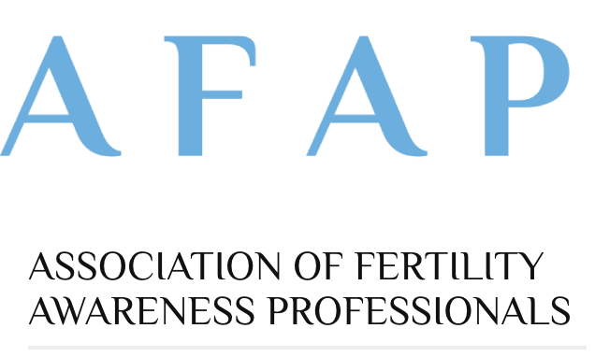

Reproductive justice: “a core part of our mission”
Aiming to improve access to high-quality FAM instruction, professionalize the field of FAM educators by providing certification and ongoing education
Maintain a list of highly qualified instructors
Notes:
Professional membership group…

Slide 78

www.factsaboutfertility.org
Good science, evidence based papers on FAM,
Aiming education at providers
The majority of the staff are religiously affiliated and anti-abortion. Strong belief in abstinence during fertile days
  Director
    Works for an org that promotes virginity in teens (TeenSTAR)
    Former medical director at a Catholic Hospital
Notes:
Director: Did family medicine clerkship at Georgetown Univ. , MD from SUNY and works w TeenSTAR, teaching fertility patterns to teens to teach responsible decision-making and communication skills in the area of sexual behavior…http://www.teenstar.org/page.asp?DH=4
One persons concerns regarding a recent symposium hosted by FACTS: http://chelseapolis.com/1/post/2015/11/when-a-scientific-meeting-on-contraception-is-not-so-scientific.html

Slide 79
Fertility Awareness, Abstinence & Withdrawal
Abstinence & Withdrawal
Cynthia Belew, CNM, WHNP-BC
Associate Clinical Professor
UCSF School of Nursing
Elizabeth Donnelly, CNM, WHNP-BC

Slide 80
Withdrawal

Slide 81
Withdrawal
Definition: Penis is withdrawn from vagina & external genitalia before ejaculation.
Efficacy: Perfect use 4% and with typical use: 18-27%
It is a commonly used method.²
  56% report ever using it.
  5%-21% current use
  Many people use it concurrent with another method and this use is not always noted in research.
  Compare to Condoms: 2% perfect use; 18% typical use
Notes:
1 Contraceptive Tech.
2 Jones, Fennell, Higgins, & Blanchard, 2009
From the Jones, Fennell, Higgins, & Blanchard (2009) paper: The field of family planning has a distinct lack of enthusiasm for withdrawal despite it’s comparative effectiveness. Respondents to surveys do not consider it a contraceptive so don’t report it. Also, in surveys, if someone reports withdrawal but also another method they are categorized as using the more effective method
How is perfect use for withdrawal defined? “Our estimate of the proportion of women becoming pregnant during a year of perfect use of withdrawal is a guess based on the reasoning that the risk of pregnancy resulting from pre-ejaculatory fluid is modest. Although three studies found no motile sperm in the pre-ejaculate [19–21], the most recent study did not replicate this result, perhaps because the samples were examined within 2 min of production [22]. In that study, 37% of subjects produced pre-ejaculatory samples that contained motile sperm, and the sperm concentration and the percentage of motile sperm were similar in an individual's pre-ejaculatory and ejaculatory specimens. However, the actual number of sperm in the pre- ejaculate was low.” (Trussell, Henry, Hassan, Prezioso, Law, & Filonenko, 2013)

Slide 82
Does pre-ejaculate contain sperm?
Several small studies have reported that no sperm is found in pre-ejaculatory fluid.
More recent well designed study “Sperm Content of Pre-ejaculatory Fluid” found:¹
  N=27; samples examined within 2 minutes of collection.
  37% of samples contained motile sperm in with concentration and motility to what would be regarded as fertile.
  Actual number of sperm in pre-ejaculates was low.
  Of the participants who produced sperm in pre-ejaculate, they always produced sperm in pre-ejaculate while those who didn’t never did.
  “we are unable to say how this finding might translate into the chances of pregnancy…except that the chances would not be zero”
Notes:
“Although our pre-ejaculatory samples often contained sperm with equivalent concentration and motility to what would be regarded as fertile in ejaculatory samples, the actual number of sperm in the pre-ejaculates was very low. We are unable to say how this finding might translate into the chances of pregnancy if these samples of pre-ejaculate were deposited in the vagina except that the chances would not be zero. All but one of our pre-ejaculatory samples contained fewer than 23 million sperm, and values as low as this were seen in ejaculatory samples of less than 2.5% of men whose partners conceived in less than 1 year (Cooper et al., 2010). We did not, however, ask our volunteers to attempt to collect all their pre-ejaculatory secretions but merely to obtain a drop on a Petri dish, and it is possible that some of them emitted more than was collected.”
older studies did not report the time interval to analysis,
1. Killick, S. R., Leary, C., Trussell, J., & Guthrie, K. A. (2011). Sperm content of pre-ejaculatory fluid. Human Fertility, 14(1), 48-52.

Slide 83
Withdrawal: Efficacy & Socio-economic factors
Kost, Singh, Vaughan, Trussell, & Bankole (2008) found significant differences in efficacy of withdrawal based on social and economic factors such as:
  Women who intend to have future births or are unsure of their intentions: ~3 x more likely to become pregnant than users who don’t want future pregnancy.
  Users who have never been married: >2x more likely to become pregnant than users who have ever been married.
  Parous users are more likely to become pregnant the nulliparous users
  Women living below or near poverty: ~2x more likely to become pregnant than women whose family incomes are at least double the poverty threshold.
Notes:
“Women who intend to have future births or are unsure of their intentions are roughly 3 times as likely to become pregnant while using withdrawal as those who do not intend a future birth (Table 4), and withdrawal users who have never been married are more than twice as likely to experience a failure as users who have ever been married. As during use of the pill and condom, nulliparous withdrawal users are about a quarter as likely to experience a failure as those who have had a birth. And, women living below or near poverty and relying on the withdrawal method experience almost twice the risk of failure as women whose family incomes are at least double the poverty threshold.” (Kost, Singh, Vaughan, Trussell, & Bankole, 2008)

Slide 84
Instructions for patient use:
Practice withdrawal with back-up method until both partners master technique
Urinate and wipe penis clean of pre-ejaculate fluid prior to vaginal penetration between consecutive acts of intercourse
Use coital positions that ensure man will be able to withdraw easily at appropriate time
Consider using Emergency contraception if withdrawal fails

Slide 85
Withdrawal Pros & Cons
Pros:
Requires partner cooperation and instruction.
Convenient, always available.
No prior planning needed - no prescription or clinic visit needed.
No cost.
No hormonal effects.
Cons:
Requires partner cooperation and instruction.
May not be applicable for couples with sexual dysfunction (and adolescents).
No STI protection.
May reduce sexual pleasure of woman and intensity of orgasm for man.
Relatively high failure rate among typical users.

Slide 86
Withdrawal: Take-away message
Your patients may be relying on this method, even if they do not report it.
It is a legitimate if slightly less effective method, similar in effectiveness to condoms & diaphragms.
  Efficacy comparisons¹:
Method | Perfect Use | Typical Use
Withdrawal | 96% | 73-82%
Condoms | 98% | 82%
Diaphragm | 94% | 88%
Hatcher, 2011
Notes:
Jones Fennell Higgins & Blanchard 2009
“it is unfortunate that some couples do not realize they are substantially reducing risk of pregnancy when using withdrawal…these misperceptions may cause unnecessary levels of anxiety”
“Encouraging sexually active men and women to reduce their risk through a number of different mechanisms could be a more realistic and effective approach than insisting upon correct and consistent condom use during every sexual encounter”
1 Hatcher, R., Trussell, J., Nelson, A., Cates, W., Kowa, D., & Policar, M., (2011). Contraceptive Technology. Ardent Media.

Slide 87
Abstinence

Slide 88
Abstinence
Definition: No standard definition¹
  Refrain from all sexual activity including masturbation.
  Refrain from sexual activity including genital contact.
  Refrain from penetrative sexual activity.
  Refrain from penile-vaginal intercourse
Efficacy: no research². Can safely say when 0% risk of pregnancy with perfect use.
Counseling considerations:
  How does the patient/client define abstinence?
  Consider STI risk discuss safer-sex practices for other sexual activities.
  Consider having a back-up method and or emergency contraception available.
Hatcher, 2011; Santelli et al, 2006
Notes:
Hatcher, R., Trussell, J., Nelson, A., Cates, W., Kowal, D., & Policar, M., (2011). Contraceptive Technology. Ardent Media.
Santelli, J., Ott, M. A., Lyon, M., Rogers, J., Summers, D., & Schleifer, R. (2006). Abstinence and abstinence-only education: a review of US policies and programs. Journal of Adolescent Health, 38(1), 72-81.

Slide 89
Abstinence: Patient Education
Communication with partner
  Important to learn negotiating skills:
  How to say no or “not now” and how to resist peer (societal) pressure
  Recommend that she ensure that partner explicitly agrees to abstain
Alternative forms of sexual pleasuring
  masturbation and outercourse
Sexually transmitted infections:
  Think about having partner tested for STIs
Time Frame
  Abstinence may just be a decision to delay intercourse. Does it may mean “not now” or does it mean “never”.
  Client may use or return to abstinence at any time in life (primary vs. secondary abstainers)
Obtain info about contraceptive methods for the future:
  Consider having a method to have on hand in case the clients wants to have sex at some point (condoms)
  Consider having Emergency Contraception (Plan B) available.

Slide 90
Test your knowledge!
Can a women get pregnant while menstruating?
Which phase of the menstrual cycle is typically more consistent?
What normal events can cause variability in Follicular phase?
What are two signs of fertility?
In order to conceive from sexual intercourse, three things are required: sperm, a mature egg and ________
Cervical Secretion methods should only be used by people whose cycle is regular? T/F
Prior to ovulation a woman’s basal body temperature is warmer or cooler than after ovulation?
Notes:
A women can get pregnant while menstruating: True. Women can produce cervical secretions during menses and it can nourish sperm for up to five days. If she has a very short cycle, i.e. a 20 day cycle she would ovulate on day 7.
luteal phase (11-16d)
Breastfeeding; perimenoupause; stress; normal variations etc.
Cervical secretions – the texture, color and consistency changes under the influence of hormones. And BBT: the temp of the body at rest rises by at least 2/10 degree F or 0.3 degrees Celcius and remains elevated after ovulation.
Cervical secretions: Sperm are incapable of survival and transport to the egg in the absence of sufficient levels of estrogen-type secretions. (Sarpa, Dunson, & Colombo, 2006)
False! All of the methods that rely on cervical secretions can be used by people with irregular cycles.
Cooler

Slide 91
References

Slide 92
References
Arévalo, M., Jennings, V., Nikula, M., & Sinai, I. (2004). Efficacy of the new TwoDay Method of family planning. Fertility and Sterility, 82(4), 885-892.
Arévalo, M., Jennings, V., & Sinai, I. (2002). Efficacy of a new method of family planning: the Standard Days Method. Contraception, 65(5), 333-338.
Attar, E., Gokdemirel, S., Serdaroglu, H., & Coskun, A. (2002). Natural contraception using the Billings ovulation method. The European Journal of Contraception & Reproductive Health Care, 7(2), 96-99.
Balsa, A. I., McGuire, T. G., & Meredith, L. S. (2005). Testing for statistical discrimination in health care. Health services research, 40(1), 227-252.
Barbieri, R (2015) Barrier contraception: Diaphragm Up To Date Retrieved from: http://www.uptodate.com.ucsf.idm.oclc.org/contents/barrier-contraception-diaphragm?source=machineLearning&search=caya+diaphragm&selectedTitle=1~150&sectionRank=1&anchor=H6#H6
Barrett, J. B., DaVanzo, J., Ellison, C. G., & Grammich, C. (2014). Religion and Attitudes Toward Family Planning Issues Among US Adults. Review of Religious Research, 56(2), 161-188.
Berglund Scherwitzl, E., Gemzell Danielsson, K., Sellberg, J. A., & Scherwitzl, R. (2016). Fertility awareness-based mobile application for contraception. European Journal of Contraception & Reproductive Health Care, 21(3), 234-241.
Bigelow, J. L., Dunson, D. B., Stanford, J. B., Ecochard, R., Gnoth, C., & Colombo, B. (2004). Mucus observations in the fertile window: a better predictor of conception than timing of intercourse. Human reproduction, 19(4), 889-892.

Slide 93
References
Biggs, M. A., Karasek, D., & Foster, D. G. (2012). Unprotected intercourse among women wanting to avoid pregnancy: attitudes, behaviors, and beliefs. Women's Health Issues, 22(3), e311-e318.
Bixby center for Global Reproductive Health (2015) Changing the Conversation: Shared Decision Making in Reproductive Health. Innovating education in reproductive health. Retrieved from: http://innovating-education.org/2016/04/changing-the-conversion-shared-decision-making-in-reproductive-health/
Center for Disease Control and Prevention (CDC) (2016) Effectiveness of Contraceptive Methods. Contraception. Retrieved from: http://www.cdc.gov/reproductivehealth/UnintendedPregnancy/Contraception.htm
Corkill, M., & Marshell, M. (2008) How to treat.: Natural fertility regulation — The Billings Ovulation Method Australian Doctor. Retrieved from: http://naturalfamilyplanning.sg/site/wp-content/uploads/2010/10/BOM-publication-19Dec08.pdf
CreightonModel.com Creighton Model Fertility Care System retrieved from: http://www.creightonmodel.com/index.html
Delendorf, C., Biftu., & Angeline T. (2016) Improving Contraceptive Counseling through Shared Decision-Making Curriculum. Retrieved from: http://innovating-education.org/2016/03/2743/
Duane, M., Contreras, A., Jensen, E., & White, A. (2016) The Performance of Fertility Awareness-based Method Apps Marketed to Avoid Pregnancy. Journal of the American Board of Family Medicine. 29 (4), 508-511
Duane, M., Motley, R., & Manhart, M. (2013). Physicians need more education about natural family planning. American family physician, 88(3), 158-9

Slide 94
References
Fehring, R. J. (2002). Accuracy of the peak day of cervical mucus as a biological marker of fertility. Contraception, 66(4), 231-235
Festin, Mario Philip R., et al. "Moving towards the goals of FP2020–Classifying contraceptives." Contraception (2016).
Frank-Herrmann, P., Heil, J., Gnoth, C., Toledo, E., Baur, S., Pyper, C., ... Freundl, G. (2007). The effectiveness of a fertility awareness based method to avoid pregnancy in relation to a couple's sexual behaviour during the fertile time: a prospective longitudinal study. Human reproduction, 22(5), 1310-1319.
Gallo, M. F., Grimes, D. A., Schulz, K. F., & Lopez, L. M. (2002). Cervical cap versus diaphragm for contraception. The Cochrane Library.
Gauthier I., & Vinebaum, L. (1994) HotPantz. Retrieved from: https://www.indybay.org/newsitems/2010/04/06/18643940.php
Gomez, A. M., Fuentes, L., & Allina, A. (2014). Women or LARC first? Reproductive autonomy and the promotion of long-acting reversible contraceptive methods. Perspectives on sexual and reproductive health, 46(3), 171.
Gribble, J. N., Lundgren, R. I., Velasquez, C., & Anastasi, E. E. (2008). Being strategic about contraceptive introduction: the experience of the Standard Days Method®. Contraception, 77(3), 147-154.
Gubrium, A. C., Mann, E. S., Borrero, S., Dehlendorf, C., Fields, J., Geronimus, A. T., ... & Luker, K. (2016). Realizing reproductive health equity needs more than long-acting reversible contraception (LARC). American journal of public health, 106(1).

Slide 95
References
Guzman, L., Caal, S., Peterson, K., Ramos, M., & Hickman, S. (2013). The use of fertility awareness methods (FAM) among young adult Latina and black women: what do they know and how well do they use it? Use of FAM among Latina and black women in the United States. Contraception, 88(2), 232-238.
Haimov-Kochman, R., & Hochner-Celinkier, D. (2007). Contraceptive counseling for orthodox Jewish women. The European Journal of Contraception & Reproductive Health Care, 12(1), 13-18.Hatcher, R., Trussell, J., Nelson, A., Cates, W., Kowal, D., & Policar, M., (2011). Contraceptive Technology. Ardent Media.
Institute for Reproductive Health at Georgetown University (2016) TwoDay Method Family Planning Presentation. retrieved from: http://irh.org/?s=TwoDay&search_type=resource&country=&paged=3
Jackson, A. V., Karasek, D., Dehlendorf, C., & Foster, D. G. (2016). Racial and ethnic differences in women's preferences for features of contraceptive methods. Contraception, 93(5), 406-411.
jenna (July 20, 2013) Unreproductive: Zines on Herbal Abortion and Menstrual Extraction. ZineLibraries.info retrieved from: http://zinelibraries.info/2013/07/20/unreproductive/
Johnson, C. G., (2013, July 7) Female inmates sterilized in California prisons without approval. The Center for Investigative Reporting. Retrieved from: http://cironline.org/reports/female-inmates-sterilized-california-prisons-without-approval-4917

Slide 96
References
Jones, R. K., Fennell, J., Higgins, J. A., & Blanchard, K. (2009). Better than nothing or savvy risk-reduction practice? The importance of withdrawal. Contraception, 79(6), 407-410.Kellogg Spadt, S., Rosenbaum, T. Y., Dweck, A., Millheiser, L., Pillai‐Friedman, S., & Krychman, M. (2014). Sexual health and religion: a primer for the sexual health clinician (CME). The journal of sexual medicine, 11(7), 1606-1619.
Kelly, P. J., Witt, J., McEvers, K., Enriquez, M., Abshier, P., Vasquez, M., & McGee, E. (2012). Clinician perceptions of providing natural family planning methods in Title X funded clinics. Journal of Midwifery & Women’s Health, 57(1), 35-42.
Killick, S. R., Leary, C., Trussell, J., & Guthrie, K. A. (2011). Sperm content of pre-ejaculatory fluid. Human Fertility, 14(1), 48-52.
Kost, K., Singh, S., Vaughan, B., Trussell, J., & Bankole, A. (2008). Estimates of contraceptive failure from the 2002 National Survey of Family Growth. Contraception, 77(1), 10-21.
Kursun, Z., Cali, S., & Sakarya, S. (2014). The Standard Days Method®: Efficacy, satisfaction and demand at regular family planning service delivery settings in Turkey. The European Journal of Contraception & Reproductive Health Care, 19(3), 203-210.
Kuyoh, M. A., Toroitich‐Ruto, C., Grimes, D. A., Schulz, K. F., Gallo, M. F., & Lopez, L. M. (2002). Sponge versus diaphragm for contraception. The Cochrane Library.
Leonard, C. J., Chavira, W., Coonrod, D. V., Hart, K. W., & Bay, R. C. (2006). Survey of attitudes regarding natural family planning in an urban Hispanic population. Contraception, 74(4), 313-317.

Slide 97
References
Malarcher, S., Spieler, J., Fabic, M. S., Jordan, S., Starbird, E. H., & Kenon, C. (2016). Fertility Awareness Methods: Distinctive Modern Contraceptives. Global health: science and practice, 4(1), 13-15.
Manhart, M. D., Duane, M., Lind, A., Sinai, I., & Golden-Tevald, J. (2013). Fertility awareness-based methods of family planning: a review of effectiveness for avoiding pregnancy using SORT. Osteopathic Family Physician, 5(1), 2-8.
Marquette University (2016) NFP Quick Instructions for the Marquette Model (Monitor and Mucus). Retrieved from: http://nfp.marquette.edu/inst_monitormucus.php
Marston, C. A., & Church, K. (2016). Does the evidence support global promotion of the calendar-based Standard Days Method® of contraception?. Contraception, 93(6), 492-497.
McKee, C. (2016, April 13) CMS Highlights State Policies to Improve Access to Long-Acting Reversible Contraceptive Methods. National Health Law Program Legal and Policy Matter. Retrieved from: http://www.healthlaw.org/issues/reproductive-health/LARC-issue-brief#.V4G1L6673KJ
Metzl, J. M., & Hansen, H. (2014). Structural competency: Theorizing a new medical engagement with stigma and inequality. Social Science & Medicine, 103, 126-133.
National Conference of State Legislatures (200) Family Cap Policies. Retrieved from http://www.ncsl.org/research/human-services/welfare-reform-family-cap-policies.aspx
Nettleman, M D, Chung, H, Brewer, J, et al. (2007). Reasons for unprotected intercourse: analysis of the PRAMS survey. Contraception, 75(5), 361-6.

Slide 98
References
Pope Paul VI Institute (2016) Welcome to the Home of FertilityCare and NaProTechnology! Retrieved from: http://www.popepaulvi.com/about.php
Roberts, D. (2014). Killing the black body: Race, reproduction, and the meaning of liberty. New York: Vintage.
Roney, J. R., & Simmons, Z. L. (2013). Hormonal predictors of sexual motivation in natural menstrual cycles. Hormones and Behavior, 63(4), 636-645.
Scarpa, B., Dunson, D. B., & Colombo, B. (2006). Cervical mucus secretions on the day of intercourse: an accurate marker of highly fertile days. European journal of obstetrics & gynecology and reproductive biology, 125(1), 72-78.
  Sinai, I., Lundgren, R. I., & Gribble, J. N. (2012). Continued use of the Standard Days Method®. Journal of Family Planning and Reproductive Health Care, 38(3), 150-156.
  sonia (April 29,2010) Menstrual Health, Abortion Options, STI’s and General D.I.Y. Health/Self-Care A-M. The Mimi Zine Distro. A Feminist Zine Distro Promoting D.I.Y. Health Care. Retrieved from: https://mimizinedistro.wordpress.com/menstrual-health-abortion-options-sti%E2%80%99s-and-general-d-i-y-healthself-care-a-g/
  Stanford, J., Lemaire, J., & Thurman, P. (1998). Women's interest in natural family planning. The Journal of family practice, 46(1), 65-71.
  Stern, A (January 7, 2016) That Time The United States Sterilized 60,000 Of Its Citizens. Politics. The Huffington Post. Retrieved from http://www.huffingtonpost.com/entry/sterilization-united-states_us_568f35f2e4b0c8beacf68713

Slide 99
References
The Church of Jesus Christ of Latter-Day Saints (2010) Birth Control. Retrieved from: https://www.lds.org/topics/birth-control?lang=eng
Trussell, J., Henry, N., Hassan, F., Prezioso, A., Law, A., & Filonenko, A. (2013). Burden of unintended pregnancy in the United States: potential savings with increased use of long-acting reversible contraception. Contraception, 87(2), 154-161.
United States Conference of Catholic Bishops. Natural Family Planning. Marriage and Family Retrieved from: http://www.usccb.org/issues-and-action/marriage-and-family/natural-family-planning/
Vogelsong Kirsten M. 2009. Natural Contraceptive Methods. Geneva Foundation for Medical Education and Research, accessed here: http://www.gfmer.ch/Endo/Lectures_11/Naturalc.htm
Weschler, T. (2006). Taking charge of your fertility: the definitive guide to natural birth control, pregnancy achievement, and reproductive health. New York: HarperCollins.
Wilcox, A. J., Dunson, D., & Baird, D. D. (2000). The timing of the “fertile window” in the menstrual cycle: day specific estimates from a prospective study. Bmj, 321(7271), 1259-1262.
Wilcox, A. J., Weinberg, C. R., & Baird, D. D. (1995). Timing of sexual intercourse in relation to ovulation—effects on the probability of conception, survival of the pregnancy, and sex of the baby. New England Journal of Medicine, 333(23), 1517-1521.

