Slide 1
Contraception 101
Michalle Ramirez-McLaughlin, RN, MS, FNP-BC
Assistant Clinical Professor
University of California, San Francisco
Notes:
Hello, my name is Michalle Ramirez-McLaughlin, I’m a Family Nurse Practitioner and an Assistant Clinical Professor at UCSF. I’m going to be giving you a brief overview of the contraceptive methods available in the US, as well as key counseling points for your patient.

Slide 2
Getting started
History and determine any contraindication
  CDC or WHO Medical Eligibility Criteria for Contraceptive Use
Shared decision making
  Just ask about your patient’s preferences
Notes:
Before launching into the different methods, I’d like to first review my approach to counseling patients about their contraceptive options. Always start by obtaining a good history and determining if there are any contraindications. If you have any concern about specific conditions, please refer to the CDC or WHO’s Medical Eligibility Criteria for Contraceptive Use. I then use a shared decision making model to help the patient find the best method that works for them at this point in their life. It is important to avoid making assumptions about a person’s priorities regarding their contraception, so just ask. “What do you want out of their birth control method?” Or “What’s important to you in your contraceptive method?” You may inquire about what they’ve used and liked or disliked in the past, and if and when they want another child. Then tailor your counseling to provide information about the methods that best suit their needs. As you go through the methods it’s important to highlight the benefits of the method, as well as any side effects, especially when it comes to changes in bleeding pattern.

Slide 3
Notes:
Keeping that in mind, for patients in my practice for whom effectiveness is a high priority, I use this tool, called a tiers of efficacy chart. This one is published by Bedsider and there are similar tools widely available. I highly recommend using this type of visual aid when helping patients find the right contraceptive for them. This table breaks down the different methods by efficacy, with the most effective ones at the top and the less effective ones at the bottom. I generally start at the top and work my way down, but I will change the way I go through the chart according to patient preferences. For example, if a person does not want a procedure done, I skip the first tier altogether.
This approach also lets you inform patients how often they have to interact with their birth control. With the methods at the top you put it in place and forget about it until it is removed. As you move down the chart the frequency of use is greater.

Slide 4
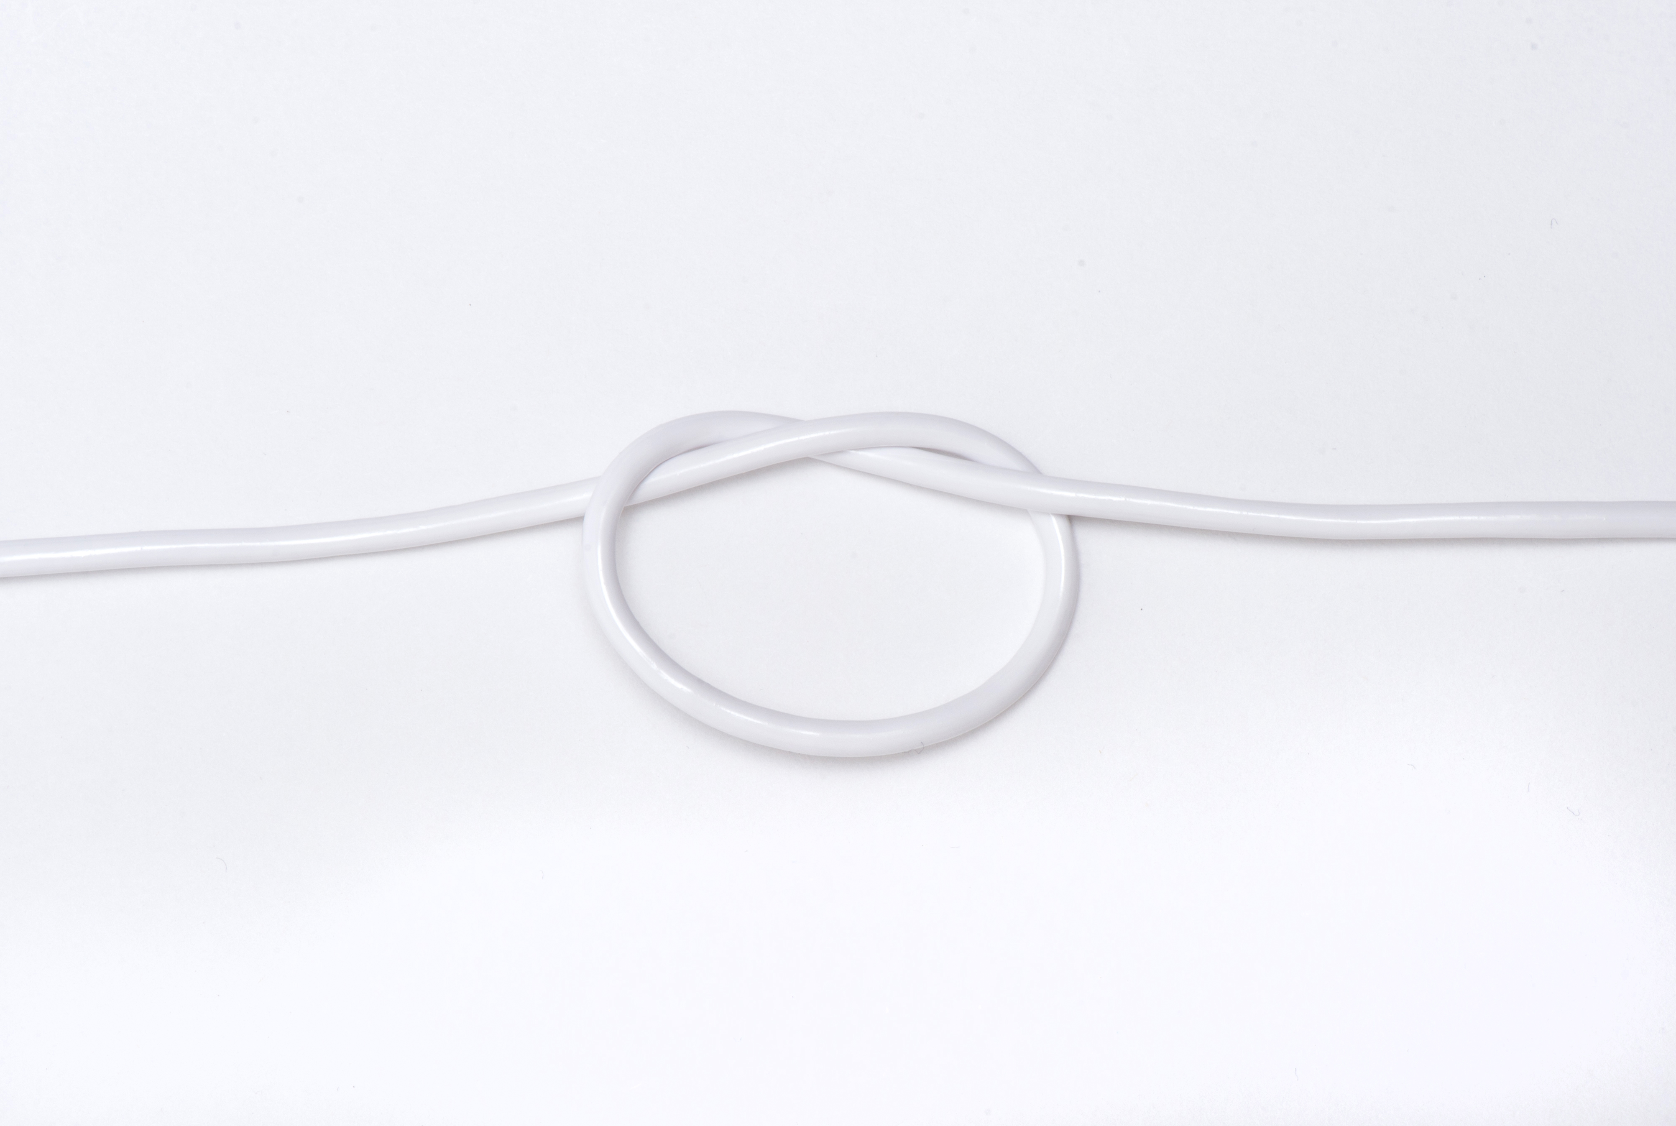
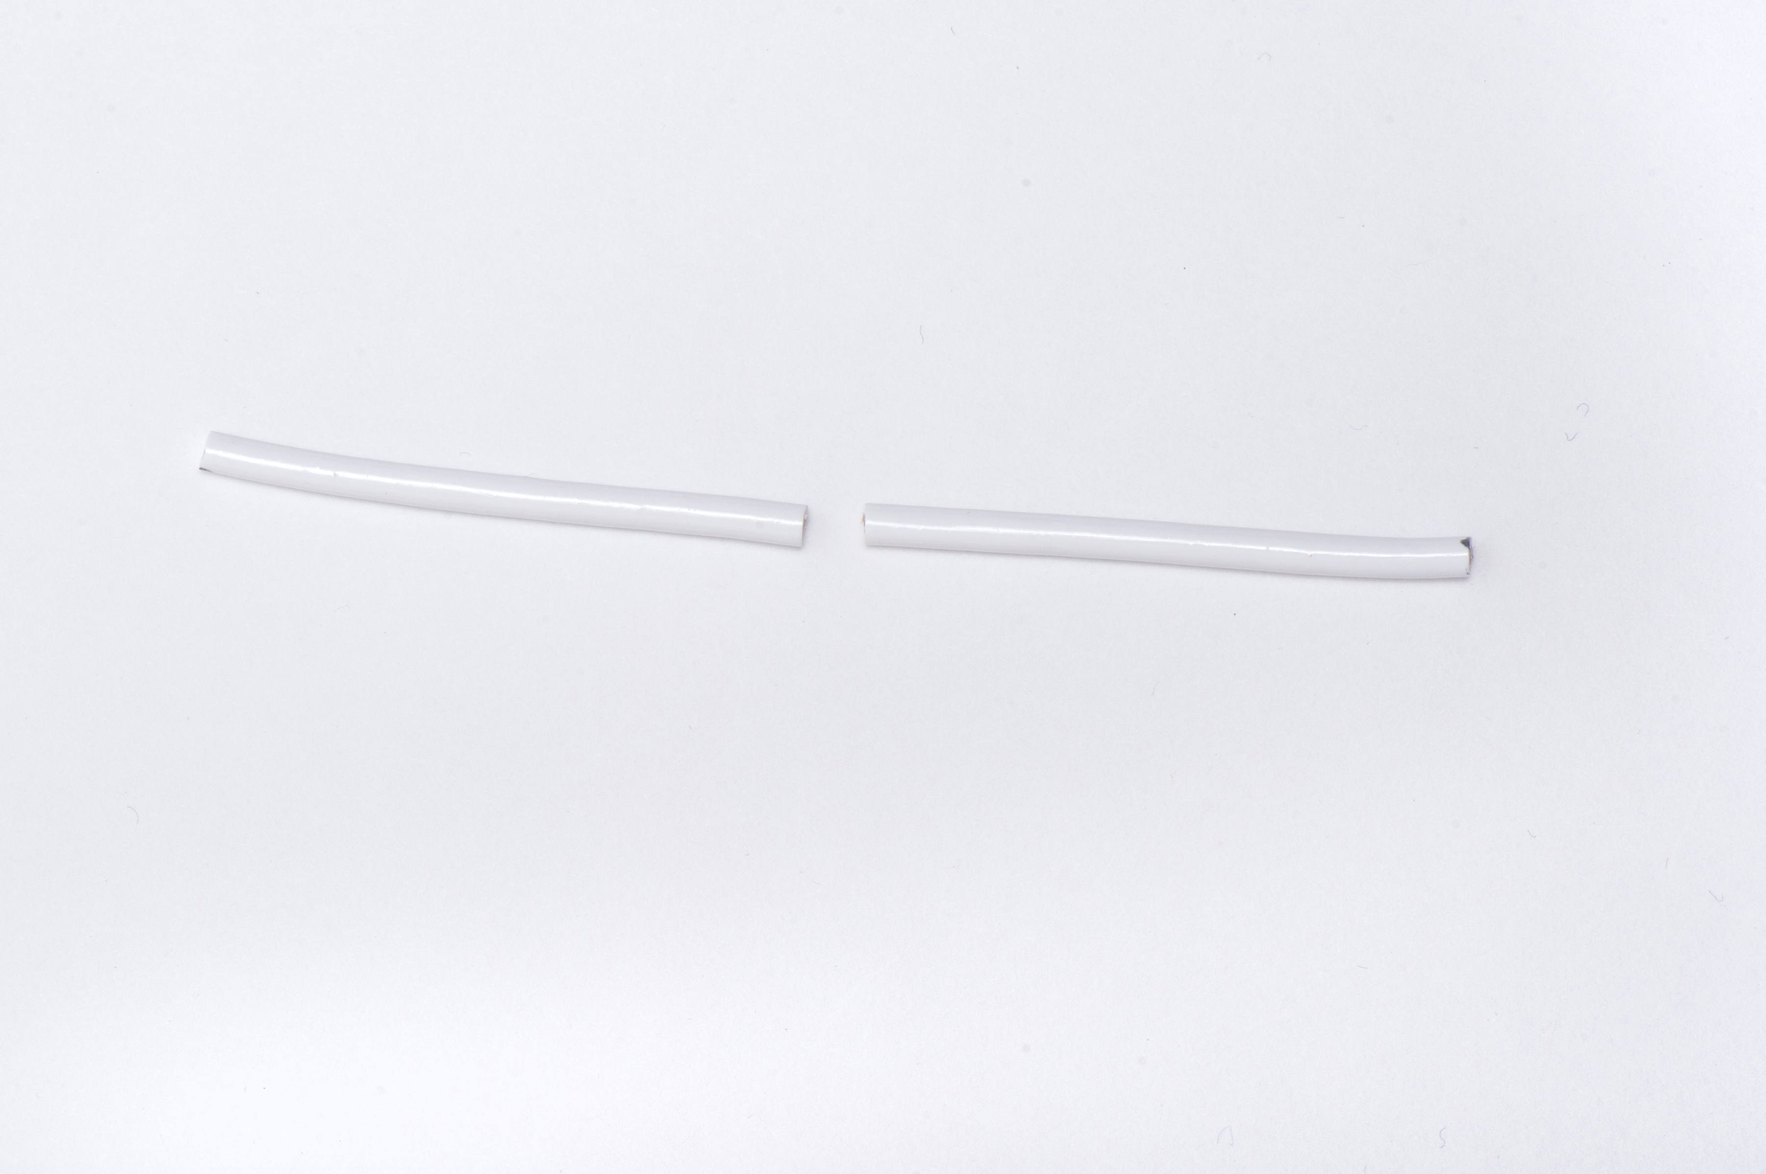
Permanent Contraception
Tubal Ligation
Vasectomy
Notes:
Permanent contraception refers tubal ligation and vasectomy. It is one of the most common methods of contraception in the US and worldwide. Tubal ligation is a surgical procedure done under anesthesia in which the fallopian tube is cut, occluded, or removed to prevent the egg and sperm from meeting. It is a very safe and effective with few side effects except for risks related to the surgery itself as well as an increased risk for ectopic pregnancy if this method were to fail. Vasectomies are just as effective as tubal ligation, and are even simpler and safer since they are done under local anesthesia. In this procedure, the vas deferens is cut so the sperm cannot pass into the ejaculate. It’s important to stress that these procedures are considered permanent. Reversal surgeries are complex, costly and do not guarantee a return to fertility.

Slide 5
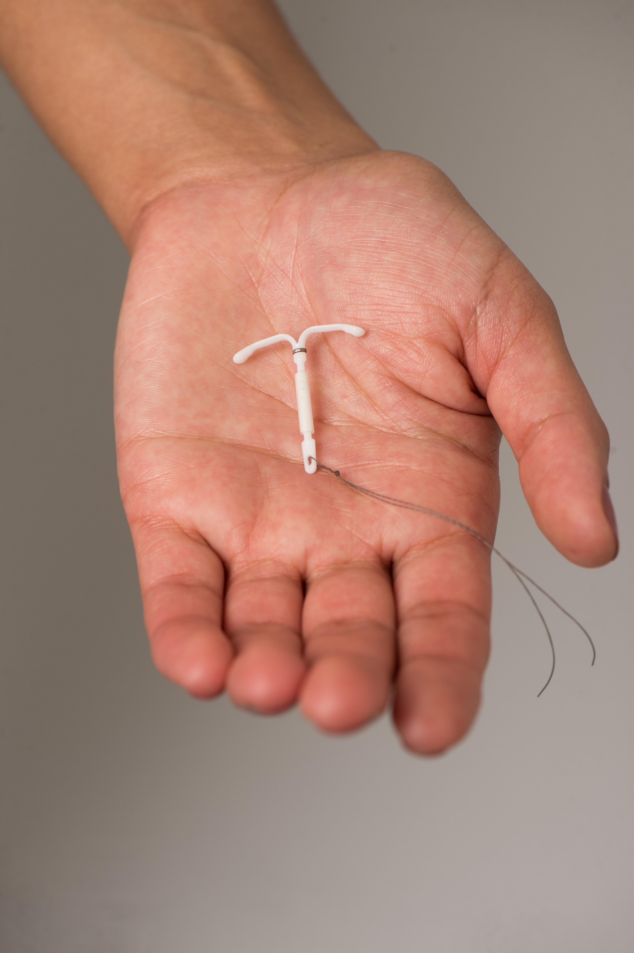
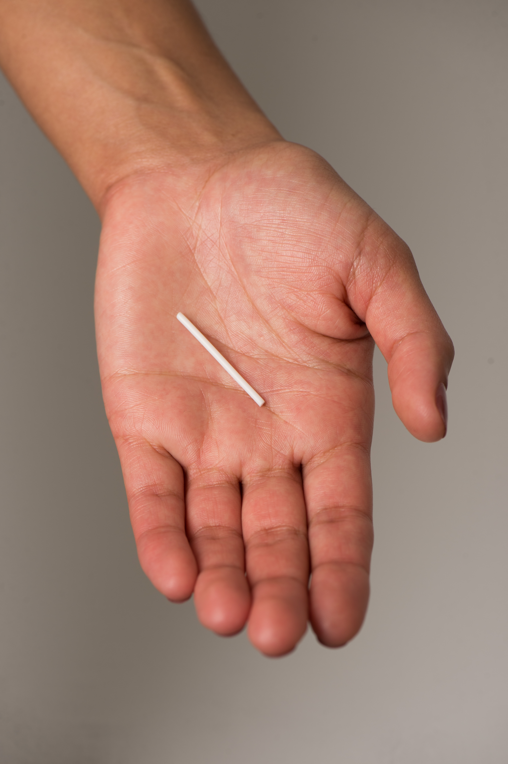
Long Acting Reversible Contraceptives
Copper IUD
Levonorgestrel IUDs
Etonogestrel Implant
Notes:
Long Acting Reversible Contraceptives also known as LARCs. These are the intrauterine contraceptives (IUD) and the implant. These methods are the most effective reversible contraceptives, with fewer than 1 pregnancy per 100 women in 1 year. They are safe and offer a quick return to fertility, but they must be inserted and removed by a medical provider in the office. I’ll go into a little more detail about each one.

Slide 6
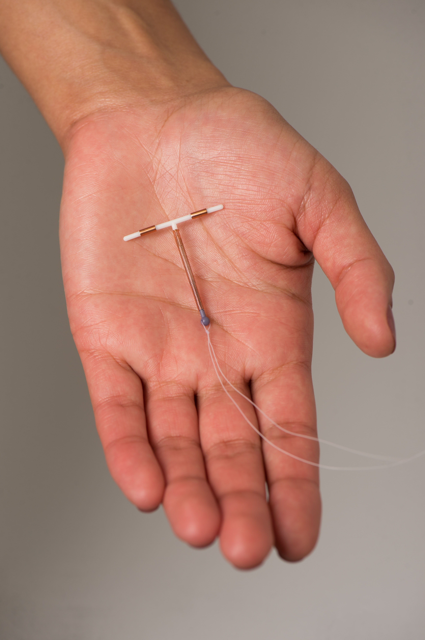
Copper IUD
99% effective
Non-hormonal
Lasts 10-12 years
Medical visit required for insertion and removal
Longer heavier periods are common
Notes:
The copper IUD (brand name Paragard) is a T shaped device that’s inserted into the uterus. It’s effective for 10 years, with good data showing it can be used for up to 12 years. It’s non-hormonal which is great for people who cannot use hormones or have had side effects with hormones. The copper in the IUD is toxic to sperm preventing fertilization, it also makes it more difficult for a fertilized egg to implant. Patients using this method will continue to have periods, with the main side effect being longer, sometimes heavier bleeding.

Slide 7
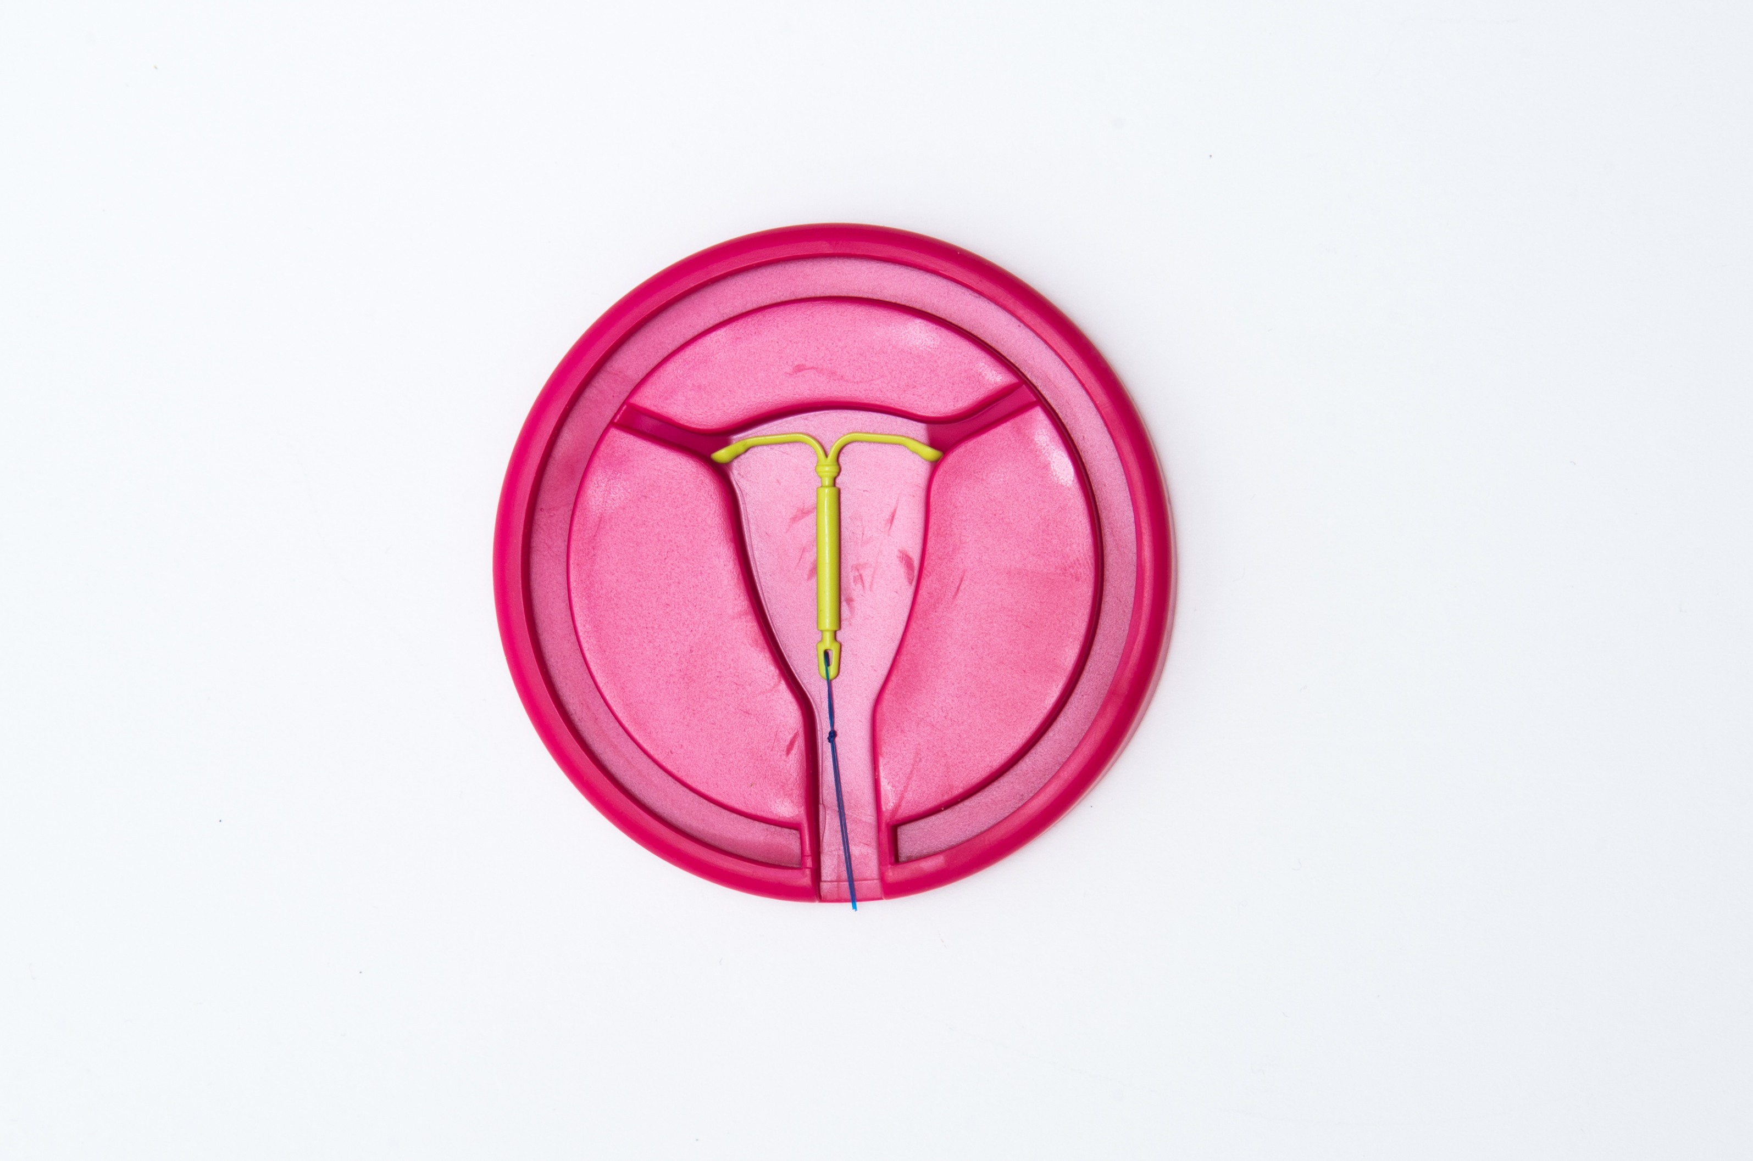
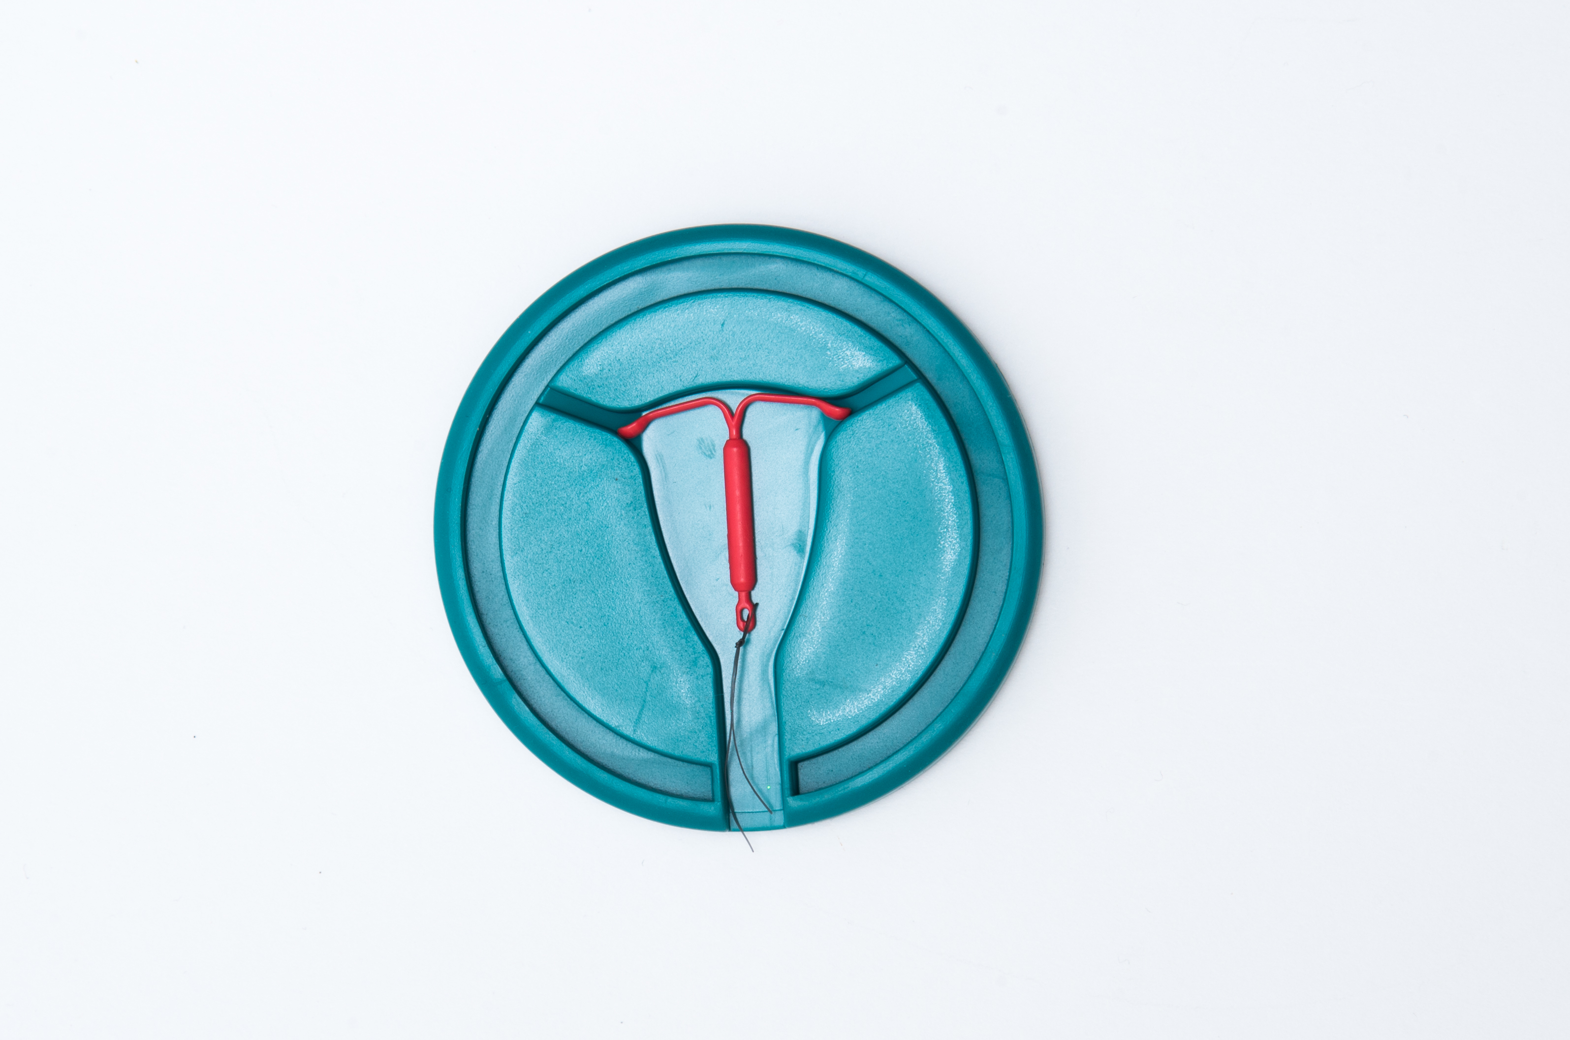
Levonorgestrel IUDs
99% effective
Lighter, shorter periods or no periods
Approved for 3-5 years, evidence shows up to 7 years
Medical visit required for insertion and removal
Irregular spotting common in first 3-6 months of use
Notes:
There are various types of hormonal IUDs sold under various brand names. They all contain levonorgestrel and are FDA approved for 3 to 5 years depending on the dose, but evidence shows effectiveness up to 7 years for several devices. These IUDs work by thickening the cervical mucus, so the sperm can’t pass through the cervix to fertilize an egg. They also thin out the endometrium, making it less habitable for a pregnancy. Because of this thinning out of the uterine lining, some IUDs are also approved for treatment of heavy bleeding and cramping. Irregular spotting in the first 3-6 months of use is common, with many patients experiencing amenorrhea or very light periods thereafter. It’s important to counsel patients regarding the changes in bleeding pattern because some patients may want to see a monthly period or may not want the potential of irregular bleeding. Conversely, not all patients will experience amenorrhea.

Slide 8
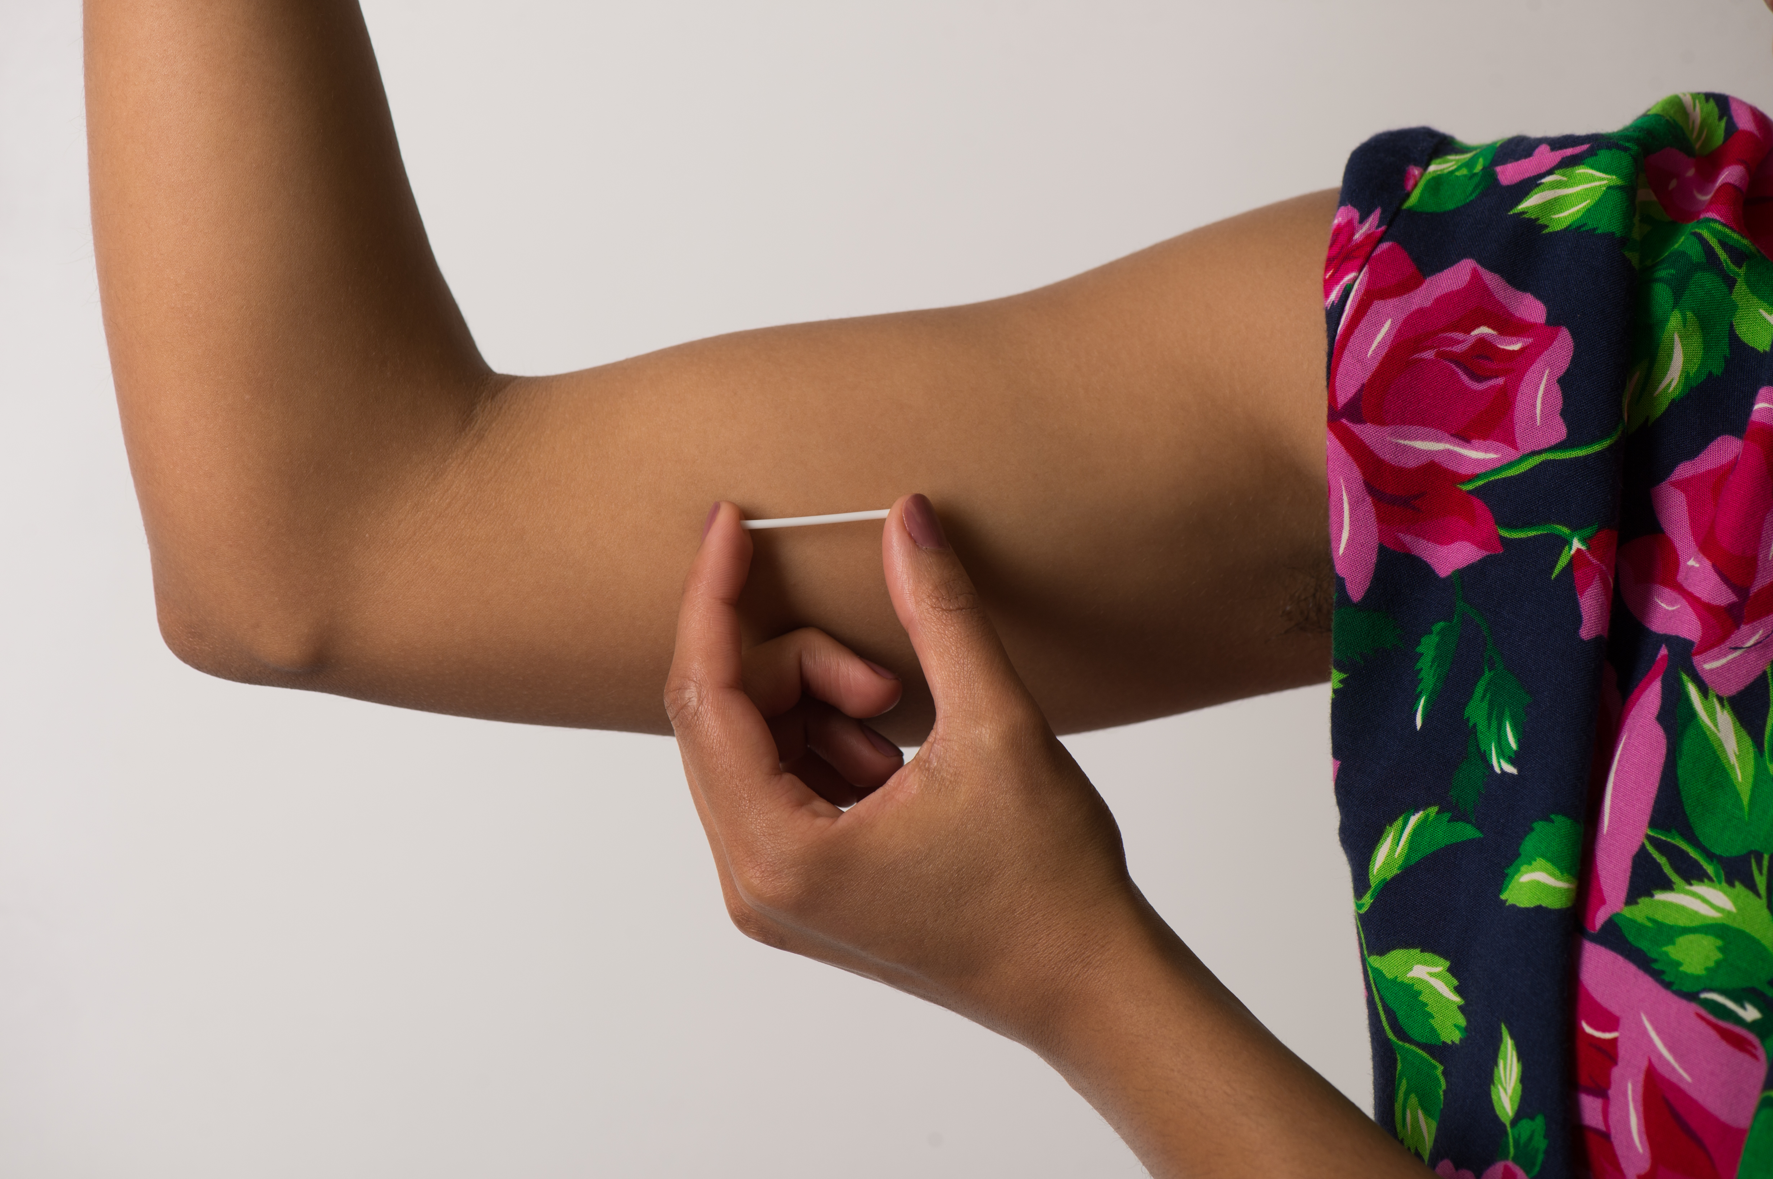
Implant
99% effective
No pelvic exam required for insertion
Lasts 3 years
Irregular spotting
Notes:
The implant (trade name Nexplanon) is a thin, flexible rod about the size of a matchstick that is placed in the inner upper arm. Again, it’s more than 99% effective, and is FDA approved for 3 years, but evidence shows it may be effective for up to 4 to 5 years. The benefit of this method is its ease of insertion, no pelvic exam needed. With this method, changes in bleeding pattern are common and can be unpredictable, from amenorrhea to prolonged bleeding.
For any of these provider-controlled methods, I am sure to emphasize that they can be removed, no questions asked, at any time.

Slide 9
Notes:
I’m now moving on to contraceptives in the second tier of effectiveness. With typical use, these are 91-94 percent effective in preventing pregnancy.

Slide 10
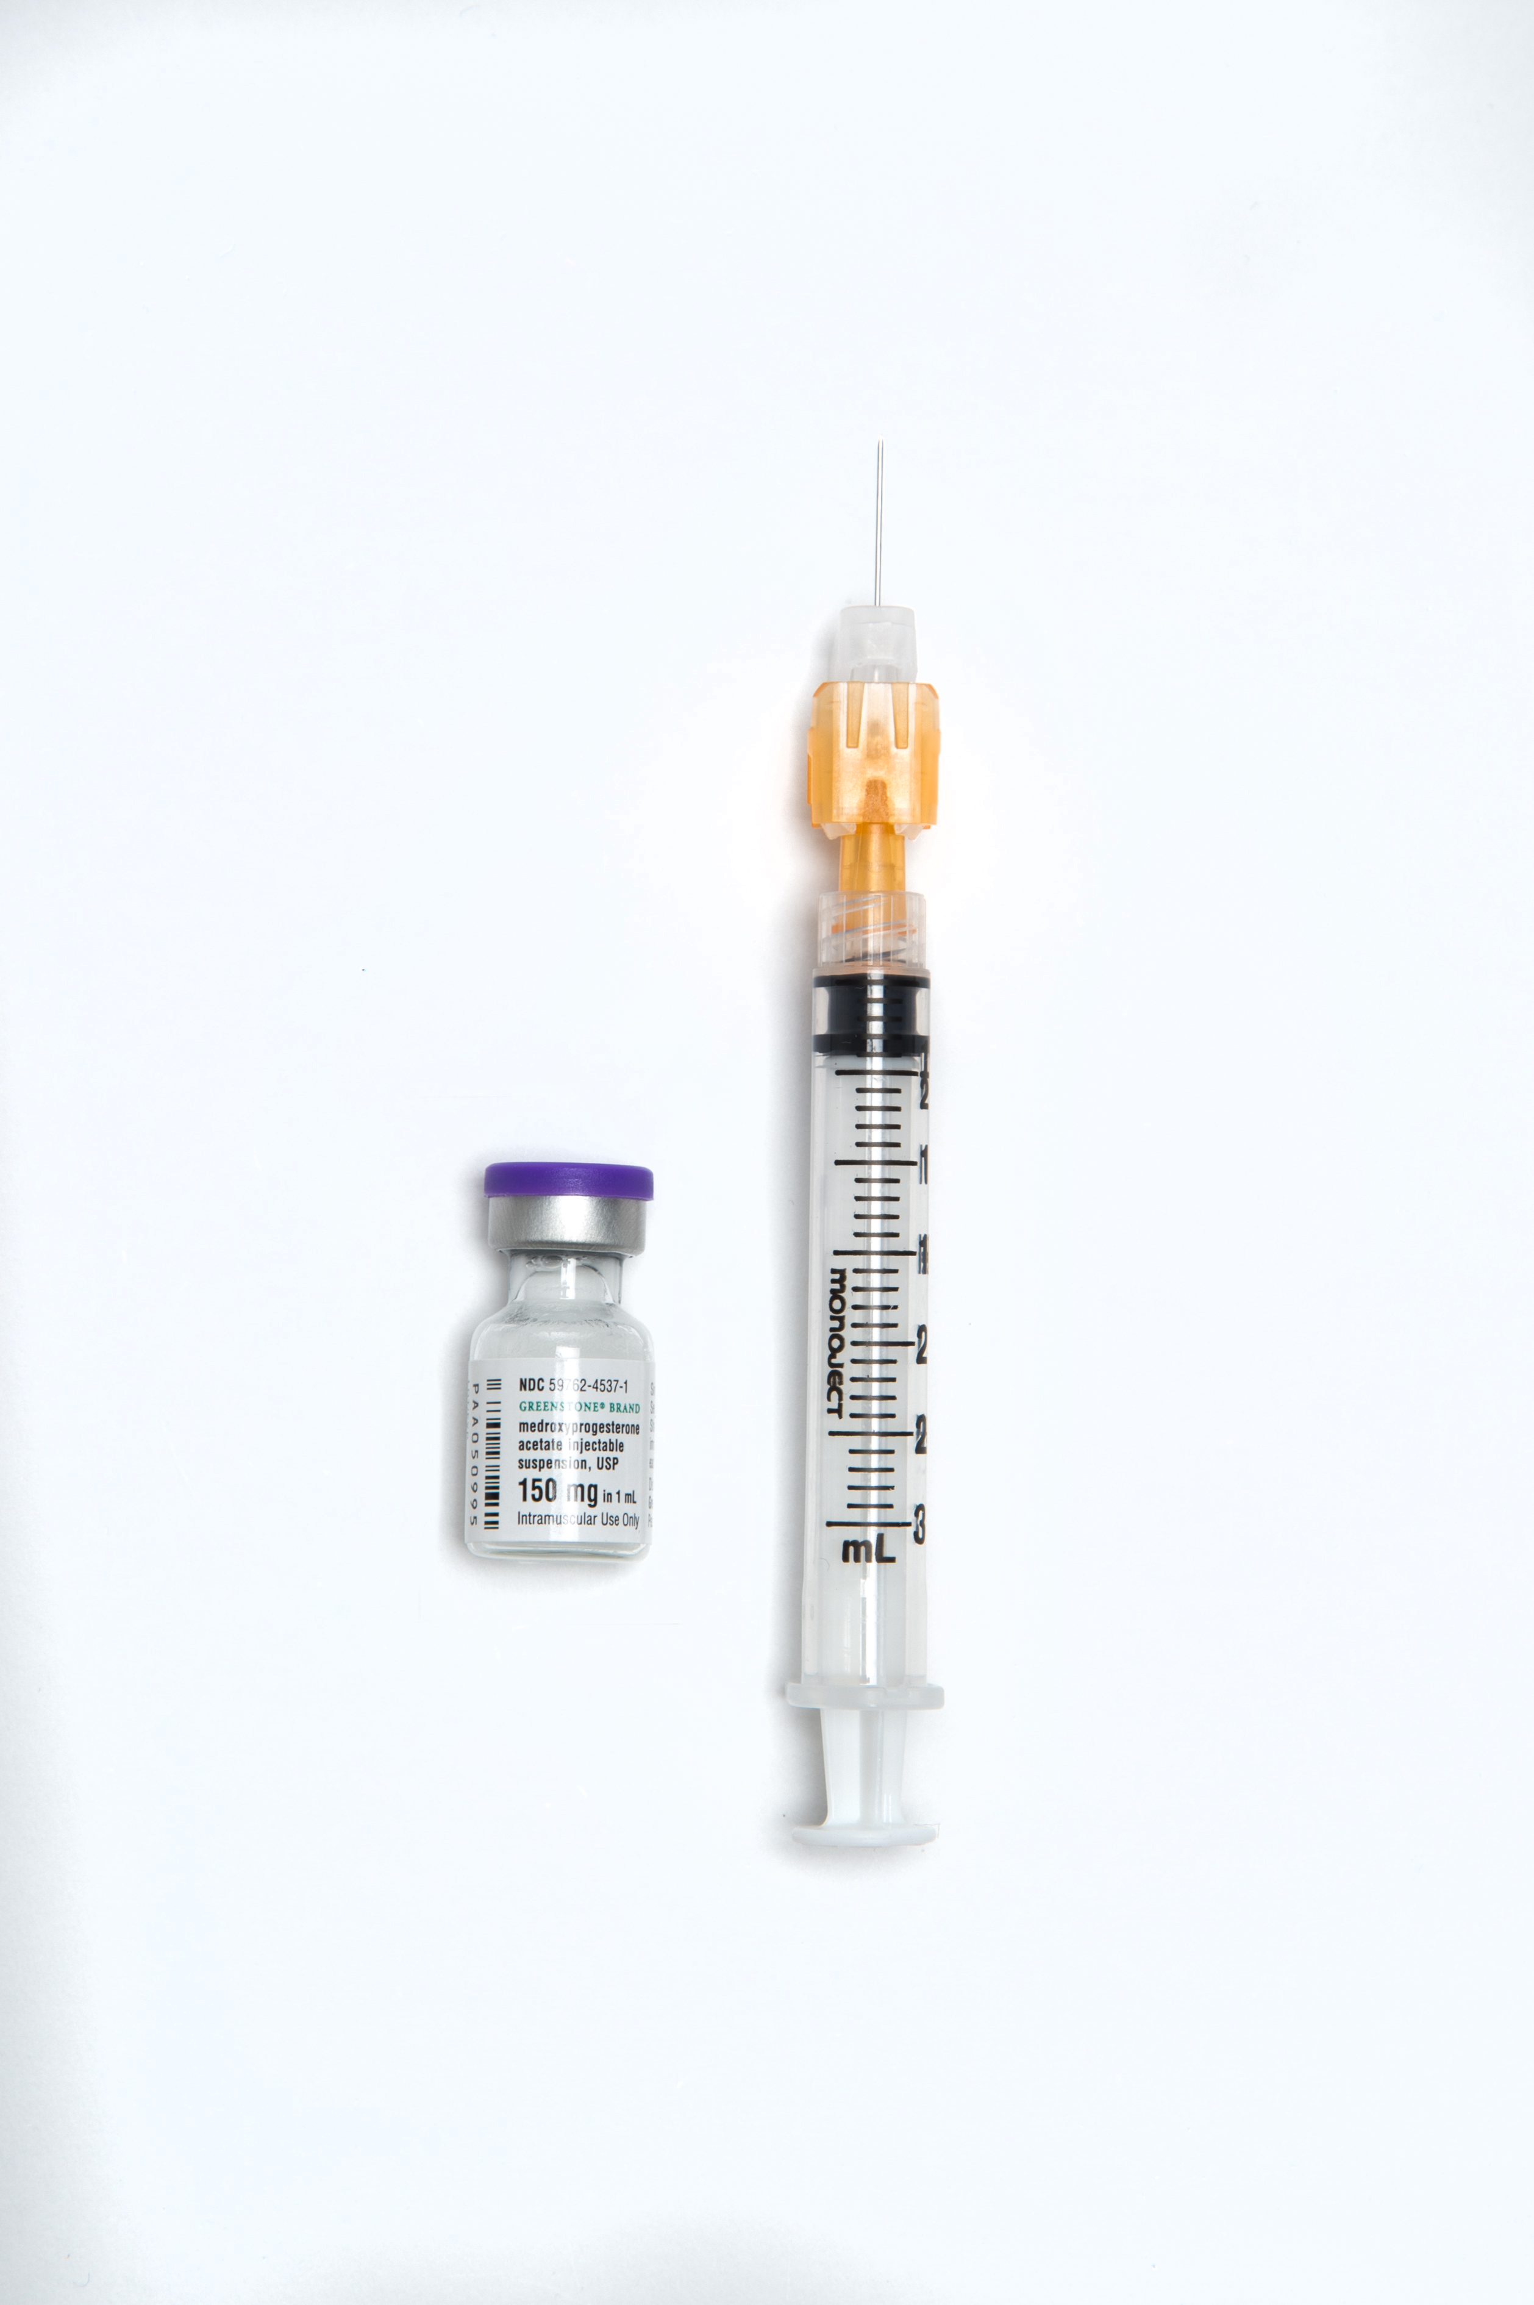
Injectable
Medroxyprogesterone acetate (DMPA)
  Depo-Provera
Given every 3 months
Discrete, effective, safe
Required office visit
Side effects: menstrual irregularities, weight gain, decreased bone density, delay in return to fertility
Notes:
Medroxyprogesterone (DMPA) also known as by the brand name Depo-Provera is an injectable contraceptive given in the clinic every 3 months. This method is discrete, safe, and effective. However, side effects include menstrual irregularities, weight gain and bone mineral density loss. It is important to note that bone mineral density quickly recovers after discontinuing DMPA. There is also a delay in return to fertility – about 50% of women who discontinue DMPA will get pregnant within 10 months of discontinuation, however this delay in fertility return can last up to 18 months in a small number of patients.

Slide 11
Combined Hormonal Contraceptives
Benefits: menstrual regulation, treat acne, treat PMS, reduce ovarian cysts
Increase risk of thromboembolism
  Use with caution in individuals with risk factors
  Not to be used immediately postpartum
Notes:
Next are the combined hormonal contraceptives. These contain both estrogen and progestin. They have many benefits including: regulating the menses and reducing cramping and bleeding, treatment of acne, treatment of premenstrual disorder, and reducing the risk of some gynecologic cancers like endometrial and ovarian cancer. However, the main concern with estrogen containing methods is an increased risk of thromboembolism and so they should not be used in patients who have cardiovascular or stroke risks such as hypertension, migraine with aura, or in patients over 35 who are heavy smokers.

Slide 12
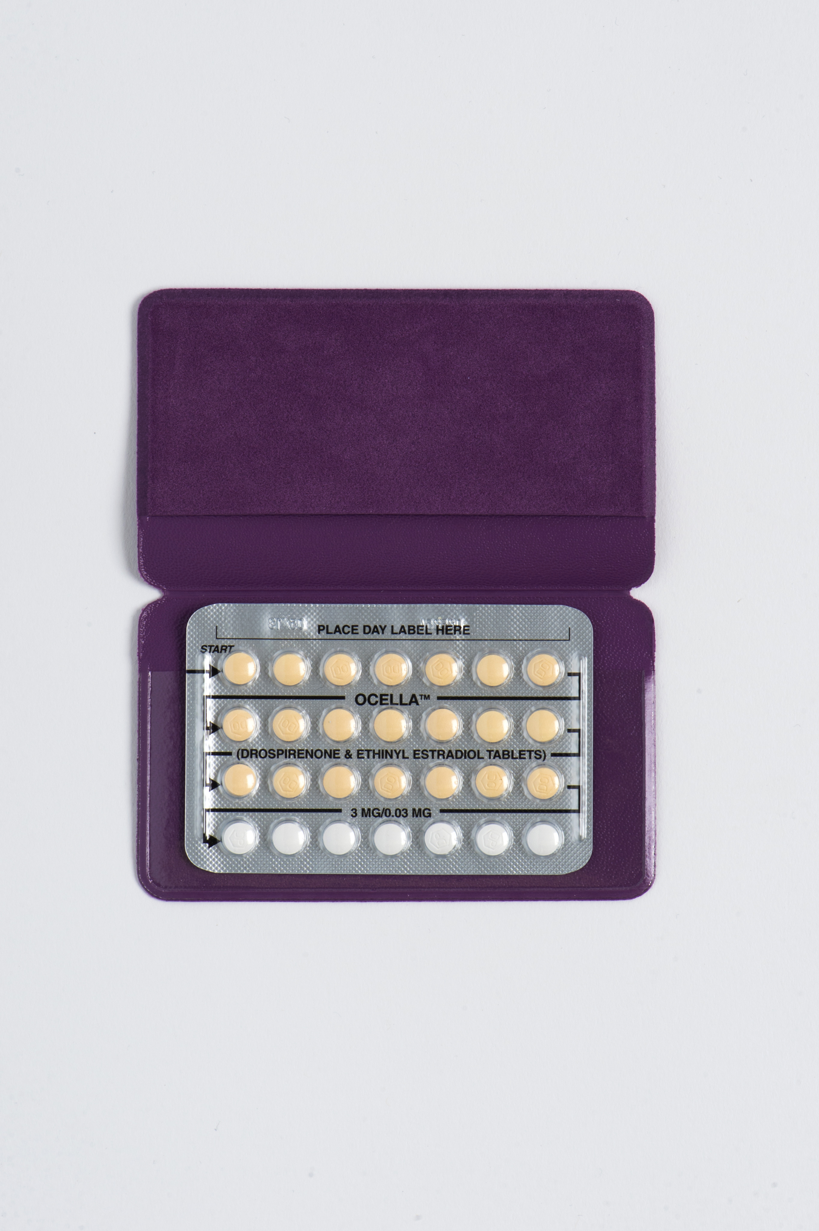
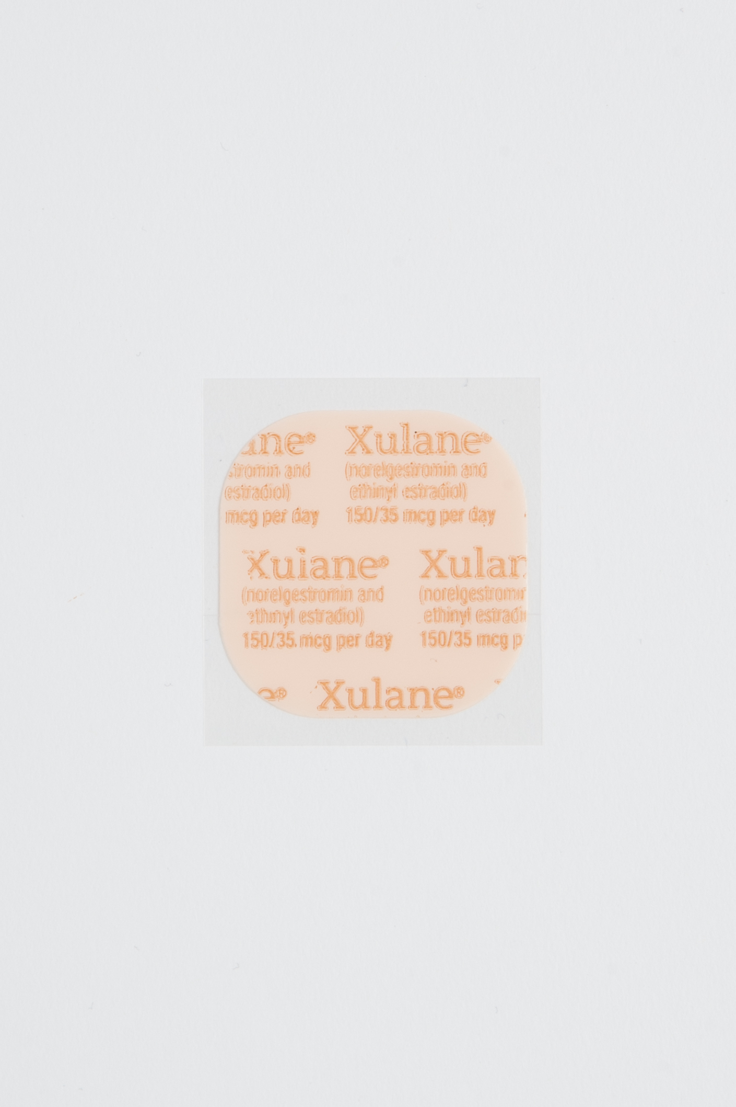
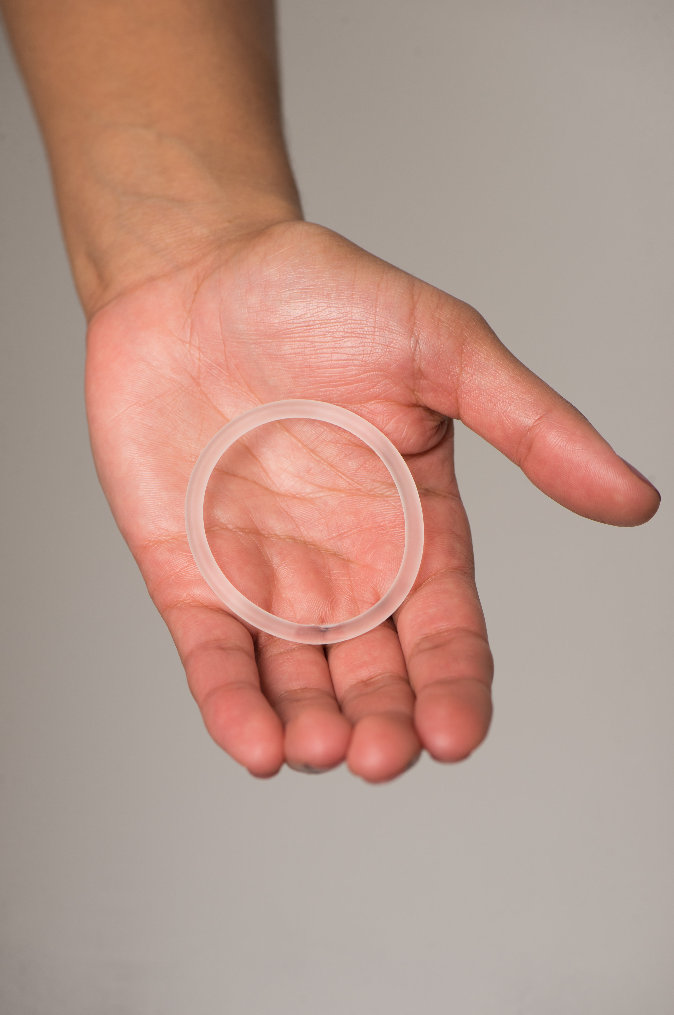
The Pill, The Patch, and The Ring
The pill is taken daily
The patch is changed weekly
  3 weeks on, 1 week off
The ring is left in place for 3 weeks, taken out for 1 week and then replaced
Notes:
The Pill commonly refers to the combined hormonal oral contraceptives. There are a variety of formulations and doses. The pill must be taken every day.
The Patch is applied to the skin, changed every week for 3 weeks and is followed by a patch free week.
The Ring is a flexible silicone ring that is inserted vaginally for 3 weeks at a time and is removed for 1 week before a new ring is inserted. The pill, patch, and ring can also be used in extended cycles.

Slide 13
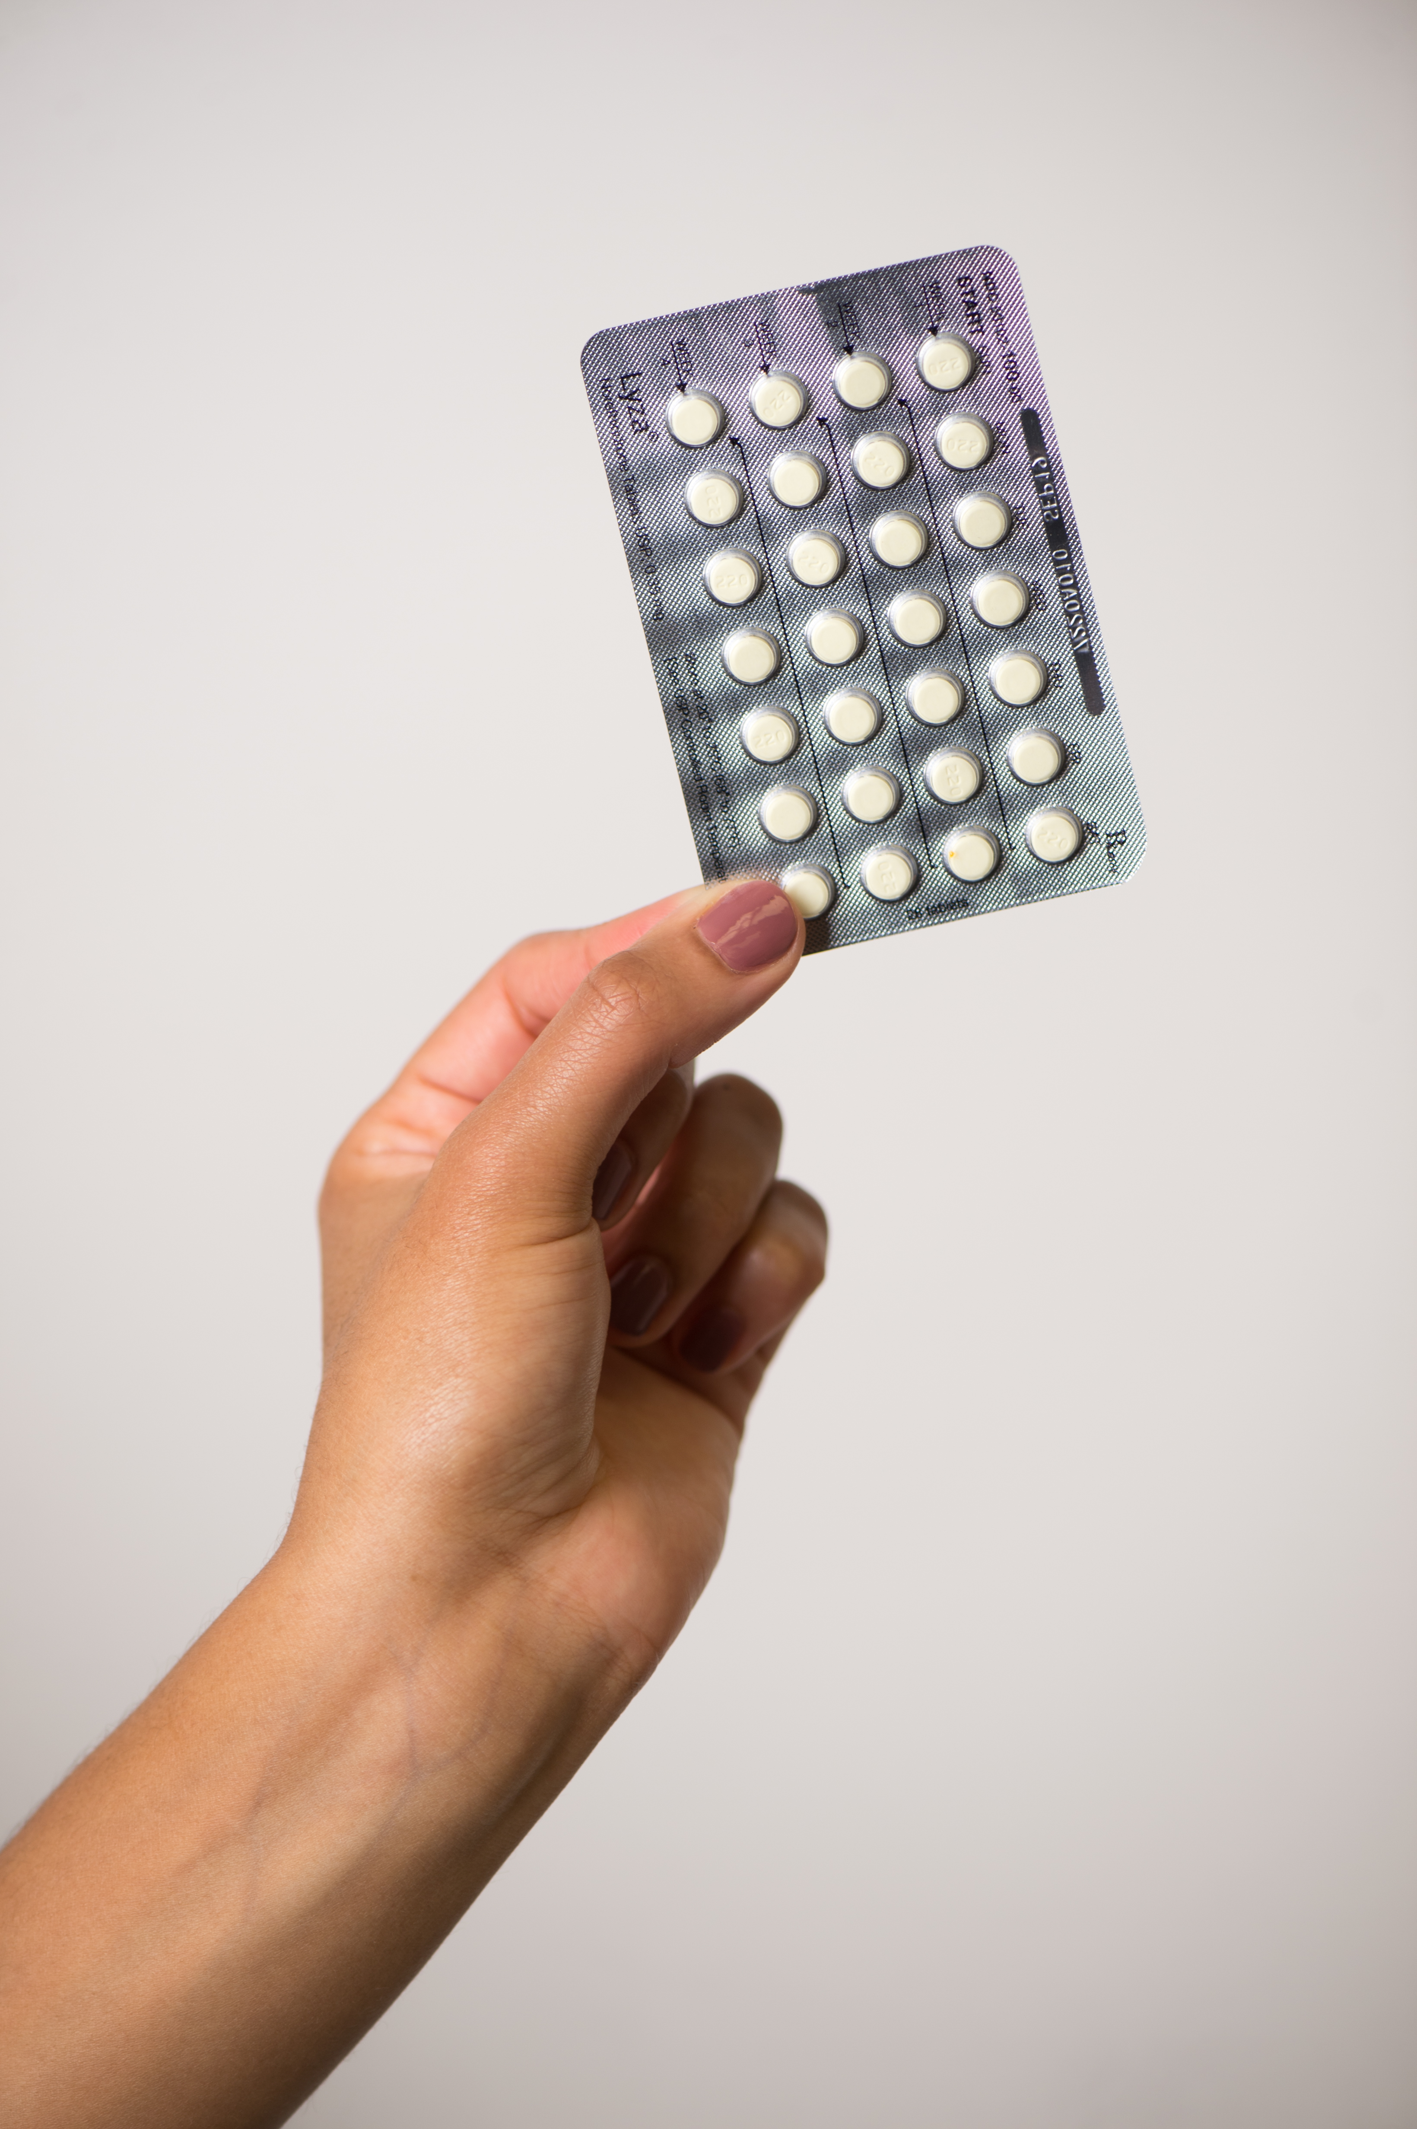
Progestin Only Pills
Also known as the mini-pill
Safe for those with contraindications to estrogen
Less effective than combined oral contraceptives
Must take at the same time every day
Notes:
There is also a progestin only oral contraceptive often referred to as the “mini-pill”. This is an alternative for patients who want oral contraception but have contraindications to estrogen. These pills are slightly less effective than the combined oral contraceptives and must be taken at the same time every day.

Slide 14
Notes:
Now I’m going to be reviewing the third tier of the table. These methods are used with every act of intercourse. Efficacy ranges from 76-88% at preventing pregnancy in 1 year. They work very well for some people.

Slide 15
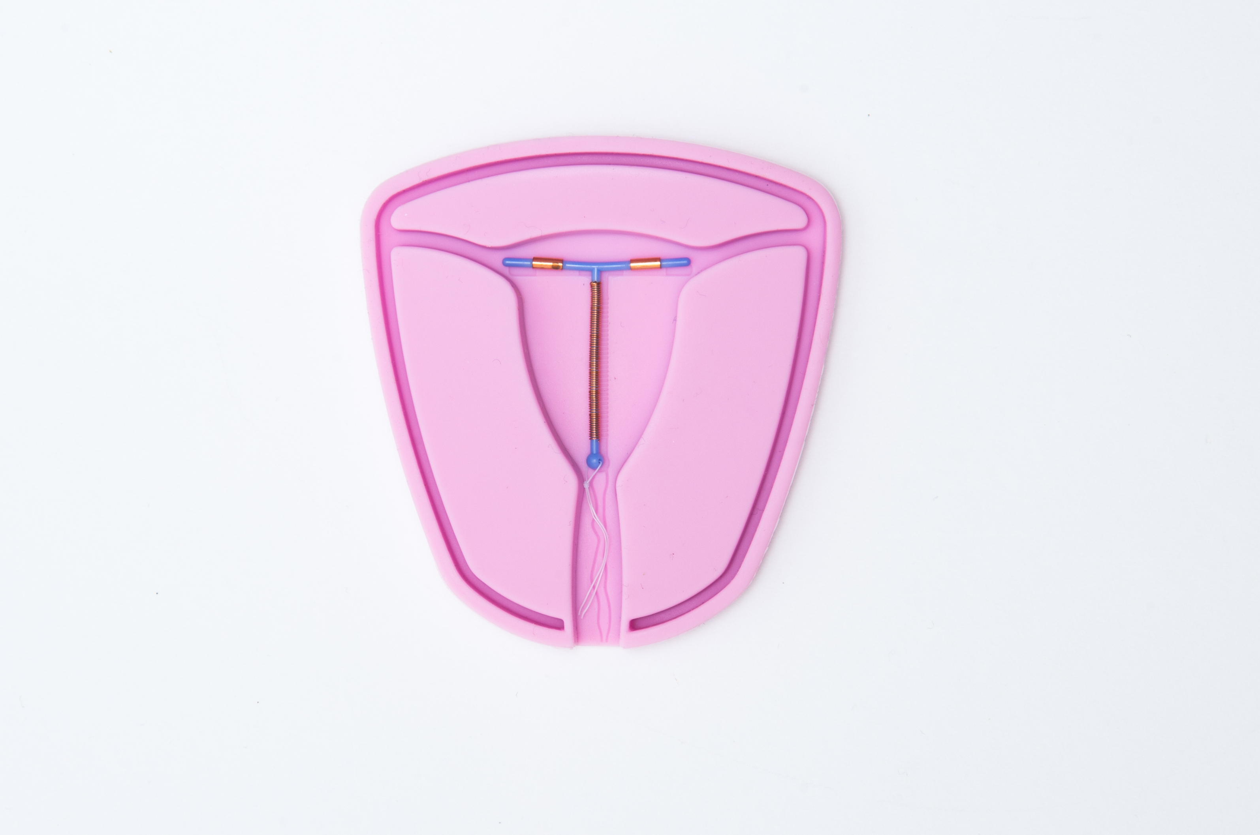
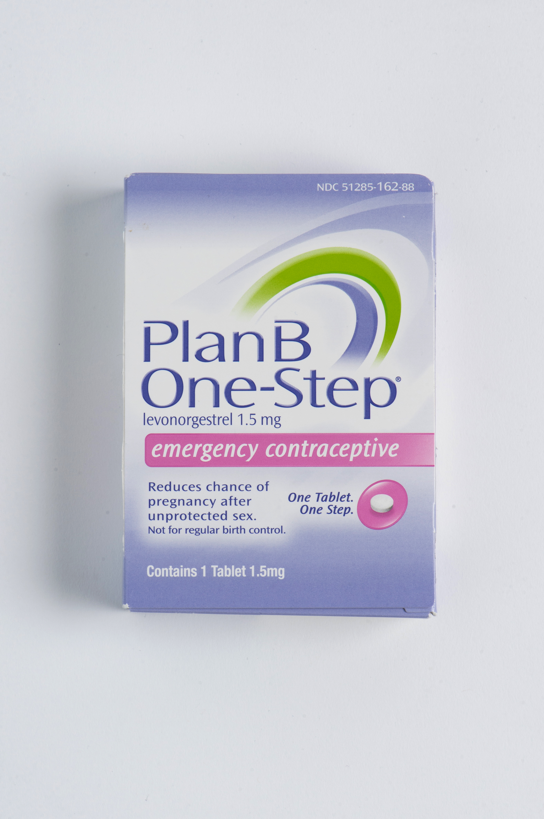
Emergency Contraception
Copper IUD
  99% effective
  Inserted within 5 days of unprotected intercourse
  Long lasting contraceptive
Oral
  Ulipristal acetate
  Levonorgestrel
  One time dose used within 5 days of unprotected intercourse
  Safe
  Will not harm a pregnancy nor induce abortion
Notes:
Emergency Contraception (EC) is contraception that is taken after intercourse has taken place when no method was used, or there was a failure of the chosen method. The copper IUD can be placed up to 5 days after intercourse and is over 99% effective in preventing pregnancy. There are also 2 types of oral EC, ulipristal acetate (Ella) and levonorgestrel (Plan B). Both can be used for up to 5 days after intercourse but taking them sooner improves chances of preventing ovulation. These pills do not harm a pregnancy and do not induce abortion. Ulipristal acetate (Ella) has the benefit of working better in individuals with higher BMIs compared to levonorgestrel which has been shown to not work better than placebo in patients weighing over 156 pounds. The downside of ulipristal acetate is that if a patient desires to use hormonal contraception going forward they would need to delay starting that method until 5 days after taking ulipristal acetate to avoid decreasing its efficacy.

Slide 16
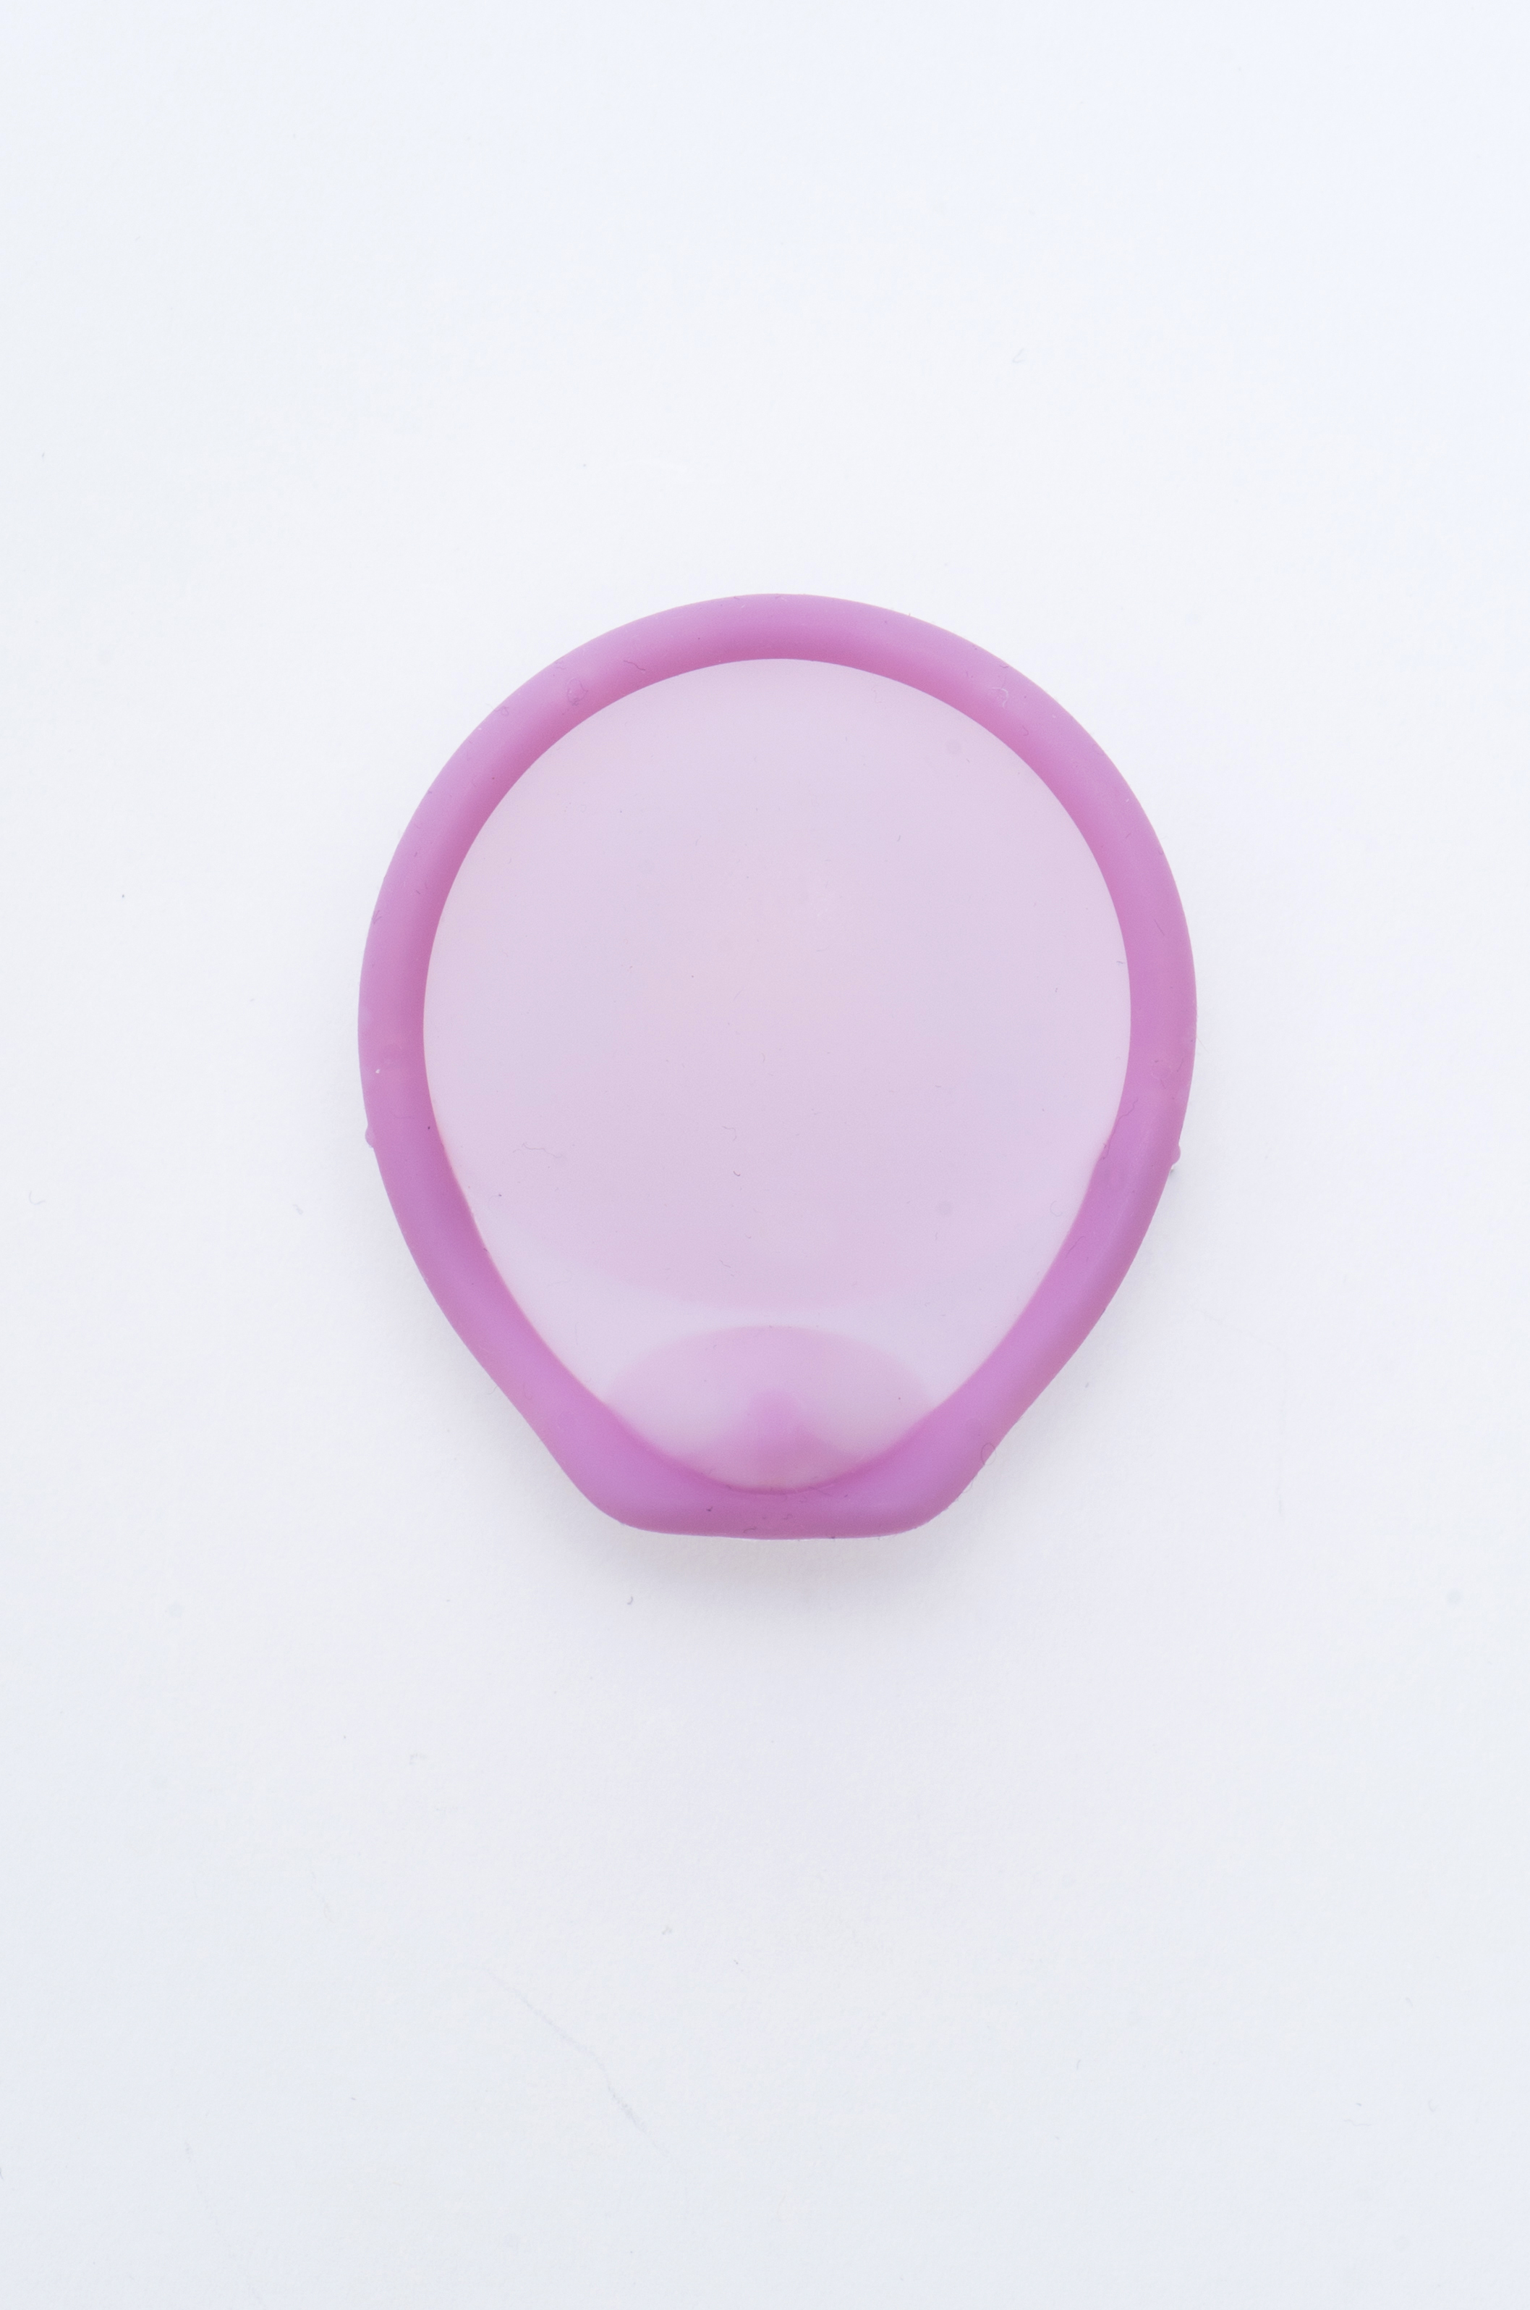

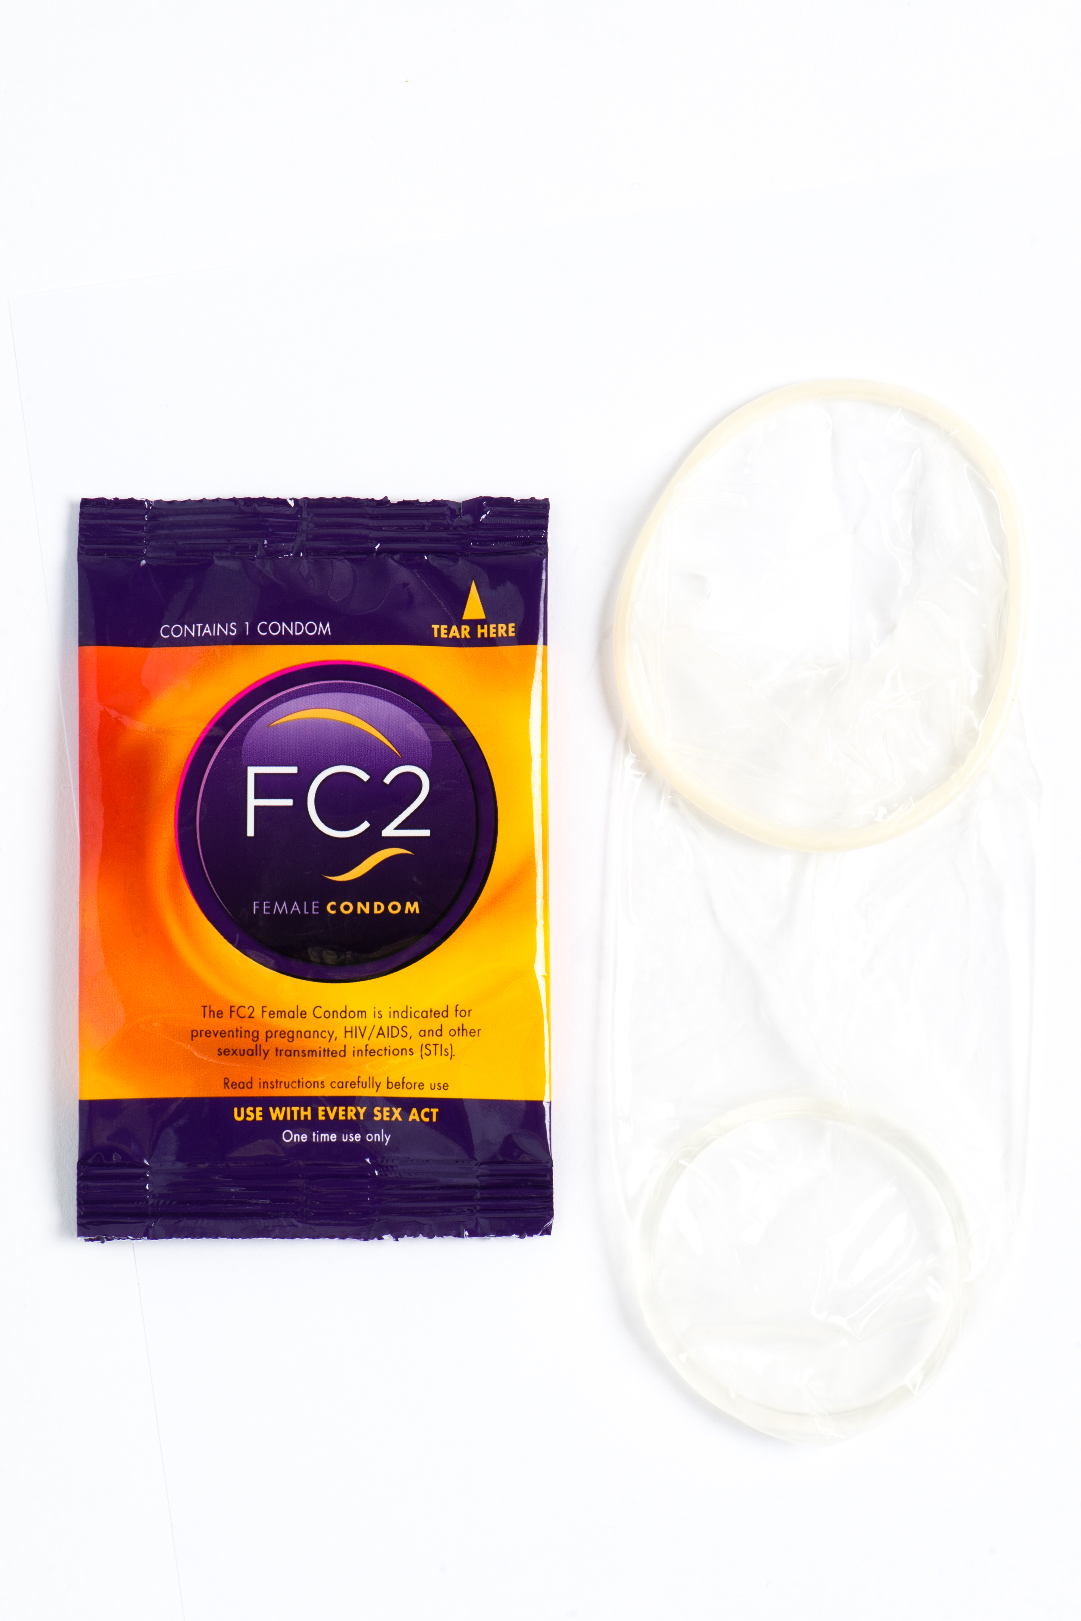
Barrier Methods
Male or Female Condoms
Spermicides
Diaphragm
Sponge
Cervical Cap
Notes:
There are a variety of barrier methods available, with male and female condoms being the only methods that also provide protection against sexually transmitted infections. Diaphragms, sponges and cervical caps are used in combination with spermicides and fit over the cervix.

Slide 17
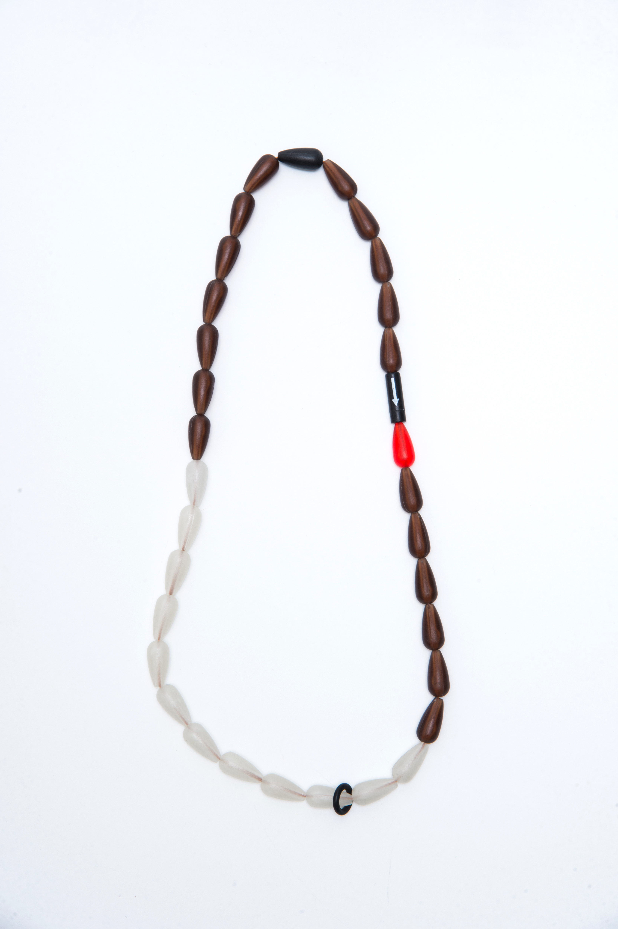

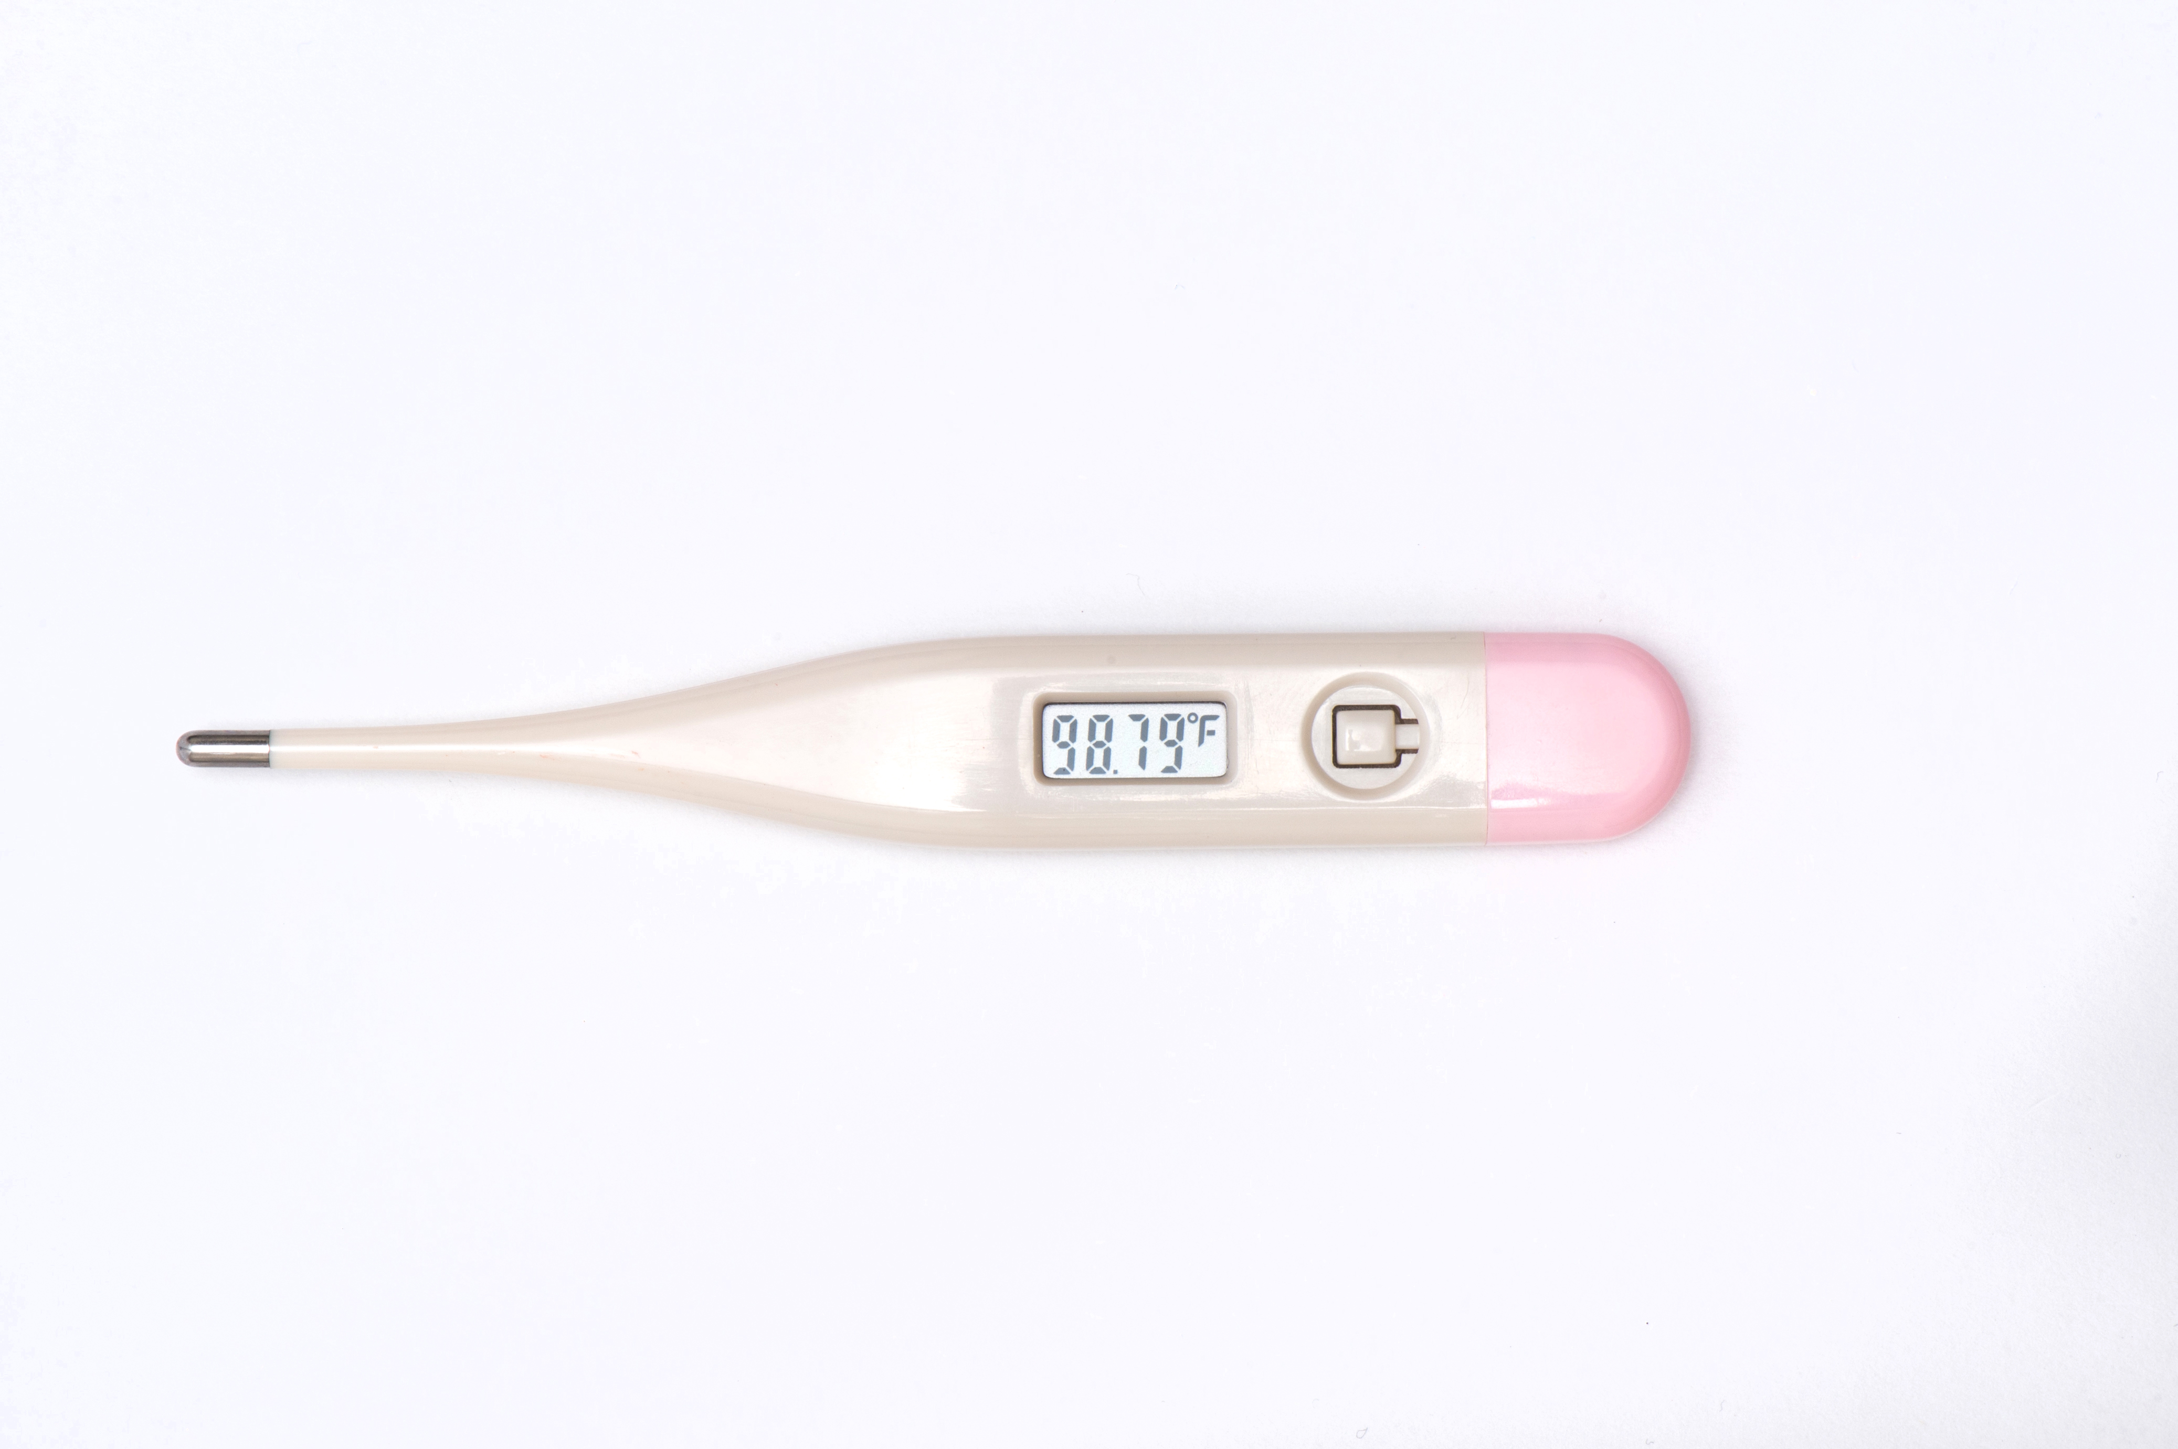
Fertility Awareness
Withdrawal
Fertility Awareness
Lactational Amenorrhea
Abstinence
Notes:
Lastly, there are fertility awareness methods. The withdrawal method is the most commonly practiced, when a partner ejaculates outside of the body. Other methods involve tracking fertile periods and abstaining or using barrier methods during fertile times. These can be very effective when done correctly, and there are a variety of mobile apps now that help track fertile times.
We’ve now reviewed the wide array of contraceptive options available. I hope that with this knowledge you can help empower your patients to make the best choice to achieve their reproductive life goals.
For more information, visit this website:

